Slide 1
Introduction
Many children are looking forward to the last day of school so that they can enjoy their summer vacation.
Lord willing, there will be a day to graduate, get a career job, get married, have children, enjoy holidays, birthdays, & anniversaries, grandchildren, retirement.
But there will be the last day of your life just as you have seen when your loved ones passed away.
Jesus spoke about “the last day” of this universe in which the world will end.

Slide 2
Introduction
False prophets will make lots of money writing books and making movies about the end times (rapture, Armageddon, tribulation, 1,000 year reign, etc.)
Many have tried to predict the day the Lord returns but all have failed and yet some will allow themselves to be deceived because they don’t know the Scriptures.
Don’t let it be you! In this lesson, we will discuss what the Bible teaches will happen on “The Last Day”.
Examine everything carefully by God’s word and hold fast to which is good and abstain from evil (1 Th. 5:21-22).

Slide 3
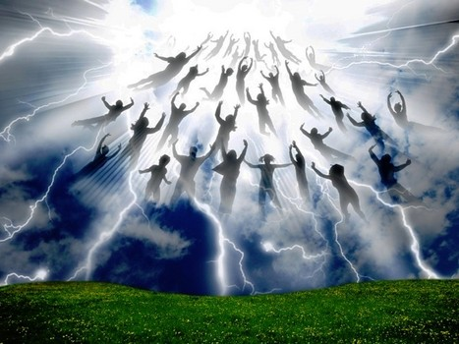
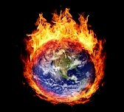
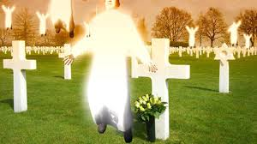
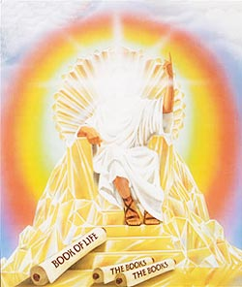
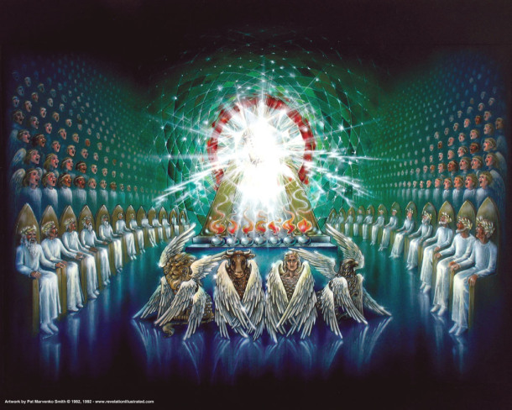
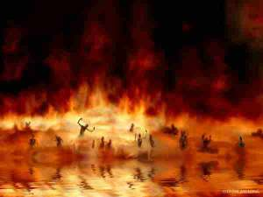
What Will Happen on “The Last Day”?

Slide 4
On the Last Day- Jesus will Return
He will appear in bodily form as He descends from heaven in a cloud (Acts 1:9-11).
Every eye will see Him- it won’t be a secret (Rev. 1:7)
He will descend from heaven with a shout and a trumpet (1 Thess. 4:16)
He will return at an unexpected time (thief in the night). (1 Thess. 5:1-3; 2 Peter 3:10)

Slide 5
On the Last Day- All the Dead Will be Raised
All who are in the tombs will be raised (John 5:28-29a).
Will the righteous be raptured before tribulation and then a 1,000 years later the wicked will be condemned?
No, because all the dead will be raised on the last day (Acts 24:15; Jn. 6:39-40; 1 Th. 4:15-17)
The righteous will be raised with an incorruptible, glorious, powerful, and spiritual body (1 Cor. 15:42-44).
When Christ returns, we shall be like Him (1 Jn. 3:2).

Slide 6
On the Last Day- Those Living will Change
We will be changed because flesh and blood cannot inherit the kingdom of God (1 Cor. 15:50-56).
Before this change happens, we will not have the opportunity to repent because it will happen in the blink of an eye.
When Jesus returns, people will be alive on the earth, there will not be global annihilation because of nuclear holocaust or any other reason.

Slide 7
On the Last Day- Brethren will be Caught up Together to Meet the Lord in the Air
The apostle Paul says that those who were alive would be caught up together with those who died in Christ in the clouds (1 Thess. 4:17).
The Bible teaches that those who are Christians would meet the Lord in the air, not on the earth.
Jesus will not set foot on earth again. He won’t come back to reign for 1,000 years in Jerusalem as He is already reigning as King on David’s throne now (Acts 2:30ff).

Slide 8
On the Last Day- Earth will be Destroyed
Another reason that Jesus is not going to come back and reign in Jerusalem for 1,000 years is because the earth is going to be destroyed (2 Peter 3:10-13).
The heavens (atmosphere) will pass away with a roar.
The elements will melt.
The earth and its works will be consumed with fire.
The earth is not going to be purged or cleansed so that people can live on it again because it will be destroyed.

Slide 9
On the Last Day- All will be Judged
After death comes the judgment (Heb. 9:27).
God has appointed a day in which He will judge the world in righteousness by Jesus Christ (Acts 17:30-31).
This is why all men everywhere are to repent of their sins.
When the Lord returns, He will judge men by their works by the word of God (Rev. 20:11-13; John 12:48).
You will not be able to argue your case before the Lord and change his mind but many will try (Mt. 7:21-22).

Slide 10
Eternity will Begin and Never End
The condemned will be cast into hell into the lake of fire. (Matthew 7:23; 25:46; Rev. 20:14-15)
“Where the worm does not die and the fire is not quenched” (Mark 9:44, 46, 48)
“Cast into outer darkness; there shall be weeping and gnashing of teeth” (Matt. 8:12; 22:13; 25:30).
The saved will be delivered to the Father in heaven where there will be no more death, sorrow, or pain but only praise (1 Cor. 15:24; Rev. 21:1-5; 4:8-11).

Slide 11
What Will Happen on the Last Day?
Jesus will Return
All the Dead will be Raised
Those Living will Change
Brethren will be Caught Up Together to Meet the Lord in the Air
The Earth will be Destroyed
All will be Judged
Eternity will Begin and Never End

Slide 12
When will that last day be? No one knows- only the Father (Mt. 24:36; 1 Th. 5:2; 2 Pet. 3:10)
Jesus tells us all- you need to “watch” & “be ready” because there will be no signs to look for & no last second to repent (Mt. 24:37-44)
The only way that you can be saved from God’s wrath is through obeying the gospel of Christ (2 Thess. 1:7-9).
Judgment Day is coming- Eternity is Forever- Repent and be baptized for the remission of your sins (Acts 2:38) or be restored today (Acts 8:20-22; 2 Cor. 6:2)!

