Slide 1
False Doctrines Refuted in Acts 2
Notes:
Acts 2 is a pivotal chapter in the Bible. Mark 9:1, Acts 1:4-8, Luke 24:46-48
About 3000 souls gladly received the gospel message and were baptized that day. (2:41)
The continued steadfastly in the apostles’ doctrine, 2:42, which is Jesus’ doctrine, John 14:26, 1 Cor. 2:16.
The Spirit revealed that this would not always be so.

Slide 2
1 Timothy 4:1-3
Now the Spirit expressly says that in latter times some will depart from the faith, giving heed to deceiving spirits and doctrines of demons, 2 speaking lies in hypocrisy, having their own conscience seared with a hot iron, 3 forbidding to marry, and commanding to abstain from foods which God created to be received with thanksgiving by those who believe and know the truth.
Notes:
There are many departures from the faith, and one of our jobs as Christians is to fight against them (Jude 3).
We want to look at this pivotal chapter and notice that several false doctrines are refuted there.

Slide 3
Error Refuted in Acts 2
Conversion by direct operation of the Spirit

Slide 4
Irresistible Grace
Irresistible Grace (or efficacious grace) is a doctrine in Christian (sic) theology particularly associated with Calvinism which teaches that the saving grace of God is effectually applied to those whom he has determined to save (the elect), whereby in God's timing, he overcomes their resistance to the call of the gospel and irresistibly brings them to a saving faith in Christ.
  http://www.theopedia.com/irresistible-grace
Notes:
God forces salvation on those individuals He chose before the foundation of the world.

Slide 5
Irresistible Grace
Those who obtain the new birth do so, not because they wanted to obtain it, but because of the sovereign discriminating grace of God. That is, men are overcome by grace, not finally because their consciences were more tender or their faith more tenacious than that of other men. Rather, the willingness and ability to do God's will are evidence of God's own faithfulness to save men from the power and the penalty of sin, and since man is so corrupt that he will not decide and cannot be wooed to follow after God, sovereign efficacious grace is required to convert him.
  http://www.theopedia.com/irresistible-grace
Notes:
God cannot “woo” man to follow Him, but the devil sure could in Genesis 3.

Slide 6
Irresistible Grace
This is done by the regeneration of the Holy Spirit whereby a fallen man who has heard the gospel is made willing and necessarily turns to Christ in God-given faith.
  http://www.theopedia.com/irresistible-grace
Notes:
Why does the fallen man need to hear the gospel? If he’s one of the elect, he can’t help but be saved.

Slide 7
The Spirit Converts Through The Word
Acts 2:4 And they were all filled with the Holy Spirit and began to speak with other tongues, as the Spirit gave them utterance.
Acts 2:14 But Peter, standing up with the eleven, raised his voice and said to them, “Men of Judea and all who dwell in Jerusalem, let this be known to you, and heed my words.

Slide 8
The Spirit Converts Through The Word
Acts 2:37 Now when they heard this, they were cut to the heart, and said to Peter and the rest of the apostles, “Men and brethren, what shall we do?”
Acts 2:40 And with many other words he bore witness and continued to exhort them, saying, “Save yourselves from this crooked generation.”

Slide 9
The Spirit Converts Through The Word
Acts 2:41 Then those who gladly received his word were baptized; and that day about three thousand souls were added to them.
Cf. Acts 10:6, 11:14, 16:9-10

Slide 10
Error Refuted in Acts 2
Conversion by direct operation of the Spirit
Salvation by faith only

Slide 11
Salvation By Faith Only
"Wherefore, that we are justified by faith, only, is a most wholesome doctrine and very full of comfort"
  http://www.umc.org/what-we-believe/the-articles-of-religion-of-the-methodist-church

Slide 12
Salvation Is Not By Faith Only
Acts 2:37 Now when they heard this, they were cut to the heart, and said to Peter and the rest of the apostles, “Men and brethren, what shall we do?”

Slide 13
Salvation Is Not By Faith Only
Acts 2:38 Then Peter said to them, “Repent, and let every one of you be baptized in the name of Jesus Christ for the remission of sins; and you shall receive the gift of the Holy Spirit.
Acts 2:41 Then those who gladly received his word were baptized; and that day about three thousand souls were added to them.
  Cf. James 2:24 You see then that a man is justified by works, and not by faith only.

Slide 14
Error Refuted in Acts 2
Conversion by direct operation of the Spirit
Salvation by faith only
Alien sins are prayed away.

Slide 15
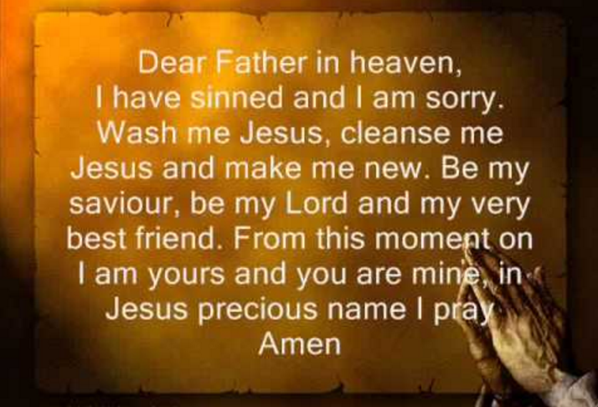
Alien Sins Are Prayed Away.
https://www.youtube.com/watch?v=uN8n0L0KHgk
Notes:
This is one of many variations of The Sinner’s Prayer.
There is no version to be found in the Scriptures – no one was every converted in this way.

Slide 16
Alien Sins Are Not Prayed Away.
Acts 2:21
And it shall come to pass
That whoever calls on the name of the Lord
Shall be saved.’
The Sinner’s Prayer?

Slide 17
Alien Sins Are Prayed Away.
Acts 2:37-38 Now when they heard this, they were cut to the heart, and said to Peter and the rest of the apostles, “Men and brethren, what shall we do?”
38 Then Peter said to them, “Repent, and let every one of you be baptized in the name of Jesus Christ for the remission of sins; and you shall receive the gift of the Holy Spirit.
  cf. Acts 22:16

Slide 18
Error Refuted in Acts 2
Conversion by direct operation of the Spirit
Salvation by faith only
Alien sins are prayed away.
Premillennialism

Slide 19
Premillennialism
Premillennialism teaches that the Second coming will occur before a literal thousand-year reign of Christ from Jerusalem upon the earth. In the early church, premillennialism was called chiliasm, from the Greek term meaning 1,000, a word used six times in Revelation 20:2-7. This view is most often contrasted with Postmillennialism which sees Christ's return after a golden "millennial age" where Christ rules spiritually from his throne in heaven, and Amillennialism which sees the millennium as a figurative reference to the current church age.
  http://www.theopedia.com/premillennialism

Slide 20
Jesus Is Reigning Now.
Acts 2:29-36 “Men and brethren, let me speak freely to you of the patriarch David, that he is both dead and buried, and his tomb is with us to this day. 30 Therefore, being a prophet, and knowing that God had sworn with an oath to him that of the fruit of his body, according to the flesh, He would raise up the Christ to sit on his throne, 31 he, foreseeing this, spoke concerning the resurrection of the Christ, that His soul was not left in Hades, nor did His flesh see corruption.
2 Peter 1:20-21 knowing this first, that no prophecy of Scripture is of any private interpretation, 21 for prophecy never came by the will of man, but holy men of God spoke as they were moved by the Holy Spirit.
Notes:
Speaking of his quotation of Psalm 16:8-11 in Acts 2:25-28 – God would not allow His Holy One to see corruption.
See also 2 Samuel 7:12-16, Psalm 132:10-11

Slide 21
Jesus Is Reigning Now.
32 This Jesus God has raised up, of which we are all witnesses. 33 Therefore being exalted to the right hand of God, and having received from the Father the promise of the Holy Spirit, He poured out this which you now see and hear.
34 “For David did not ascend into the heavens, but he says himself:
‘ The LORD said to my Lord,
“ Sit at My right hand,
35 Till I make Your enemies Your footstool.”’
36 “Therefore let all the house of Israel know assuredly that God has made this Jesus, whom you crucified, both Lord and Christ.”
Notes:
Mark 9:1, Colossians 1:13, Revelation 1:9

Slide 22
Error Refuted in Acts 2
Conversion by direct operation of the Spirit
Salvation by faith only
Alien sins are prayed away.
Premillennialism
Salvation is outside the church

Slide 23
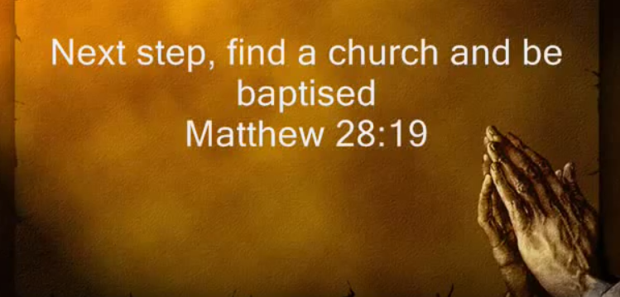
Salvation is outside the church.
https://www.youtube.com/watch?v=uN8n0L0KHgk

Slide 24
Salvation is not outside the church.
Acts 2:40-41 And with many other words he testified and exhorted them, saying, “Be saved from this perverse generation.”⁴¹ Then those who gladly received his word were baptized; and that day about three thousand souls were added to them.
Acts 2:47b …And the Lord added to the church daily those who were being saved.

Slide 25
Salvation is not outside the church.
Ephesians 5:23 For the husband is head of the wife, as also Christ is head of the church; and He is the Savior of the body. Cf. Eph. 1:22f
2 Timothy 2:10 Therefore I endure all things for the sake of the elect, that they also may obtain the salvation which is in Christ Jesus with eternal glory.
Acts 20:28 Therefore take heed to yourselves and to all the flock, among which the Holy Spirit has made you overseers, to shepherd the church of God which He purchased with His own blood.

Slide 26
Be Added To The Church.
Believe – John 8:24
Confess – Romans 10:10
Repent – Luke 13:3
Be Baptized – Mark 16:16

