Slide 1
Hymns for Worship at Woodmont
178- True Worship
350- I Know Whom I Have Believed
635- A Beautiful Prayer
359- Victory in Jesus
297- Prepare to Meet Thy God
498- Where He Leads I’ll Follow
Notes:
Last week we learned about mankind building a tower to “make a name for themselves” in defiance of God’s will. God confused their language so they had to quit and they scattered over the earth as God desired. God made promises to Abram [land, nation, seed] which He fulfilled in time (Gen. 12:1-3). After this, Abram allows Lot to choose to move to Sodom to avoid strife between their herdsmen. Why did God destroy this beautiful place?

Slide 2
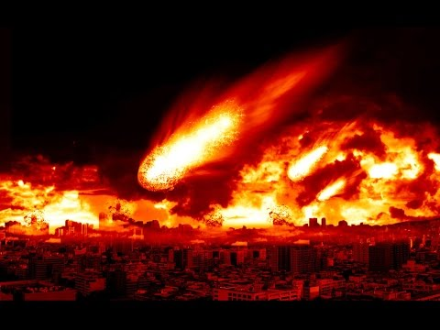
Why Did God Destroy Sodom?

Slide 3
God Destroyed Sodom because of Wickedness
They were exceedingly wicked (Gen. 13:13; 18:20). Abram pleads with God from 50 down to 10 righteous people so that the cities would be spared. He agreed (Gen. 18:32).
The men of Sodom came to Lot’s house and demanded to have sex with the men who were receiving hospitality from Lot. Lot said, “Don’t act wickedly” (Gen. 19:1-7).
(Sodomy is still defined even today as “copulation with the member of the same sex”)
The Sodomites were going to break through the door but were blinded by the angels (Gen. 19:8-11).

Slide 4
God Destroyed Sodom because of Wickedness
They told Lot they were going to destroy this place because of the outcry against it (Gen. 19:12-13).
The Lord rains down fire and brimstone on Sodom and Gomorrah so that all the people died (Gen. 19:17-29).
Lot’s wife turns back and becomes a pillar of salt while Lot and his two daughters make it to Zoar (Gen. 19:26).
Along with homosexuality, they were guilty of being prideful, arrogant, gluttonous, and idle. They also didn’t help the poor and needy (Ezek. 16:49).

Slide 5
The Destruction of Sodom is an Example to Those Who Would Live Ungodly Later
God warned Israel if they forsook His laws, they would be uprooted from His land (Deut. 29:22-28; 31:19-21; 32:32).
The northern kingdom (Israel) went into captivity to Assyria (Isa. 1:9-10; 2 Kings 17:6-23)
The Southern Kingdom (Judah) went into captivity to Babylon (Jer. 23:14; 2 Chron. 36:15-21).
The Babylonians who plundered Jerusalem would be no more. Babylon would become uninhabitable (Isa. 13:19).
Notes:
The Israelites were to be taught a song that would testify against them as a witness and Moses wrote the song the same day. Nation void of counsel, vine was the vine of Sodom, and of the fields of Gomorrah. We need songs of warning as well as encouragement. I need it!

Slide 6
The Destruction of Sodom is an Example to Those Who Would Live Ungodly Later
God desires that those who are ungodly today understand that they will suffer the punishment of eternal fire in hell if they don’t repent (2 Pet. 2:4-6; 3:9, Jude 1:7)!
The devil wants men to reject God’s will and has influenced many in our society to think that homosexuality is OK even among religious people. False teachers won’t warn people! (Rom. 1:20-27; 2 Pet. 2:18-20)
But God will rescue the godly from temptation and to keep the unrighteous under punishment (2 Pet. 2:7-9).
Notes:
In 2001, Americans opposed same sex marriage by 57-35%. In 2016, Americans approve 55-37%. 58% of Catholics, 64% of Protestants approve. (Pew Research).

Slide 7
What Should the Righteous Do?
We can’t allow the fear of persecution (insults, name calling, being unpopular) to intimidate us into silence on this or any other issue (2 Tim. 3:12; 1 Pet. 3:13-16).
We must be holy & keep on exposing the unfruitful deeds of darkness (Eph. 5:1-12). [Christians have succumbed].
Keep speaking the truth in love so that sinners might come to their senses and be saved (Eph. 4:15; 2 Tim. 2:24-26).
Contrary to public opinion, homosexuals can change their behavior just like the Corinthians did (1 Cor. 6:9-11).
Notes:
Sons and daughters of members of the church, even children of gospel preachers have yielded to this sin.

Slide 8
Conclusion
While Sodom and Gomorrah was being destroyed for their sins, God had not forgotten his promise to Abraham of a blessing for everyone through his seed (Gen. 12:3).
Jesus Christ is that seed and through His death you can be forgiven of all your sins and be heirs of heaven according to the promise. If you believe and are baptized you will be saved and belong to Christ (Gal. 3:8, 16, 26-29).
God wants us to remember Sodom and Gomorrah as a symbol for the punishment of eternal life! Will you heed the warning and escape from the wrath to come?
Notes:
Sons and daughters of members of the church, even gospel preachers have yielded to this sin.

Slide 9
Hymns for Worship at Woodmont
178- True Worship
350- I Know Whom I Have Believed
635- A Beautiful Prayer
359- Victory in Jesus
297- Prepare to Meet Thy God
498- Where He Leads I’ll Follow
Notes:
Last week we learned about mankind building a tower to “make a name for themselves” in defiance of God’s will. God confused their language so they had to quit and they scattered over the earth as God desired. God made promises to Abram [land, nation, seed] which He fulfilled in time (Gen. 12:1-3). After this, Abram allows Lot to choose to move to Sodom to avoid strife between their herdsmen. Why did God destroy this beautiful place?

