Slide 1
Hymns for Worship at Woodmont
27 – Joyful, Joyful We Adore Thee
24 – For the Beauty of the Earth
652 – There Is a Green Hill
219 – How Sweet, How Heavenly
263 – Is Thy Heart Right With God?
72S – Hilltops of Glory

Slide 2
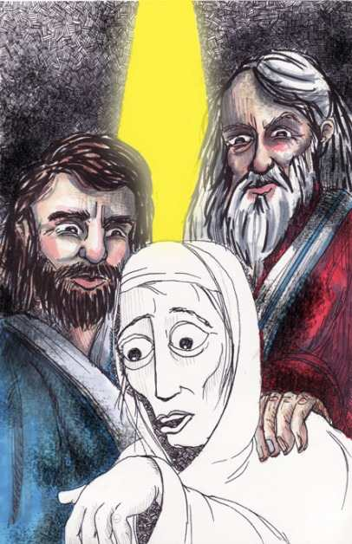
Envy that Led to Leprosy

Slide 3
Numbers 12
While Moses was humble, Miriam & Aaron spoke against him for marrying an Ethiopian woman (v. 1, 3).
Miriam took advantage of this opportunity (with Aaron) to question whether God had only spoken through Moses and not through them as well (v. 2).
God heard it, defended Moses as his faithful servant, rebuked them and punished Miriam with leprosy (v. 2-10)
Aaron confesses sin, Moses prays for Miriam’s healing, and she is received back after 7 days of isolation (v. 11-16).
Notes:
Miriam could have tried to argue her case before God, she was the oldest child, Aaron and Moses younger. She helped save her brother’s life when he was a baby (never would have been the delieverer from Egypt), she was a prophetess who quoted God’s word and led the women out with timbrels and dancing (Ex. 14:20). It is really fair that to say that God had only spoken through Moses? Moses made excuses why he couldn’t be God’s spokesmen, slow speech, not eloquent, send somebody else and said that Aaron would speak for him.

Slide 4
Envy Corrupts & Condemns the Soul
A person argues, “But everyone does it and it isn’t nearly as bad as the seven deadly sins God hates” (Pr. 6:16-19).
He has a diseased heart & is rotten to the core (Pr. 14:30).
Jesus said that it makes a person unclean (Mark 7:22).
Wherever it is present, there is evil & chaos (Jas. 3:14-16).
Those who are guilty won’t go to heaven (Gal. 5:19-21).
Notes:
Synonymns- hatred, malice, resentment, rivalry, backbiting, grudging, lustful, spite, green eyed monster (Shakespear),

Slide 5
Envy- “I wish I was…
…powerful
(those who exalt themselves will be humbled- Matt. 23:12)
…prosperous
(it leads to many sorrows- 1 Tim. 6:3-5, 9-10)
…pretty
(beauty fades, only those who fear God are praised- Pr. 31:10)
…proficient
(use talent to God’s glory- Rom. 12:6-8; Matt. 5:16)
…popular
(broad way- destruction, narrow way- life, Matthew 7:13-14)
Notes:
Imagine speaking out against God that He doesn’t know what He’s doing in this world! God had a plan. Pharisees had power, desired to keep it, Jesus threatened it, they exalted themselves doing good to get praise from men, They silenced & had him crucified. Christ is the head of the church but speak out against His will thinking that His plan isn’t working and we need to change it to get more numbers. Speak out against elders decisions we don’t like it, and leave. Men want to be boss at work, Women not content roles/responsibilities of being submissive, homemakers, being a help meet, want power in the pulpit. Prosperous- athletes, Men want to be rich like athletes, actors, musicians, win lottery. Women- pretty, Men- body builder, Mr. Universe, False teachers motive is riches so they compromise truth for it. Women want to be beautiful like movie stars who are immodestly dressed, wear expensive jewelry. I wish I could preach, lead singing, play instrument, make people laugh, Popular- I want to be in a larger congregation with lots of kids and activities, I grew up in a larger group with lots of kids and almost all of them became worldly.

Slide 6
Examine Yourself by the Scriptures
Do you rejoice with others’ success or good news, or do you ignore or find some reason to cut them down?
Are you content with your present circumstances, or do you wish you were someone else?
Are you tearing other people down, or building them up in the faith?
Are you praying for others who are dealing with “the green-eyed monster” to repent and confess their sins or wish they suffer its consequences?

Slide 7
Replace Envy with Positive Traits
We used to be enslaved, but we have been buried with Christ to be like Him (Rom. 6:3; Tit. 3:3; 1 Pet. 2:1-3)
Be content with what you have (1 Tim. 6:6; Phil. 4:12)
Rejoice with those who rejoice (Rom. 12:15)
Encourage and build others up (Eph. 4:12, 16, 29)
Pray for others like Jesus did (Matt. 27:18; Luke 23:34)
Notes:
Before you think that envy is not a big deal remember that Miriam’s envy led to leprosy & Jesus was delivered up because of envy. It led to them having Jesus killed. Just as Miriam, Aaron heard them speaking against Moses and called them out, we will be called out in the Judgment Day and will be judged by the deeds done in the body. Jesus died for you so that you can be forgiven of every sin. Obey the gospel or confess your sins!

Slide 8
Hymns for Worship at Woodmont
27 – Joyful, Joyful We Adore Thee
24 – For the Beauty of the Earth
652 – There Is a Green Hill
219 – How Sweet, How Heavenly
263 – Is Thy Heart Right With God?
72S – Hilltops of Glory

