Slide 1
Hymns for Worship at Woodmont
363- He Hideth My Soul
405- Wonderful Words of Life
183- ‘Tis Midnight on Olive’s Brow
121- I’ll be a Friend to Jesus
341- The Way of the Cross Leads Home
194- When We All Get to Heaven

Slide 2
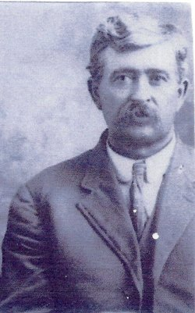
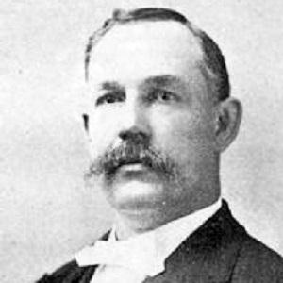
I’ll be a Friend to Jesus
Written by
Johnson Oatman Jr.
1856-1922
The Melody was Arranged by
John Wesley Dennis
1866-1947
Notes:
Parents - members of the church, he was a also & married a Christian rearing six children in a God-fearing home. Learned to read & write music 1884 at singing school & was involved in it most of his life. In 1922, while getting ready for one of his singing schools, he contacted Oatman, who died later that year, and asked him for some poems that his students could set to music. Among the poems that Oatman sent was "I’ll Be A Friend To Jesus." When Dennis saw it, he immediately decided to provide a melody for it himself, and after working on it for two years, first published it in 1924. Sometimes Dennis is listed as the author; it may be that he did some arranging of the text, but it is more likely that this is simply an error.

Slide 3
I’ll be a Friend to Jesus by Johnson Oatman Jr.
They tried my Lord and Master, (John 13:13-14)
With no one to defend; (Mark 14:43-50)
Within the halls of Pilate (John 19:1-5)
He stood without a friend. (Luke 22:63-65)
Jesus was tried, arrested, and condemned to death
like a criminal to be crucified while His disciples
abandoned Him!

Slide 4
I’ll be a Friend to Jesus by Johnson Oatman Jr.
The world may turn against Him, (Jn. 12:19; 19:6)
I’ll love Him to the end, (Jn. 13:1; Mark 12:30-31)
And while on earth I’m living, (2 Pet. 1:3-4)
My Lord shall have a friend. (Mark 8:34-38)
Even though the world is rebelling against Christ,
I will love Him with every fiber of my being & take up
His cross & follow Him to the end.

Slide 5
I’ll be a Friend to Jesus by Johnson Oatman Jr.
I’ll do what He may bid me; (Jn. 14:15; 15:13-15)
I’ll go where He may send; (Mt. 28:18-20; Ax 1:8)
I’ll try each flying moment (John 15:8)
To prove that I’m His friend. (John 15:18-21)
I demonstrate that I’m His friend by responding to
His love with obedience to His commands trying to
save lost souls even if the world hates me!

Slide 6
I’ll be a Friend to Jesus by Johnson Oatman Jr.
To all who need a Savior, (1 Tim. 2:3-4)
My Friend I’ll recommend; (Heb. 2:9)
Because He brought salvation, (Acts 4:12)
Is why I am His friend. (Luke 15:7)
There is no greater friend we can have than Jesus
because He died for you & me. Instead of being
helpless, hopeless, & godless in this world, I can
rejoice and praise Him in heaven forever.

Slide 7
I’ll be a Friend to Jesus by Johnson Oatman Jr.
Refrain:
I’ll be a friend to Jesus,
My life for Him I’ll spend;
I’ll be a friend to Jesus,
Until my years shall end.
Will you be a friend to Jesus by obeying the gospel?
Will you spend your life for Him until your years shall
end? You will never regret it if you do!

Slide 8
Hymns for Worship at Woodmont
363- He Hideth My Soul
405- Wonderful Words of Life
183- ‘Tis Midnight on Olive’s Brow
121- I’ll be a Friend to Jesus
341- The Way of the Cross Leads Home
194- When We All Get to Heaven

