Slide 1
Hymns for Worship at Woodmont
Notes:
Moses & the book of Exodus is an amazing lesson in God’s providence during a time of depression, discouragement, & doubt with the Israelites being enslaved & baby boys being ordered to be killed. But because of the faith of Moses’ parents, he lived & was raised in Pharaoh’s palace. At one time he though he was the one who would deliver Israel at the age of 40, when he killed an Egyptian, he fled to the wilderness for 40 years & God called him from the burning bush. He made excuses over & over again & said I can’t do it & send somebody else, & even blamed God for not delivering them right away. God was very patient with him & used him to perform mighty miracles & plagues on Egyptians demonstrating that He was more powerful than the gods of Egypt but now they’re at the Red Sea trapped after Pharaoah let them go & the Israelites are complaining against Moses. How will he respond? How will you?

Slide 2
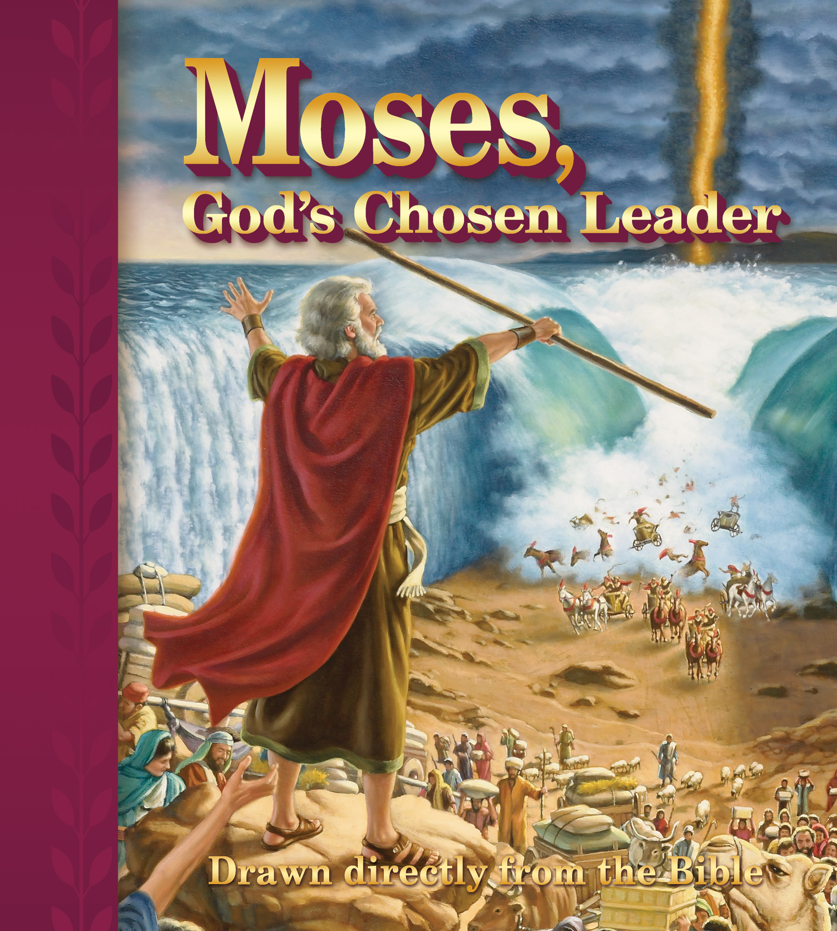
Notes:
Moses & the book of Exodus is an amazing lesson in God’s providence during a time of depression, discouragement, & doubt with the Israelites being enslaved & baby boys being ordered to be killed. But because of the faith of Moses’ parents, he lived & was raised in Pharaoh’s palace. At one time he though he was the one who would deliver Israel at the age of 40, when he killed an Egyptian, he fled to the wilderness for 40 years & God called him from the burning bush. He made excuses over & over again & said I can’t do it & send somebody else, & even blamed God for not delivering them right away. God was very patient with him & used him to perform mighty miracles & plagues on Egyptians demonstrating that He was more powerful than the gods of Egypt but now they’re at the Red Sea trapped after Pharaoah let them go & the Israelites are complaining against Moses. How will he respond? How will you?

Slide 3
Moses Leadership in Crisis (Exodus 14:13-31)

Slide 4
Moses Leadership in Crisis (Exodus 14:13-31)
Confident in God, not himself any more and didn’t fear the enemy (Exodus 14:13)

Slide 5
Moses Leadership in Crisis (Exodus 14:13-31) | In Christ, You can Overcome any Crisis (Philippians 4:13)
Confident in God, not himself any more and didn’t fear the enemy (Exodus 14:13)
Notes:
Crisis of Covid-19, crisis of health- hospitalized, cancer, terminal illness, death of close friend or family member, caring for elderly, sudden death like 16 month old of a Christian, financial crisis because you lost your child, persecution, division in the church, trust in God, not yourself or your feelings in the crisis. Your child decides that they are homosexual or is going to change sexes, or divorce their spouse.

Slide 6
Moses Leadership in Crisis (Exodus 14:13-31) | In Christ, You can Overcome any Crisis (Philippians 4:13)
Confident in God, not himself any more and didn’t fear the enemy (Exodus 14:13) | You can be confident in God’s promises instead of being afraid (Proverbs 3:5-8; Acts 4:13; 1 John 2:3-6; 5:13; Matthew 10:28; 2 Timothy 1:12; 4:6-8)

Slide 7
Moses Leadership in Crisis (Exodus 14:13-31) | In Christ, You can Overcome any Crisis (Philippians 4:13)
Calmly trusted in God’s power & did not panic like the Israelites (Exodus 14:14)

Slide 8
Moses Leadership in Crisis (Exodus 14:13-31) | In Christ, You can Overcome any Crisis (Philippians 4:13)
Calmly trusted in God’s power & did not panic like the Israelites (Exodus 14:14) | You can be calm in chaos instead of being worried (Mark 4:35-39; Matthew 6:25-34; Philippians 4:6-9; James 1:2-4, 12; Acts 27:25)

Slide 9
Moses Leadership in Crisis (Exodus 14:13-31) | In Christ, You can Overcome any Crisis (Philippians 4:13)
Courageous & obedient when it seemed hopeless (Exodus 14:15ff)

Slide 10
Moses Leadership in Crisis (Exodus 14:13-31) | In Christ, You can Overcome any Crisis (Philippians 4:13)
Courageous & obedient when it seemed hopeless (Exodus 14:15ff) | You can conquer any foe with your faith (Joshua 1:6-9, 18; 1 John 4:4; 5:3-4; 2 Corinthians 10:3-6; Romans 8:31-39; Hebrews 13:5-6)
Notes:
Either character will be produced in a time of crisis where someone will stand up & have to oppose Diotrephes, smooth talking false teacher, the factious person, atheist, & cast down their false arguments with the word of God & you might be in a place where you can do that. The Lord will help you conquer any foe that you face but you must be prepared for the spiritual battle and grab the sword of the Spirit to convict the sinner so that they might repent of their sins & be baptized to be forgiven!

