Slide 1
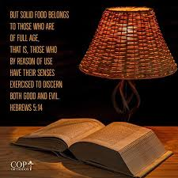
Are Your Senses Exercised so that You Discern Good from Evil?

Slide 2
To Discern Good from Evil with Your Senses…
…you must fill your mind & study God’s word
(Isa. 55:8-9; Col. 1:9; Phil. 4:8; 2 Tim. 2:15; 3:14-17)
…you must habitually practice what you are learning
(Phil. 4:9; Col. 1:10; 2 Pet. 1:5-11; Jas. 1:22-25)
…keep a good conscience- examine self by the Bible,
repent of sin, & suffer for doing what’s right
(1 Thess. 5:21-22; 1 Tim. 1:5, 19; 4:16; Rom. 2:17-24;
2 Cor. 13:5; 1 John 1:8-10; Prov. 28:13; 1 Pet. 3:13-18)

