Slide 1
Hymns for Worship at Woodmont
1 Holy Holy Holy
Notes:
Though the eye of sinful man Thy glory may not see that nakedness is shameful. Holy, Holy, Holy is the Lord God Almighty and we are supposed to be holy as He is holy and we do that by learning from His word & being obedient to Him.. They are clothed, righteous acts of the saints (Rev. 19:14). Rev. 12:17 Dragon goes over those that are keeping the commandments of God & hold to the testimony of Jesus. Some from the church at Sardis needed to repent or the Lord would come upon them as a thief, so they might be clothed in white raiment (Rev. 3:4-5). Those who have been baptized into Christ have clothed themselves with Christ (Gal. 3:27). So we are keeping our garments on while are striving to be pure by watching & obeying the Lord.

Slide 2
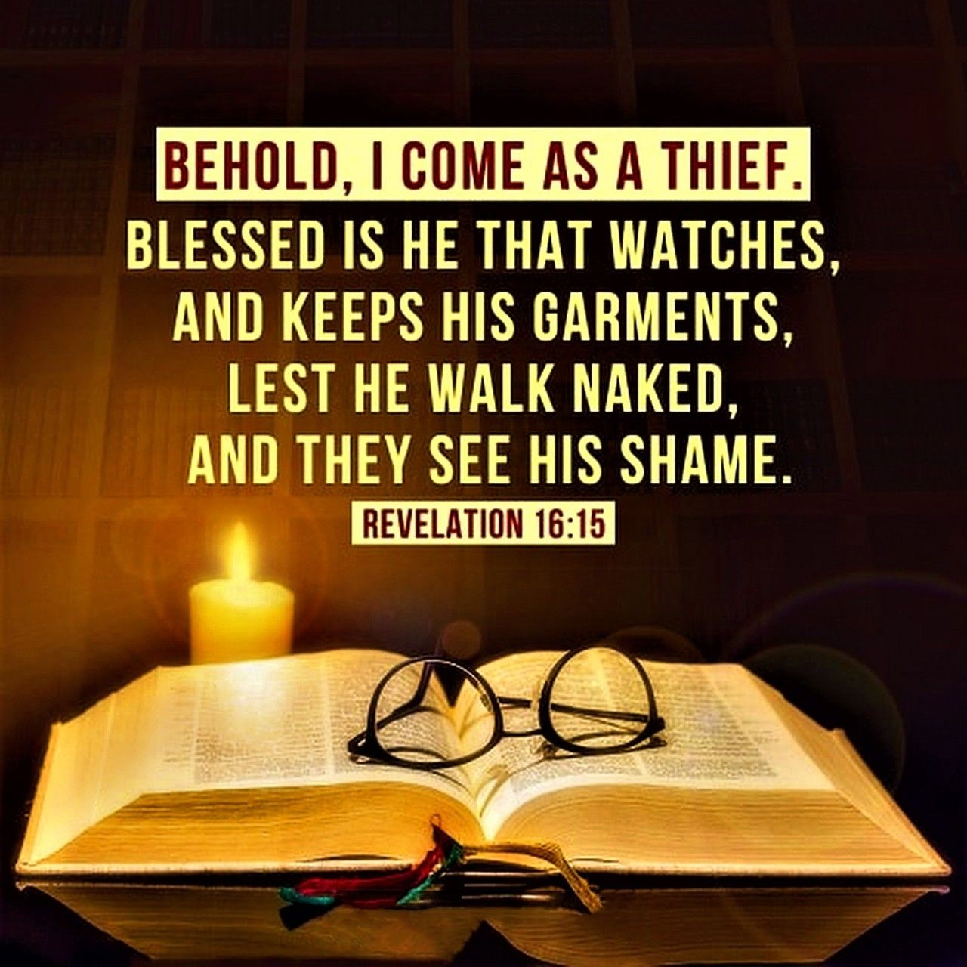
Notes:
Though the eye of sinful man Thy glory may not see that nakedness is shameful. Holy, Holy, Holy is the Lord God Almighty and we are supposed to be holy as He is holy and we do that by learning from His word & being obedient to Him.. They are clothed, righteous acts of the saints (Rev. 19:14). Rev. 12:17 Dragon goes over those that are keeping the commandments of God & hold to the testimony of Jesus. Some from the church at Sardis needed to repent or the Lord would come upon them as a thief, so they might be clothed in white raiment (Rev. 3:4-5). Those who have been baptized into Christ have clothed themselves with Christ (Gal. 3:27). So we are keeping our garments on while are striving to be pure by watching & obeying the Lord.

Slide 3
Our Bodies are to be a Living Sacrifice to God
Public nakedness is unlawful in Texas. The standard of what is
pleasing to God is from the Bible & is more restrictive than
what man says about it (Isa. 55:8-9; 2 Tim. 2:15; 3:16-17).
We should be transformed by God’s good, acceptable, and
perfect will instead of being like the world in dress (Ro. 12:2)
God speaks clearly about what nakedness is in the Bible & it is
the same standard for all people everywhere (Acts 17:30-31)
& doesn’t change with the times to suit mankind’s desires.
Notes:
An individual charged with an indecent exposure offense faces a Class B misdemeanor, which is punishable by up to 180 days in jail and/or a fine not more than $2,000. I’m thankful for some here who have taught me Scriptures about modesty that have helped me and especially one who rebuked me when I had been dressing w/o clothing much of my early life living in Florida.

Slide 4
God Wants Nakedness to be Covered (Tunic)
Adam & Eve- naked & unashamed before sin (Gen. 2:25)
But after they sinned, they knew they were naked, & tried
to cover up with fig leaves & loin coverings (Gen. 3:7)
Was God satisfied with their choice to cover being naked?
No. “God made tunics of skin for Adam and his wife and
clothed them” (Genesis 3:21).
They were considered naked even though partially clothed.
Notes:
Professor Amy Werbel author Lust on Trial, a historical book American obscenity. “She says America's opposition to female nudity is rooted in "evangelical Christian opposition to the display of the body that goes back to the arrival of the Puritans in New England". "They brought with them a very particular reading of the OT story of Adam & Eve. And when Adam and Eve come into the world of knowledge, the first thing they realise about themselves is their nakedness, and they fashion aprons to cover themselves.
"It's a pivotal moment in which you recognise the shame of nudity. And that has lingered."

Slide 5
God Wants Nakedness to be Covered (Tunic)
“Here the ‘coat’ (Hebrew ketho?neth) was the ordinary
‘inner garment’ worn by the Israelite of the day, in which
he did the work of the day (see Mat 24:18; Mar 13:16).
It resembled the Roman ‘tunic,’ corresponding most nearly
to our ‘long shirt,’ reaching below the knees always, and, in
case it was designed for dress occasions, reaching almost
to the ground” (International Standard Bible Encyclopedia)
God desired that men & women be covered with clothing
from the neck to the knee from the beginning of time!

Slide 6
God Wants Nakedness to be Covered (Chest)
"I made you thrive like a plant in the field; & you grew,
matured, & became very beautiful. Your breasts were
formed, your hair grew, but you were naked & bare. When I
passed by you again & looked on you, indeed your time was
the time of love; so I spread My wing over you & covered
your nakedness. I swore an oath to you & entered into a
covenant with you & you became Mine, says God” (Ezk. 16:7-8)
Displaying the breast was considered nakedness & needed
to be covered so as not to entice lust in others.

Slide 7
God Wants Nakedness to be Covered (Waist)
God told the priests to wear “linen trousers to cover their
nakedness; they shall reach from the waist to the thighs”
(Exodus 28:42)
If they disobeyed the command as they went into the tent of
meeting or the holy place, they would bear the guilt & die.
(Exodus 28:43)
These examples are written for us as Christians which
gives us the Biblical definition of nakedness (Romans 15:4).

Slide 8
God Wants Nakedness to be Covered (Thigh)
“Remove your veil, Take off the skirt, Uncover the thigh,
Pass through the rivers. Your nakedness shall be uncovered,
your shame will be seen; I will take vengeance, & I will
not arbitrate with a man" (Isaiah 47:2-3).
Babylon was pictured as being like a woman exposed in her
nakedness with her thighs uncovered.
Many are exposing their nakedness at the beach, pool, park,
gym, & putting pictures of it on Facebook w/o shame.
Notes:
Mary Quant was the most iconic British fashion designer of the 1960s. She popularised super-high hemlines & other irreverent looks that were critical to the development of the 'Swinging Sixties' scene. Mary Quant, said this, “It was for the purpose of making sex more available in the afternoon. Mini-clothes are symbolic of those girls who want to seduce a man.” November 13, 1967 Many daughters disobeyed their mothers and were immodest by uncovering their thighs. Women on TV shows in the 50’s and early 60’s generally were modest.

Slide 9
Holy Women in the OT are Given As Examples to Christian Women Today
The Apostle Peter said, ”Your adornment
must not be merely external-
braiding the hair, & wearing gold jewelry,
or putting on dresses;
but let it be the hidden person of the heart,
with the imperishable quality of a gentle & quiet spirit,
which is precious in the sight of God…

Slide 10
Holy Women in the OT are Given As Examples to Christian Women Today
…for in this way in former times the holy women also,
who hoped in God, used to adorn themselves,
being submissive to their own husbands,
just as Sarah obeyed Abraham, calling him lord,
& you have become her children if you do what is right
without being frightened by any fear.”
(1 Peter 3:3-6)

Slide 11
Holy Women in the OT are Given As Examples to Christian Women Today
Holy women like Sarah did not dress to attract attention to
their body but to their gentle, quiet, & submissive spirit as
they obeyed their husbands!
What are you attracting by your appearance & demeanor?
We are to let our light shine before others that they may
see our good works & glorify our Father in heaven, not
cause others to lust by our nakedness (Matt. 5:16; 18:6).

Slide 12
Paul Told Timothy to Preach on Modesty
The apostle Paul said, “I want women to adorn themselves
with proper clothing, modestly & discreetly, not with
braided hair & gold or pearls or costly garments,
but rather by means of good works, as is proper for
women making a claim to godliness” (1 Timothy 2:9-10)
Timothy was to preach on modest dress to help the brethren to
have love from a pure heart, a good conscience, & a sincere
faith (1 Timothy 1:5), and not dress naked like the world!

Slide 13
Nakedness is Shameful & Must be Covered
Showing cleavage, exposing the thigh, or form fitting.
(swim suits, prom dresses, wedding dresses, yoga pants,
cheerleading outfits, sports uniforms, split skirts, jeans,
short shorts, skin tight clothes, see through, bare midriff, etc.)
When you are seated some outfits hike up and expose the
thigh or cleavage might show when you bend over.
Many will be more offended by the Bible’s descriptions of
nakedness than the lustful desires it causes that can lead
to sexual immorality, adultery, or homosexuality.
Notes:
What right do you have to bind your opinion on others? Schools, businesses, and prisons have a right to have a dress code & enforce them. When I was visiting a young man in prison at TYC they had rules that you couldn’t wear shorts at all. You know why? Not for religious reasons but it caused problems among the young male prisoners when the women would wear immodest dress.

Slide 14
Nakedness is not Shameful in a Scriptural Marriage but Outside it’s Sinful
Adam & his wife were naked & unashamed (Gen. 2:25).
“Marriage is to be held in honor among all & the marriage bed
is to be undefiled; for fornicators & adulterers God will judge”
(Hebrews 13:4)
Husbands & wives are to fulfill their conjugal obligations to
each other (except by agreement for a time) so that Satan
will not tempt them for lack of self-control (1 Cor. 7:1-5).

Slide 15
God Wants You to Cover Your Nakedness
Fathers need to bring up their children to know what the Bible
says about nakedness so they will dress modestly (Eph. 6:4).
Older women need to teach the younger women so that
they might be pure & submit to their husbands (Titus 2:3-5).
Preachers need to uphold the sound teaching of God’s word so
that brethren will be holy & pure (2 Tim. 4:2-5)!
God’s word is able to judge our thoughts & intentions & all will
be uncovered & exposed in the Judgment (Heb. 4:12-13)!
Notes:
If we don’t teach our children to cover up nakedness, the world will teach them that it’s okay to be naked. Elders asked me to preach this & approved of PPT slides. As a GP I will be judged more strictly & I don’t want to go to the Judgment Day & be condemned because I was too afraid of the persecution, insults, & name calling I might receive for warning about nakedness & helping people to be holy in dress. I was immodestly dressed most of early life until my 20’s even though raised in the church having been raised in Florida until a young preacher had the conviction to rebuke me. I got mad & then realized he was right & I’m so thankful he had the courage to do so.

