Slide 1
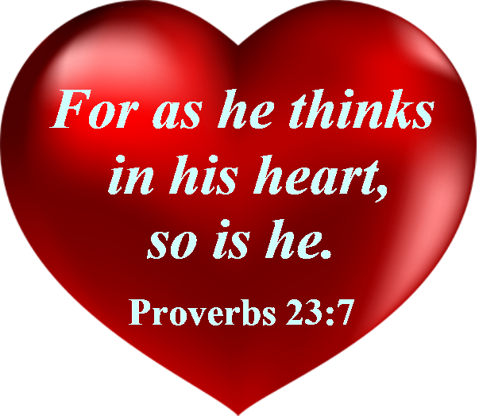
Notes:
What are you thinking in your heart? It starts with the mind. Be careful little mind what you think for the Father up above is looking down with love so be careful little mind what you think.

Slide 2
What are You Thinking in Your Heart?
kardía – heart; "the affective center of our being" and the capacity of moral preference (volitional desire, choice; see P. Hughs, 2 Cor, 354); "desire-producer that makes us tick" (G. Archer), i.e our "desire-decisions" that establish who we really are. (Helps Word Studies)
“the center and seat of spiritual life, "the soul or mind, as it is the fountain and seat of the thoughts, passions, desires, appetites, affections, purposes, endeavors" (Thayer’s)
Notes:
Intellect, emotions, will, and conscience. When someone gets caught in the wicked thing they said or did the excuse is that’s not me. It is you. And we need to own up to it, repent & confess for what we’ve done that is wrong.

Slide 3
What are You Thinking (mind)?
diánoia ("critical thinking"), use the mind… critical thinking,
literally "thorough reasoning,“ incorporates both sides of a
matter to reach a meaningful (personal) conclusion.
Such "full-breadth reasoning" is essential to loving
(25 /agapáō) the Lord and our neighbor (see Mk 12:30).
It is also the instrument of self-destruction when exercised
without God's light and power
(Lk 1:51; Eph 2:3, 4:18; Col 1:21).
[Helps Word Studies]
Notes:
God wants us to use our minds to reason with. Dee-an’-oy- ah

Slide 4
What are You Thinking (mind)?
Why do many not believe God created the universe as
described in the Bible? (Gallup Poll 2019- 60%)
40% of Americans Believe in Creationism (gallup.com)
Claims- Not enough evidence, evil in the world, bad
religious experience, God didn’t answer prayer, wanted
independence, negative teachings on sexuality/hell,
hypocrites, persecution, grew up in a faithless home, etc.
Are you examining the evidence? God asks you to do that.
(Isaiah 1:18; 1 Thessalonians 5:21-22)
Notes:
Be careful little mind what you think! Your life is shaped by your thoughts. Sadly, many are helpless, hopeless, and godless which leaves them depressed, discouraged, and sometimes even in despair because this world can only offer you fleeting pleasures, they will all pass away, & there won’t be true peace, joy, & love in your life w/o God.

Slide 5
What are You Thinking (mind)?
What does the Bible say about unbelievers?
Many accept the general theory of evolution as being true
which suppresses the truth & evidence of God creating the
universe in six days (Exodus 20:11; Romans 1:18-20).
God’s word says they are irreverent as they don’t honor
their Creator, do what is contrary to God’s justice, profess
to be wise in their thinking, & reject God’s plan of salvation
in Christ (Romans 1:21-23; 5:6-11).

Slide 6
What are You Thinking (mind)?
When individuals reject God’s will, He gives them up to
a depraved mind to worship & serve the creature rather
than the Creator (Romans 1:24-25, 28).
We see the evidence of this wickedness today.
(Romans 1:26-32)
The fool has said in his heart there is no God so he doesn’t
want to even examine to see if the Bible is true.
(Psalm 10:4; 14:1; 53:1; Romans 1:29)

Slide 7
What are You Thinking (mind)?
What are you thinking in your mind as a Christian who has
obeyed the gospel of Christ by being baptized for the
forgiveness of your sins (Romans 6:3-4, 16-18)?
Is your mind still guided by God’s thoughts or your own?
(Isaiah 55:8-9; Jeremiah 17:9; Proverbs 14:12)
Do you seek God’s word as you would for hidden treasures
or allow yourself to be distracted by the world?
(Proverbs 2:1-6; Matthew 6:19-24; 13:46-48)

Slide 8
What are You Thinking (mind)?
What are you reading, studying, or being entertained by?
(Ephesians 3:1-5; Matthew 11:15; 19:4; Mark 4:24)
If God’s word is in your heart it will come out in your
speech (Philippians 4:8; Matthew 12:35; Ephesians 4:29).
Garbage that comes into your brain will come out if you
don’t think before you speak & you’ll be judged by every
careless word (Prov. 15:28; Matt. 12:34-37; 15:18-20).
Notes:
When you read you can understand Paul’s insight into the mystery of Christ. If any man has ears to hear let him hear. Have you not read? Be careful what you listen to. What comes out of your mouth will have been in your heart.

Slide 9
What are You Thinking (mind)?
God wants you to examine the Scriptures with a good and
honest heart. The Bereans did (Luke 8:15; Acts 17:11)!
Do you believe that Jesus died, buried, & rose from the
dead on the 3rd day (1 Cor. 15:3-8)? Thomas didn’t at first.
But when Thomas saw the nail prints in his hand & side he
said, “My Lord & My God” (John 20:25-28).
We believe based on eyewitness testimony & obey Jesus’
words of eternal life (Jn. 14:6, 15; 20:29-31). Have you?
Notes:
The god of this world has blinded the minds of the unbelieving that they might not see the light of the gospel (2 Cor. 4:4). God wants you to be saved & come to a knowledge of the truth, sending His Son to die on the cross for your sins. Can you wrap your mind about the love that He had to do that & Jesus responded out of love & obedience. Will you do the same by being baptized for the forgiveness of your sins?

Slide 10
What are You Thinking (mind)?
Don’t let Satan blind your mind to the reality that there is a
God, He sent His Son to die on the cross so that you can
be forgiven of your sins, and live a holy life to glorify &
honor Him in your body (cf. 2 Cor. 4:4-6; Titus 2:11-14).
But you’re going to have to humble your pride so as to
examine the evidence from the Bible, believe Jesus Christ
is the Son of God, repent of your sins, be baptized to
wash away your sins & be faithful ‘til death (Acts 2:36-38)!
Notes:
Many are either ignorant, deceived, uncaring, or hardened their heart (Eph. 4:17-19) The god of this world has blinded the minds of the unbelieving that they might not see the light of the gospel (2 Cor. 4:4). God wants you to be saved & come to a knowledge of the truth, sending His Son to die on the cross for your sins. Can you wrap your mind about the love that He had to do that & Jesus responded out of love & obedience. Will you do the same by being baptized for the forgiveness of your sins?

