Slide 1
What Heaven is and what Heaven is not
Heb. 11:13-16
Notes:
Heb 11:13-16 These all died in faith, not having received the promises, but having seen them afar off, and were persuaded of them, and embraced them, and confessed that they were strangers and pilgrims on the earth. (14) For they that say such things declare plainly that they seek a country. (15) And truly, if they had been mindful of that country from whence they came out, they might have had opportunity to have returned. (16) But now they desire a better country, that is, an heavenly: wherefore God is not ashamed to be called their God: for he hath prepared for them a city.

Slide 2
Heaven is:
Described - Rev. 21:2, 9-21; 22:1-2
(symbolically in terms we can understand)
Notes:
Chalcedony – kal sa don e
Sardonyx – sar don icks
Sardius - ˈsar de us
Chrysolite - ˈkris a light
chrys·o·prase
ja·cinth

Slide 3
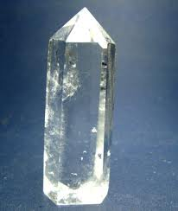
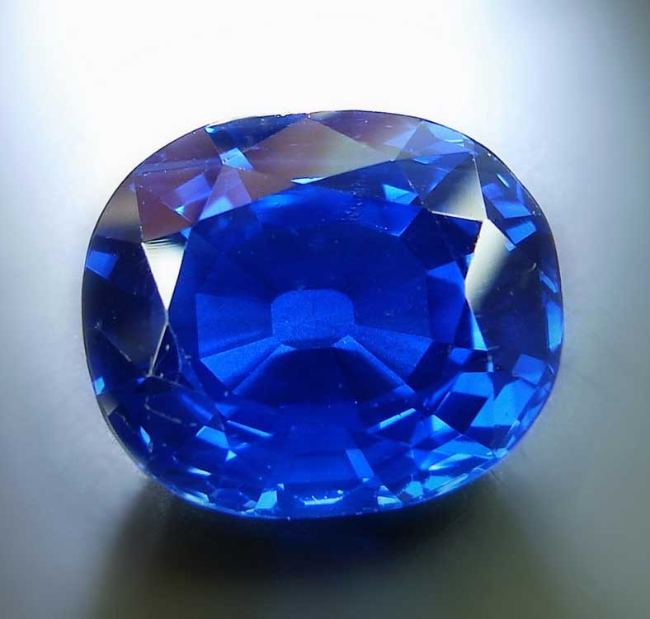
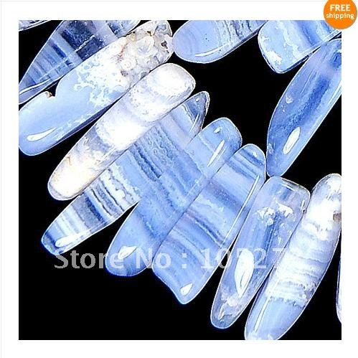
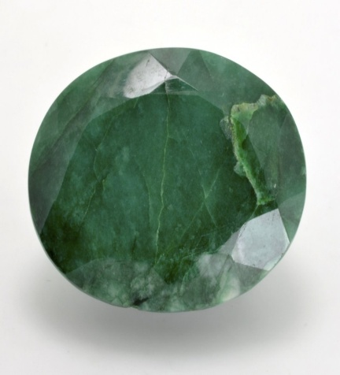
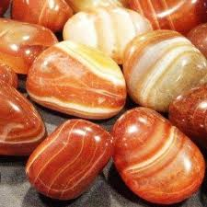
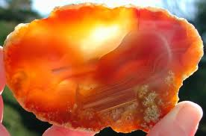
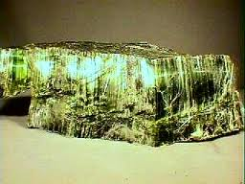
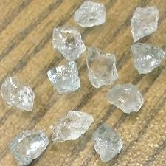
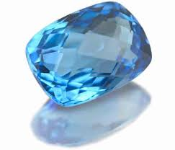
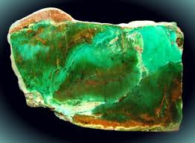
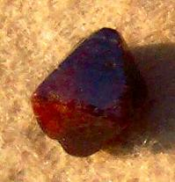
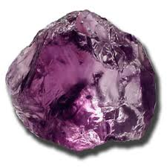
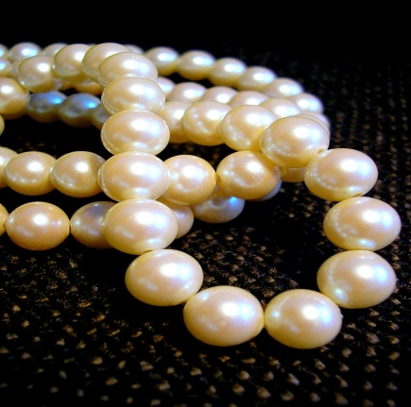
Jasper
Pure Gold
sapphire
chalcedony
emerald
sardonyx
sardius
chrysolite
beryl
topaz
chrys·o·prase
jacinth
pearls
amethyst
Notes:
Chalcedony – kal sa don e
Sardonyx – sar don icks
Sardius - ˈsar de us
Chrysolite - ˈkris a light
chrys·o·prase
ja·cinth

Slide 4
Heaven is:
Described - Rev. 21:2, 9-21; 22:1-2
The abode of God – John 14:2-3
Notes:
John 14:2-3 In my Father's house are many mansions: if it were not so, I would have told you. I go to prepare a place for you. And if I go and prepare a place for you, I will come again, and receive you unto myself; that where I am, there ye may be also.

Slide 5
Heaven is:
A place of:
Rest – Heb. 4:9-11; Rev. 14:13
Peace – Luke 16:19-22
Service – Rev. 7:15; 22:3
Righteousness – 2 Pet. 3:13
Reward – Mt. 5:11-12
Many mansions – John 14:2-3
For the Innocent and obedient – Mt. 18:1-3; 2 Sam. 12:23; Heb. 5:8-9
For those found in the Book of Life – Rev. 3:5; 21:27
Notes:
Rev 14:13 And I heard a voice from heaven saying unto me, Write, Blessed are the dead which die in the Lord from henceforth: Yea, saith the Spirit, that they may rest from their labours; and their works do follow them.
Rev 7:15 Therefore are they before the throne of God, and serve him day and night in his temple: and he that sitteth on the throne shall dwell among them.
Rev 22:3 And there shall be no more curse: but the throne of God and of the Lamb shall be in it; and his servants shall serve him:
2Pe 3:13 Nevertheless we, according to his promise, look for new heavens and a new earth, wherein dwelleth righteousness.
2Sa 12:22-23 And he said, While the child was yet alive, I fasted and wept: for I said, Who can tell whether GOD will be gracious to me, that the child may live? (23) But now he is dead, wherefore should I fast? can I bring him back again? I shall go to him, but he shall not return to me.
Rev 3:5 He that overcometh, the same shall be clothed in white raiment; and I will not blot out his name out of the book of life, but I will confess his name before my Father, and before his angels.
Rev 21:27 And there shall in no wise enter into it any thing that defileth, neither whatsoever worketh abomination, or maketh a lie: but they which are written in the Lamb's book of life.

Slide 6
Heaven is:
A place without:
Death – Luke 20:36
Marriage – Mt. 22:30
Sorrow – Rev. 7:17
End – Mt. 25:46; Rev. 22:5
Notes:
Luk 20:36 Neither can they die any more: for they are equal unto the angels; and are the children of God, being the children of the resurrection.
Mat 22:30 For in the resurrection they neither marry, nor are given in marriage, but are as the angels of God in heaven.
Rev 7:17 For the Lamb which is in the midst of the throne shall feed them, and shall lead them unto living fountains of waters: and God shall wipe away all tears from their eyes.
Mat 25:46 And these shall go away into everlasting punishment: but the righteous into life eternal.
Rev 22:5 And there shall be no night there; and they need no candle, neither light of the sun; for the Lord God giveth them light: and they shall reign for ever and ever.

Slide 7
Heaven is not:
A golf course, shopping mall, full of 70 virgins, eternal avenue for your favorite hobby/entertainment

Slide 8
Heaven is not:
A place for:
Wicked people – Rev. 22:15
Abominable and defiled – Rev. 21:27
The unrighteous – 1 Cor. 6:9-10
The workers of the flesh – Gal. 5: 19-21
Those who are not in the Book of Life – Rev. 13:7-8; 20:15
Notes:
Rev 22:15 For without are dogs, and sorcerers, and whoremongers, and murderers, and idolaters, and whosoever loveth and maketh a lie.
Rev 21:27 And there shall in no wise enter into it any thing that defileth, neither whatsoever worketh abomination, or maketh a lie: but they which are written in the Lamb's book of life.
Rev 20:15 And whosoever was not found written in the book of life was cast into the lake of fire.

Slide 9
The Lord’s Invitation
Notes:
Good news – 1 Cor. 6:11; Acts 22:16; Rev. 7:14; 1 Pet 3:20-21

