Slide 1
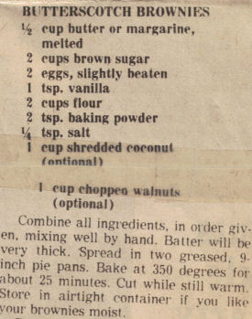
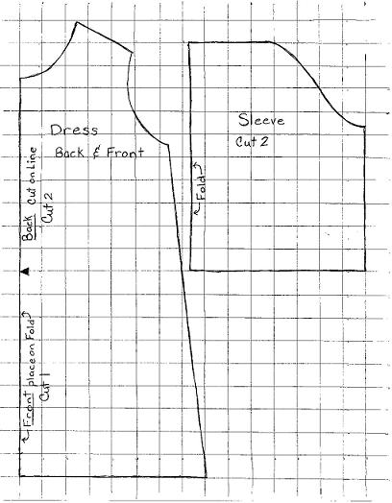
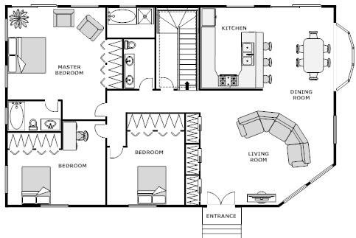
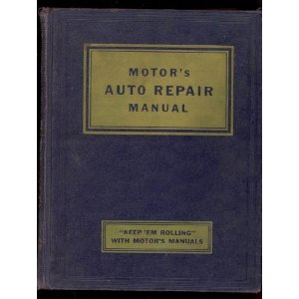
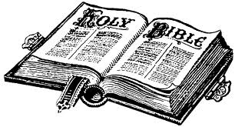
The Pattern

Slide 2
Introduction
Patterns are a necessary part of our everyday life.
A mother follows a pattern in making a dress.
A contractor uses a blueprint to build a house.
A cook uses a recipe to make a meal.
An auto mechanic uses a repair manual to fix cars.
Most people understand the need for patterns in their everyday life but sadly they don’t when it comes to the Bible which will determine whether they will spend eternity in heaven or hell!

Slide 3
The Pattern in God’s Creation
God created everything good and the seven day week is a pattern for mankind (Gen. 1:31- 2:3; Ex. 20:11).
Everything reproduces after its own kind [plants, trees, fruit, vegetables, animals, humans] (Ge. 1:11; 24-28).
The seasons, sun, moon, and stars will not cease to exist while the earth remains (Gen. 1:14-18; 8:22).
The directions were decreed by God (Ps. 89:12).
If men reject God’s evidence that He is the Creator they are without excuse (Rom. 1:18ff).

Slide 4
The Pattern in the Old Testament
God gave Noah a blueprint for building the ark & he obeyed which saved his family (Ge. 6:13-22; He. 11:7).
God gave Moses a pattern of laws on how they must live, a pattern for the tabernacle and of its furniture for their worship. Moses and the people obeyed Him. (Ex. 19:5-6; 25:9, 40; 39:32; 40:16)
But Aaron’s sons disobeyed the Lord when they offered strange fire & they died (Lev. 10:1-3; 16:12-13).
God demands holiness and punishes disobedience!

Slide 5
The Pattern in the Old Testament
Solomon built the Lord’s house according to the pattern including all the furniture (1 Chr. 28:6-20; 2 Chr. 6:2)
Sadly, the Jews disobeyed God by mocking and despised His word from the prophets, and defiled the house of the Lord (2 Chron. 36:14-16).
They went into Babylonian captivity and the temple was burned to the ground (Deut. 28:45ff; 2 Chr. 36:17ff).
God demands holiness and punishes disobedience!

Slide 6
The Pattern in the New Testament
As God had given the pattern for the tabernacle & temple under the Old Law, we have been given the pattern of work & worship under the New Covenant through Jesus Christ (Heb. 8:5-6; Matt. 28:20).
We are to be holy, teach others, and do good works. (1 Pet. 1:13-16; 4:1-5; Ti. 2:7; 2 Tim. 1:13; 2:24-26)
We must worship Him in spirit & truth (John 4:24).
God demands holiness and punishes disobedience in the NT (Acts 5:1-11; Heb. 2:1-3; 2 Thess. 1:7-8).

Slide 7
Conclusion
We have all failed to obey the Lord but there is love, grace, mercy, & forgiveness in the pattern through the blood of Christ (1 Timothy 1:12-16).
If you are willing to receive the seed (God’s word) and obey it’s teaching from your heart, you will be forgiven of your sins and become a Christian, nothing else. (Luke 8:11, 15; Rom. 6:17; 1 Pet. 1:22-23; Acts 11:26)
God will judge according to the pattern & if you reject it, you’ll have judged yourself unworthy of eternal life. (John 12:48-50; Acts 13:46; Prov. 14:12)
Notes:
The creeds of men will not produce Christians but instead Catholics, Methodists, Baptists, etc.

Slide 8
Pattern for Salvation in the New Testament
HEAR (Romans 10:17; John 5:25)
BELIEVE (John 8:24; Heb. 11:6)
REPENT (Luke 13:3, 5; Acts 17:30-31; 2 Peter 3:9)
CONFESS (Mt. 10:32; Rom. 10:9; Acts 8:37).
BE BAPTIZED (Mark 16:16; Acts 2:38)
GROW SPIRITUALLY (2 Peter 1:5-11; 3:18)
BE FAITHFUL to CHRIST until DEATH (Rev. 2:10)

