Slide 1
Songs for Worship at Woodmont

Slide 2
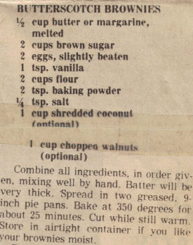
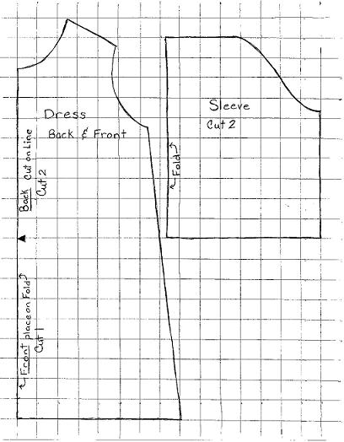
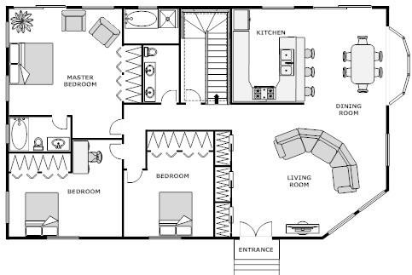
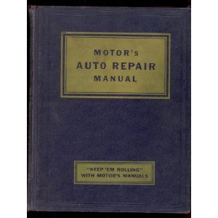
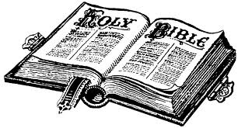
The Pattern (Part 2)

Slide 3
Introduction
This morning we began studying how patterns are a necessary part of our everyday life (making a dress or a meal, building a house, fixing a car).
We studied the application of God’s pattern in creation (7 day week, reproduction after its own kind, seasons), the Old Testament (the tabernacle, temple), the New Testament (holiness, evangelism, good works)
This afternoon we will study God’s pattern of worship in the NT (John 4:24) and why people don’t follow it.

Slide 4
The Pattern in NT for Worship
We are to pray to God through Christ, not the Pope, Mary, a priest, or the saints (1 Tim. 2:5; Acts 10:25-26).
When we sing, we are to make melody in our heart, not on a mechanical instrument (Eph. 5:19; Col. 3:16-17).
Funds are raised by saints giving on the 1st day of the week, not on any other day or by selling merchandise, raffles, etc. (1 Cor. 16:1-2)
The Lord’s supper is to be partaken on the first day of the week (Acts 20:7), not monthly, quarterly, or yearly.
When God’s word is preached, we examine and apply it to our lives (2 Tim. 4:2; Acts 17:11).

Slide 5
Why Don’t People Follow the Pattern
They love to sin & hate the Light (John 3:19-21).
They do what seems right to them (Prov. 14:12).
They follow the majority (Num. 14:1f; Mt. 7:13-14).
They conform themselves to the world (Ro. 12:2).
They judge according to appearance (John 7:24).
They believe they’re saved by faith only (Js. 2:24).

Slide 6
Why Don’t People Follow the Pattern
They are deceived by false teachers (2 Pt. 2:1-3).
They don’t love the truth (2 Th. 2:8-12; Lk. 8:12).
Affliction or persecution comes (Mark 4:17)
Worries of the world, deceitfulness of riches, or desire for other things (Mark 4:19)
They justify themselves (Luke 16:15)

Slide 7
Conclusion
God’s word tells us to hold fast the pattern of sound words and not go beyond what is written. (2 Tim. 1:13; 1 Cor. 4:6)
Many will argue with Jesus in the Judgment saying we prophesied, cast out demons, and did many wonderful works in Your name but they didn’t obey (Mt. 7:21-23).
Our worship will be in vain if we submit to man’s traditions over God’s pattern (Matt. 15:9-14).
There is forgiveness in the pattern through Christ’s shed blood (Eph. 1:7; Rom. 6:16-18).
Notes:
The creeds of men will not produce Christians but instead Catholics, Methodists, Baptists, etc.

Slide 8
Pattern for Salvation in the New Testament
HEAR (Romans 10:17; John 5:25)
BELIEVE (John 8:24; Heb. 11:6)
REPENT (Luke 13:3, 5; Acts 17:30-31; 2 Peter 3:9)
CONFESS (Mt. 10:32; Rom. 10:9; Acts 8:37).
BE BAPTIZED (Mark 16:16; Acts 2:38)
GROW SPIRITUALLY (2 Peter 1:5-11; 3:18)
BE FAITHFUL to CHRIST until DEATH (Rev. 2:10)

