Slide 1
God’s Promises to Abraham (Nation and Land)

Slide 2
Introduction
Two weeks ago we discussed why the patriarchs deceived others and how they were deceived themselves.
But God will still able to fulfill His promises despite man’s sin using a man named Abraham.
God promised to make of him “a great nation”; to give to his descendants “a land”, and through his seed “all the families of the earth would be blessed” (Gen. 12:1-3, 7).
Failure to understand that these promises were conditioned upon obedience has led to the error of premillenialism.

Slide 3
God’s Promises to Abraham
By faith, Abram left his country & relatives at the age of 75 with his barren wife not knowing his destination or when the promise would be fulfilled (Gen. 12:4; Heb. 11:8).
After Abram and Sarai wait 10 years and have no child, Sarai gives Abram her maid Hagar as a wife and they have a son Ishmael (Gen. 16) which caused many problems then and even up until now in the Middle East.
When Abram is 99, God changes their names to Abraham and Sarah and they have a son Isaac who would be the heir of the promise (Gen. 17:4-5, 15-16; 21:1-3).

Slide 4
“My covenant is with you & you shall be a father of many nations. No longer shall your name be called Abram, but your name shall be Abraham; for I have made you a father of many nations….”God said…As for Sarai your wife, you shall not call her name Sarai, but Sarah shall be her name. "And I will bless her & also give you a son by her; then I will bless her, & she shall be a mother of nations; kings of peoples shall be from her (Gen. 17:4-5, 15-16).
“…The LORD did for Sarah as He had spoken. For Sarah conceived & bore Abraham a son in his old age, at the set time of which God had spoken to him. And Abraham called the name of his son who was born to him- whom Sarah bore to him- Isaac (Gen. 21:1-3).

Slide 5
God’s Promise (Great Nation- Israel)
God promised Abram to make of him a great nation but he died before its fulfillment (Gen. 12:2; 25:7).
God’s promise is repeated to Isaac but he died before its fulfillment (Gen. 26:2-5; 35:28-29).
God changed Jacob’s name to Israel & told him that he would make of him a great nation in Egypt but he died before its fulfillment. (Gen. 35:9-11; 46:3; 47:28)

Slide 6
“God appeared to Jacob again, when he came from Padan Aram, and blessed him. God said to him, "Your name is Jacob; your name shall not be called Jacob anymore, but Israel shall be your name." So He called his name Israel. Also God said to him: "I am God Almighty. Be fruitful and multiply; a nation and a company of nations shall proceed from you, and kings shall come from your body” (Gen. 35:9-11)
“He said, I am God, the God of your father; do not fear to go down to Egypt, for I will make of you a great nation there” (Gen. 46:3).
“Jacob lived in the land of Egypt 17 years. So the length of Jacob's life was 147 years” (Gen. 47:28).

Slide 7
God’s Promise (Great Nation- Israel in Egypt)

Slide 8
"But when the time of the promise drew near which God had sworn to Abraham, the people grew and multiplied in Egypt” (Acts 7:17).
“All those who were descendants of Jacob were 70 persons (for Joseph was in Egypt already). Joseph died, all his brothers, & all that generation. But the children of Israel were fruitful and increased abundantly, multiplied and grew exceedingly mighty; and the land was filled with them. Now there arose a new king over Egypt, who did not know Joseph” (Exodus 1:5-8).
Pharaoh commanded all his people, saying, "Every son who is born you shall cast into the river…(Ex. 1:22) but Moses was allowed to live (Ex. 2:10; Acts 7:18-20).

Slide 9
God’s Promise (Great Nation- Israel in Egypt)
There were 70 descendants of Jacob that went down into Egypt then Joseph and all his brothers died along with that generation (Acts 7:17; Ex. 1:5-6).
The time of the promise being fulfilled that God had sworn to Abraham was near when the Israelites were multiplying in Egypt (Ex. 1:7; Acts 7:17).
Another Pharaoh arose who didn’t know Joseph and wanted all of Israel’s male babies killed but Moses lived (Ex. 1:8, 22; 2:10).

Slide 10
God’s Promise (Great Nation- Israel in Egypt)

Slide 11
“God heard their groaning, & God remembered His covenant with Abraham, with Isaac, & Jacob. God saw the children of Israel, & took notice of them (Ex. 2:24-25).
“The LORD said: "I have surely seen the oppression of My people who are in Egypt, and have heard their cry because of their taskmasters, for I know their sorrows. "So I have come down to deliver them out of the hand of the Egyptians” (Ex. 3:7-8a).
"I have surely seen the oppression of my people who are in Egypt; I have heard their groaning and have come down to deliver them. And now come, I will send you to Egypt."' "This Moses…is the one God sent to be a ruler and a deliverer by the hand of the Angel who appeared to him in the bush…” (Acts 7:34-35).

Slide 12
God’s Promise (Great Nation- Israel)
God calls Moses to deliver His people out of Egyptian bondage as He remembered His promise. (Ex. 2:24-25; 3:7-8; Acts 7:34-35)

Slide 13
“The children of Israel journeyed from Rameses to Succoth, about 600,000 men on foot, besides children” (Exodus 12:37).
“All who were numbered were 603,550” (Num 1:46).
“The LORD your God has multiplied you, & here you are today, as the stars of heaven in multitude” (Deut. 1:10).
“You shall answer before the LORD your God: 'My father was a Syrian, about to perish, & he went down to Egypt & dwelt there, few in number; & there he became a nation, great, mighty, & populous” (Deut. 26:5).

Slide 14
God’s Promise (Great Nation- Israel in Egypt)
God calls Moses to deliver His people out of Egyptian bondage as He remembered His promise. (Ex. 2:24-25; 3:7-8; Acts 7:34-35)
They became a great and mighty nation in Egypt as God had promised with over 600,000 men. (Ex. 12:37; Num. 1:46; Deut. 1:10; 26:5)
To continue being a great nation was conditioned upon their obedience to God’s covenant with them. (Ex. 19:5-6)

Slide 15
God’s Promise (Great Nation- Israel in Egypt)
“Therefore, if you will indeed obey My voice and keep My covenant, then you shall be a special treasure to Me above all people; for all the earth is Mine. 'And you shall be to Me a kingdom of priests and a holy nation.' These are the words which you shall speak to the children of Israel" (Exodus 19:5-6).
God fulfilled His promise to Abraham that he would make of them a great nation, but they would have to obey to remain a holy nation.

Slide 16
God’s Promise (Land- Canaan)
When God calls Moses, it was to bring them to the same land He promised to Abraham, Isaac, & Jacob. (Ex. 6:8; Gen. 17:8; 26:3; 28:4)

Slide 17
God said to Moses, “I will bring you into the land which I swore to give to Abraham, Isaac, & Jacob'" (Ex. 6:8).
To Abraham God said, “I give to you & your descendants after you the land in which you are a stranger, all the land of Canaan…" (Gen. 17:8).
To Isaac God said, “Dwell in this land, and I will be with you and bless you; for to you and your descendants I give all these lands, and I will perform the oath which I swore to Abraham your father” (Gen. 26:3).
Isaac told Jacob, “May God give you the blessing of Abraham, To you and your descendants with you, That you may inherit the land In which you are a stranger, Which God gave to Abraham" (Gen. 28:4).

Slide 18
God’s Promise (Land- Canaan)
When God calls Moses, it was to bring them to the same land He promised to Abraham, Isaac, & Jacob. (Ex. 6:8; Gen. 17:8; 26:3; 28:4)
God had them send 12 spies into the land (Nu. 13:1-2).

Slide 19
“They returned from spying out the land after forty days. Now they departed and came back to Moses and Aaron and all the congregation of the children of Israel in the Wilderness of Paran, at Kadesh; they brought back word to them and to all the congregation, and showed them the fruit of the land. Then they told him, and said: "We went to the land where you sent us. It truly flows with milk and honey, and this is its fruit. "Nevertheless the people who dwell in the land are strong; the cities are fortified and very large; moreover we saw the descendants of Anak there. "The Amalekites dwell in the land of the South; the Hittites, the Jebusites, and the Amorites dwell in the mountains; and the Canaanites dwell by the sea and along the banks of the Jordan.“ (Numbers 13:25-29)

Slide 20
…Then Caleb quieted the people before Moses, and said, "Let us go up at once and take possession, for we are well able to overcome it." But the men who had gone up with him said, "We are not able to go up against the people, for they are stronger than we." And they gave the children of Israel a bad report of the land which they had spied out, saying, "The land through which we have gone as spies is a land that devours its inhabitants, and all the people whom we saw in it are men of great stature. "There we saw the giants (the descendants of Anak came from the giants); and we were like grasshoppers in our own sight, and so we were in their sight" (Numbers 13:30-33).

Slide 21
“Because all these men who have seen My glory & the signs which I did in Egypt & in the wilderness, & have put Me to the test now these 10 times, & have not heeded My voice, "they certainly shall not see the land of which I swore to their fathers, nor shall any of those who rejected Me see it” (Num. 14:22-23)
'The carcasses of you who have complained against Me shall fall in this wilderness, all of you who were numbered, according to your entire number, from 20 years old and above” (Num. 14:29).

Slide 22
God’s Promise (Land- Canaan)
When God calls Moses, it was to bring them to the same land He promised to Abraham, Isaac, & Jacob. (Ex. 6:8; Gen. 17:8; 26:3; 28:4)
God had them send 12 spies into the land (Num. 13:1-2).
Israel hears the bad report from the 10 spies, they reject God’s promises, and die in the wilderness after wandering 40 years (Num. 13:25-33; 14:22-23, 29).
After Moses dies, God calls Joshua to lead them into the land and it was conditioned upon his careful obedience to all the Law of Moses (Josh. 1:2, 8).

Slide 23
God tells Joshua, "Moses My servant is dead. Now therefore, arise, go over this Jordan, you and all this people, to the land which I am giving to them- the children of Israel” (Joshua 1:2).
"This Book of the Law shall not depart from your mouth, but you shall meditate in it day and night, that you may observe to do according to all that is written in it. For then you will make your way prosperous, and then you will have good success” (Joshua 1:8)

Slide 24
“The LORD said, 'Surely not one of these men of this evil generation shall see that good land of which I swore to give to your fathers, 'except Caleb the son of Jephunneh; he shall see it, and to him and his children I am giving the land on which he walked, because he wholly followed the LORD.' "The LORD was also angry with me for your sakes, saying, 'Even you shall not go in there; 'Joshua the son of Nun, who stands before you, he shall go in there. Encourage him, for he shall cause Israel to inherit it. 'Moreover your little ones and your children, who you say will be victims, who today have no knowledge of good and evil, they shall go in there; to them I will give it, and they shall possess it” (Deut. 1:34-39).

Slide 25
God’s Promise (Land- Canaan)
Caleb and the children of the disobedient parents would enter in with Joshua (Deut. 1:34-39).

Slide 26
God’s Promise (Land- Canaan)
“So Joshua took the whole land, according to all that the LORD had said to Moses; and Joshua gave it as an inheritance to Israel according to their divisions by their tribes. Then the land rested from war” (Joshua 11:23).

Slide 27
God’s Promise (Land- Canaan)
Caleb and the children of the disobedient parents would enter in with Joshua (Deut. 1:34-39).
The Bible says that Joshua took the whole land according to all that the Lord had spoken to Moses and gave it for an inheritance to Israel according to their tribes (Joshua 11:23).

Slide 28
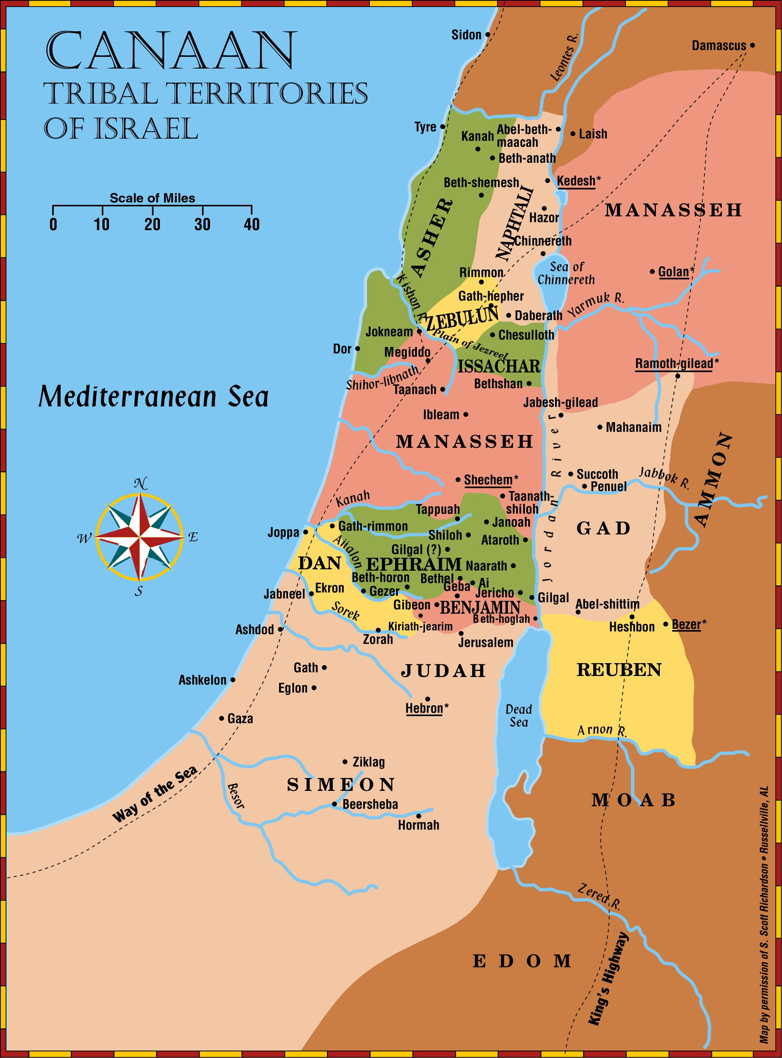
b
Joshua 13-20

Slide 29
“The LORD gave to Israel all the land of which He had sworn to give to their fathers, & they took possession of it & dwelt in it. The LORD gave them rest all around, according to all that He had sworn to their fathers. And not a man of all their enemies stood against them; the LORD delivered all their enemies into their hand. Not a word failed of any good thing which the LORD had spoken to the house of Israel. All came to pass”. (Joshua 21:43-45)
Joshua said, “You know in all your hearts and in all your souls that not one thing has failed of all the good things which the LORD your God spoke concerning you. All have come to pass for you; not one word of them has failed” (Joshua 23:14).

Slide 30
God’s Promise (Land- Canaan)
Caleb and the children of the disobedient parents enter in with Joshua (Deut. 1:34-39).
The Bible says that Joshua took the whole land according to all that the Lord had spoken to Moses and gave it for an inheritance to Israel according to their tribes. (Joshua 11:23)
Joshua said that God had fulfilled every promise he made to Israel (Joshua 21:43-45; 23:14) and yet premillenialists today say that God didn’t fulfill it yet.
Who will you believe? Man or God

Slide 31
God’s Promise (Land- Canaan)
This was a conditional promise to Israel as they would only remain in the land if they obeyed. (Lev. 26-28; Dt. 28-30)

Slide 32
"Therefore it shall come to pass, that as all the good things have come upon you which the LORD your God promised you, so the LORD will bring upon you all harmful things, until He has destroyed you from this good land which the LORD your God has given you. "When you have transgressed the covenant of the LORD your God, which He commanded you, and have gone and served other gods, and bowed down to them, then the anger of the LORD will burn against you, and you shall perish quickly from the good land which He has given you" (Josh 23:15-16).

Slide 33
"The LORD will send on you cursing, confusion, & rebuke in all that you set your hand to do, until you are destroyed and until you perish quickly, because of the wickedness of your doings in which you have forsaken Me…. you shall beget sons and daughters, but they shall not be yours; for they shall go into captivity… "The LORD will bring a nation against you from afar, from the end of the earth, as swift as the eagle flies, a nation whose language you will not understand… "If you do not carefully observe all the words of this law that are written in this book, that you may fear this glorious and awesome name, the Lord your God then the Lord will bring extraordinary plagues on you” (Deut. 28:20; 41, 49, 58)

Slide 34
“In the 9th year of Hoshea, the king of Assyria took Samaria & carried Israel away to Assyria…” (2 Kgs. 17:6)
“Nebuchadnezzar king of Babylon came against the city, as his servants were besieging it…. Also he carried into captivity all Jerusalem: all the captains, all the mighty men of valor, 10,000 captives, & all the craftsmen & smiths. None remained except the poorest people of the land. And he carried Jehoiachin captive to Babylon. The king's mother, the king's wives, his officers, & the mighty of the land he carried into captivity from Jerusalem to Babylon. All the valiant men, 7,000, & craftsmen & smiths, 1,000, all who were strong & fit for war, these the king of Babylon brought captive to Babylon. (2 Kings 24:11,14-16)

Slide 35
God’s Promise (Land- Canaan)
This was a conditional promise to Israel as they would only remain in the land if they obeyed (Lev. 26-28; Dt. 28-30)
If they disobeyed, God would destroy them or make them go into captivity (Josh. 23:15-16; Dt. 28:20,41,49,58).
This was fulfilled about 700-900 years later- [Assyrian captivity 722 BC - Babylonian captivity 586 BC] (2 Kings 17:6; 24:11, 14-16)

Slide 36
'But if they confess their iniquity and the iniquity of their fathers, with their unfaithfulness in which they were unfaithful to Me, and that they also have walked contrary to Me, and that I also have walked contrary to them and have brought them into the land of their enemies; if their uncircumcised hearts are humbled, and they accept their guilt- then I will remember My covenant with Jacob, and My covenant with Isaac and My covenant with Abraham I will remember; I will remember the land” (Lev. 26:40-42)

Slide 37
God’s Promise (Land- Canaan)
This was a conditional promise to Israel as they would only remain in the land if they obeyed (Lev. 26-28; Dt. 28-30)
If they disobeyed, God would destroy them or make them go into captivity (Josh. 23:15-16; Dt. 28:20,41,49,58).
This was fulfilled about 700-900 years later- [Assyrian captivity 722 BC - Babylonian captivity 586 BC] (2 Kings 17:6; 24:11, 14-16)
If they confessed their sins, they would be restored back to their land- [Fulfilled when Daniel confessed after reading Jeremiah 29:10-14] (Lev. 26:40ff; Daniel 9:1-23)

Slide 38
God says, “After 70 years are completed at Babylon, I will visit you & perform My good word toward you, & cause you to return to this place. For I know the thoughts that I think toward you, says the Lord, thoughts of peace & not of evil, to give you a future & a hope. Then you will call upon Me & go & pray to Me, & I will listen to you. You will seek Me & find Me, when you search for Me with all your heart. I will be found by you, says the Lord & I will bring you back from your captivity; I will gather you from all the nations & from all the places where I have driven you & I will bring you to the place from which I cause you to be carried away captive” (Jer. 29:10-14)

Slide 39
Are there Promises for Fleshly Israel today?
God rejected national Israel and gave the kingdom to another nation (Matt. 21:31-46).
Jesus wanted them to be saved, but they rejected and killed Him (Matt. 23:34-38).
The temple in Jerusalem was destroyed in that generation just as Christ said (Matt. 24:1-34) in 70 AD.
Israel getting back their land in 1948 has no fulfillment in Bible prophecy and Jesus will not be reigning in Jerusalem on David’s throne for 1,000 years.

Slide 40
Conclusion
God’s promises to Abraham (nation, land) have already been fulfilled.
The promises had as their attainment a chosen people (National Israel) and a chosen land (Canaan).
Abraham, Isaac, and Jacob all died without receiving the promises but they were looking for the heavenly country. (Heb. 11:13-16) Are you?
If you are going to enjoy the benefits of God’s promise to Abraham & be heirs according to the promise, you must obey the conditions of forgiveness- believe, repent and be baptized (Gal. 3:26-29; Mark 16:16; Acts 2:38-39).

