Slide 1
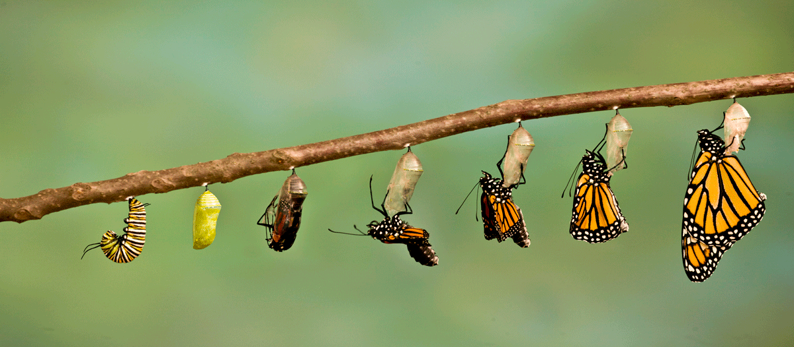
From Ugly Worm to Beautiful Butterfly (Saint)

Slide 2
Introduction
We can learn so many things from God’s creation which may seem so insignificant and may even be repulsive to us. (ant, locust, lizard, worm)
The ugly worm goes through a metamorphosis and becomes a beautiful butterfly.
In this sermon we will draw some parallels from the life cycle of a worm to a butterfly and make application to our lives.
Just as there is a distinctive change in that creature, there is also a change in the life of one who becomes a Christian.

Slide 3
From Insignificant Beginning to Incredible Growth
The journey to becoming a butterfly begins with a tiny egg which is about the size of a period.
The egg hatches and it becomes a caterpillar which has an insatiable appetite in which it grows by molting (shedding of its skin).
We grow from being conceived in our mom’s tummy until we are born and then grow significantly in our youth. (1 Samuel 2:21, 26)
The Psalmist gives praise to God for this and so should we. (Psalm 139:13-17)

Slide 4
We Become like Worms when we Sin
Worms can be destructive- God appointed one to destroy the gourd that protected Jonah from the sun (Jonah 4:7).
Jacob was called a worm of which the Israelites followed his sinful example (Isa. 41:14; Gen. 27:35).
Even though David was a king he considered himself a worm (Psalm 22:6)
A worm can be defined today as a contemptible person which we all are before God since we all have sinned. (Romans 3:23)

Slide 5
Just As Worms Must Die before Changing We Must Die to that Old Self
The caterpillar goes into the pupa stage where it sheds its skin for the last time in preparation for its change.
Before we can change into becoming a new creature we must be willing to quit our sinful ways (1 Peter 2:24; 4:1-3).
If we refuse to repent of our sins, we will die without God’s grace (Luke 13:3; Acts 17:30-31).
So don’t be conformed to this world but be transformed by God’s perfect word (Romans 12:2)

Slide 6
As the Worm Changes into a Butterfly we Rise from the Dead to a New Life in Christ
The ugly worm becomes a beautiful butterfly that will never go back to that old life again as it displays the glory of God for all to see.
When does our metamorphosis begin?
It begins when we are buried with Christ in baptism and rise to walk in a new life (Romans 6:3-6).
As saints, we don’t want to sin anymore but learn to grow to become more like Christ everyday. (Romans 6:16-18; 2 Peter 3:18)

Slide 7
Just as the Butterfly’s Purpose is to Reproduce, We Should Plant the Word so that there will be More Christians
The gospel is God’s power to save the lost (Rom. 1:16).
It is to be preached to every creature. (Matthew 28:18-20; Mark 16:15-16; 2 Timothy 2:2)
Our responsibility is to plant and water the seed and God will give the increase to those who have good and honest hearts (1 Cor. 3:6-8; Luke 8:15).

Slide 8
Conclusion
If you want to change from a worm to a saint you must….
…be willing to die to that old self and rise to walk in newness of life through the death, burial, and resurrection of Christ (Rom. 6:3-4).
…grow in the grace and knowledge of Jesus Christ becoming conformed to His image- not the world (Ro. 8:29; 12:2).
Then you can look forward to an eternal transformation in heaven with a new body (1 Cor. 15:51-57; Phil. 3:20-21).

