Slide 1
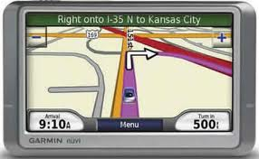
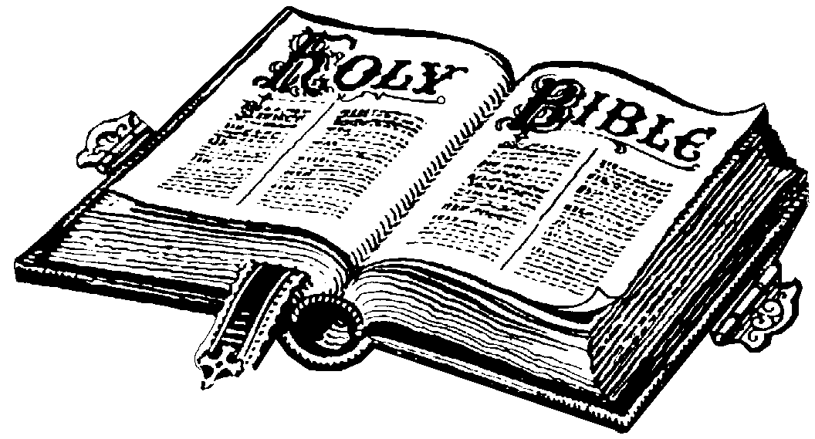
The Christian’s
GPS

Slide 2
Global Positioning System (GPS)
“A global system of U.S. navigational satellites developed to provide precise positional and velocity data and global time synchronization for air, sea, and land travel” (dictionary.com unabridged).
Many Americans are depending on their GPS to get to their vacation destination this summer.
In a similar way, a Christian must use God’s GPS guidebook (the Bible) to get to the eternal destination in heaven and avoid going to hell (using the acronym GPS).

Slide 3
The Christian’s GPS Guide
Recognize GPS (God’s Perceptive Sight)

Slide 4
Recognize God’s Perceptive Sight
Like the manmade GPS, God knows where you are at and where you are going like he did with Adam and Eve (Gen. 3:9-13, 16-24).
But while the manmade GPS makes mistakes (maps not updated, lost satellite reception etc.), God is infallible which all men must recognize or they will be headed down the wrong road (Ro 1:20ff)
“The eyes of the LORD are in every place, watching the evil and the good” (Pr. 15:3).

Slide 5
Recognize God’s Perceptive Sight
God has given us an inspired, infallible, and inerrant word to correct us when we are wrong & instruct us in righteousness so that we will have the wisdom to get to our eternal destination through Christ (2 Tim. 3:14-17; John 14:1-6).
Too many are doing what is right in their own eyes and not the eyes of the Lord (Jdg. 17:6; 21:25).
Do you realize God is watching you and you cannot hide from His sight (Prov. 5:21; Heb. 4:13)?

Slide 6
The Christian’s GPS Guide
Recognize GPS (God’s Perceptive Sight)
Follow the GPS (God’s Powerful Standard)

Slide 7
Follow God’s Powerful Standard
Just as the GPS gives us choices as to which road to go on, we also make decisions as to our eternal destination.
God has created us in His image without sin at birth, but at some point we choose to sin. (Ezek. 18:20; Job 13:26; Jer. 3:25; Jas. 1:13ff; Rom. 3:23; 1 John 3:4).

Slide 8
Follow God’s Powerful Standard
When we make choices based on our feelings or conscience alone, the GPS (Bible) tells us that it leads to death (Acts 23:1; 26:9; Pr. 14:12)
We cannot guide our own footsteps in righteousness (Jer. 10:23).
But through Christ’s blood and His resurrection we can be born again by the GPS (Bible). (1 Pet. 1:3, 19, 22-25; Rom. 1:16)

Slide 9
The Christian’s GPS Guide
Recognize GPS (God’s Perceptive Sight)
Follow the GPS (God’s Powerful Standard)
Overcome the GPS (Great Prowling Schemer)

Slide 10
Overcome the Great Prowling Schemer (Satan)
You can be thinking you’re right and be wrong. (Following manmade GPS & taking the wrong turn)
Satan is a great prowling schemer who seeks to devour our souls by appearing to be righteous (1 Peter 5:8; 2 Cor. 11:2-3, 14).
How does Satan deceive people?

Slide 11
The GPS (Satan) Can Use Family
Satan took away everything Job had but allowed his wife to live so that she would tell him to “curse God and die” (Job 2:9).
If your loved one is trying to get you to disobey God, Satan is at work! Don’t give in (1 Pt. 5:9)!
But Job overcame the GPS (Satan) and did not curse God and rebuked his wife (Job 1:22; 2:10)

Slide 12
The GPS (Satan) Can Use Friendships
“Bad company corrupts good morals” (1 Cor. 15:33) but you want to make friends with the popular crowd to avoid persecution so you follow from a distance.
Satan got Peter to deny the Lord 3X (Luke 22:31; 61).
Say no to sinners enticements (Pr. 1:10ff).
Even if you have good friends, Satan can use them to lead you astray (judging by appearance, traditions, prejudice). (Job 4:8; 8:8; 11:5-6; 19:14; 32:3; 42:7)

Slide 13
The GPS (Satan) Can Use Ministers
Satan appears righteous so he can use his ministers (2 Cor. 11:15) to tell people...
that “all roads lead to heaven ”;
“just accept Christ as your personal Savior and/or say the sinners prayer and you will be saved“;
“once you’re saved, you’re always saved””;
“it doesn’t matter what you believe as long as you are honest and sincere”; etc.

Slide 14
The Christian’s GPS Guide
Recognize GPS (God’s Perceptive Sight)
Follow the GPS (God’s Powerful Standard)
Overcome the GPS (Great Prowling Schemer)
Obey the GPS (God’s Plan of Salvation)

Slide 15
GPS (Obey God’s Plan of Salvation)
The GPS will change the mileage the closer I get to the destination and is accurate even though there are different answers along the route.
It is the same way concerning salvation as those in the book of Acts are told different things based on where they are at spiritually.
But they all had to obey Jesus in order to be saved. (Hebrews 5:8-9; John 14:15)

Slide 16
GPS (Obey God’s Plan of Salvation)
An unbeliever must examine the facts of the gospel so that he might believe Jesus is God’s Son or he will die in his sins (John 20:30-31; 8:24).
The only way to have faith is by hearing God’s word (Rom. 10:17), not by miracle, vision, or feelings.
The Philippian jailer was told to believe in the Lord Jesus Christ and he would be saved (Acts 16:31) but he still had to obey.

Slide 17
GPS (Obey God’s Plan of Salvation)
Those on the Day of Pentecost who were pricked in their hearts that Jesus was God’s Son were told “repent and be baptized for the remission of sins” (Acts 2:38).
Saul, a penitent believer was told “arise and be baptized and wash away your sins calling on the name of the Lord” (Acts 22:16).
The Ethiopian eunuch had Jesus preached to him and requested to be baptized upon seeing water and was told if he believed with all his heart he could. He confessed and was baptized (Acts 8:35-38).

Slide 18
GPS (Obey God’s Plan of Salvation)
God’s word was spoken to the Philippian jailer and in the same hour of the night he was baptized immediately. (Acts 16:32-34)
In all the conversions in Acts, the last act of obedience before salvation is baptism in water, because in that act in you are dying to that old man of sin & rising to walk in newness of life through Jesus’ death, burial, & resurrection (Acts 8:35-38; Ro. 6:3-4, 16-18).
After baptism, we obey Jesus’ commands (Mt. 28:18-20). Set your conscience by God’s word (1 Tim. 1:5)!

Slide 19
Conclusion
The manmade GPS is a helpful tool to get us to our earthly destination but the Bible (God’s Powerful Standard) is absolutely essential to get to heaven.
The Great Prowling Schemer (Satan) has many devices that he uses to deceive people (family, friends, false teachers) into thinking that they are OK by their feelings or saved by faith alone.
If you are subject to heaven’s invitation, obey God’s plan of salvation or be restored (2 Cor. 6:2).

