Slide 1
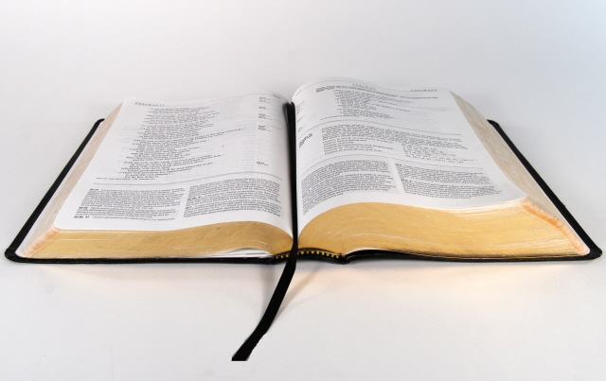
How to Establish Bible Authority

Slide 2
Standards Necessary for Law & Order
Time- NIST- F2 Atomic Clock as of 4/3/2014
Weights & Measures- equity between seller & buyer
Money- exchange rates decided by supply & demand
Military- Uniform Code of Military Justice
Law making- traffic speed, lights, directions
Dictionary- authority for the meaning of words today
How long is this line _______________________?
Many opinions can be given by appearance but you get out the standard (ruler) and that should settle it.
Notes:
National Institute of Standards and Technology

Slide 3
The Bible is like a Measuring Rod that is God’s Standard and Guide for our Lives
“Those who will walk by this rule (Greek- canon), mercy and peace be on him” (Gal. 6:16)
“from kane (a straight reed, i.e. rod); a rule ("canon"), i.e. (figuratively) a standard (of faith & practice)…line” (Strong’s Greek Dictionary)
We will be judged by God’s word (John 12:48).
In religious discussions, don’t argue opinions, feelings, or think so’s- get out the standard (the Bible) & examine yourself by it (2 Cor. 13:5) or there will be division which God is not the author of (1 Cor. 14:33).

Slide 4
Chain of Command in the Bible
God the Father- Creator, reigns on His throne (Ps. 93:1ff).
God the Son (Christ)- died, buried, and rose so that man could be saved & now has all authority as King of kings and Lord of lords (1 Cor. 15:3ff; 1 Tim. 6:15).
God the Holy Spirit- sent by the Son to the apostles to guide them into all the truth (John 14:26; 15:26; 16:13).
Apostles and Prophets- were given authority to preach the the gospel & wrote it down so that when men read they could understand (Mt. 28:19-20; Eph. 3:1-6).

Slide 5
How to Establish Bible Authority
Direct Command or Statement from God
Since Christ has all authority, we are to obey what He has commanded in the Scriptures (Mt. 28:18-20).
We must obey the commands that were written in the Bible by the apostles and prophets because they wrote the Lord’s commandments (2 Peter 3:1-2; 1 Cor. 14:37).
After 3,000 individuals were baptized on the Day of Pentecost they continued steadfastly in the apostles doctrine, not the Law of Moses (Acts 2:42).

Slide 6
How to Establish Bible Authority
Divinely Approved Example
Christ left us an example that we should follow (1 Peter 2:21)
Example (hupogrammos)- “drawing of lines by the elementary teacher in order to guide children who are learning to write” (ISBE)
The apostle set forth an example for brethren to follow but many did not follow (1 Cor. 11:1; Phil. 3:17-18)
The apostles wrote infallibly in the Bible but sometimes sinned and had to be rebuked as Paul had to do to Peter when he played the hypocrite (Gal. 2:11ff).

Slide 7
How to Establish Bible Authority
Necessary Inference
Necessary- “absolutely essential” (American Heritage Dict.)
Inference- “the act or process of deriving logical conclusions from premises known or assumed to be true. The act of reasoning from factual knowledge or evidence”
Necessary inference-
An absolutely essential conclusion based upon factual knowledge or evidence.

Slide 8
Example of Jesus Using Necessary Inference
In response to the Sadduccees question about whose wife of seven husbands would she be in the resurrection, Jesus asked them – “Have you not read what was spoken to you by God?” (Matt. 22:31)
Jesus quotes Exodus 3:6, “'I am the God of Abraham, the God of Isaac, and the God of Jacob'?” (Direct Statement)
Jesus states a fact: “God is not the God of the dead, but of the living." (Matt. 22:32).
The Sadducees & the crowds understood that Jesus taught the resurrection from the dead based on the Scripture.

Slide 9
Necessary Inference
Since the sum of God’s word is truth (Ps. 119:160), study all that the Scriptures say on a subject.
The devil tried to get Jesus to jump off the temple by quoting Psalm 91:11-12 but Jesus refused since it contradicted another Scripture, “You shall not put the Lord your God to the test” (Mt. 4:7)
Study to show yourselves approved to God so that you might handle the truth accurately (2 Tim. 2:15) & not be deceived.
Let us hold fast to that which is good and abstain from every form of evil (1 Thess. 5:21-22).

Slide 10
Are Men Saved by Faith Alone?
Direct Statement of Man- ”we are justified by faith, only, is a most wholesome doctrine and very full of comfort” (Methodist Discipline, Article IX, p. 69, 1972)
Direct Statement of God- “You see that a man is justified by works and not by faith alone.”
Divinely approved examples – Abraham and Rahab justified by faith + works (James 2:21,25)
Necessary Inference- faith only will not save you because you are saved by faith + works!

Slide 11
Baptism- Is it essential for salvation?
Direct Statement of Man- “"Baptism is not essential to salvation…but it is essential to obedience, since Christ has commanded it” (The Standard Manual For Baptist Churches, by Edward T. Hiscox, D.D., p. 20, Note 8).
Direct Statement or Command of God – “He who believes and is baptized shall be saved”…”baptism now saves you”. (Mark 16:16; 1 Pet. 3:21)
Divinely Approved Examples- (Acts 2:38, 41; 8:35-38; 16:31-34; 22:16)

Slide 12
Baptism- Is it essential for salvation?
Belief + baptism = salvation (Mark 16:16)
or belief – baptism = salvation (Scripture?)
Repent + baptism = salvation (Acts 2:38)
or repent – baptism = salvation (Scripture?)
Necessary Inference-
Jesus is the author of eternal salvation to those who obey Him which includes being baptized in water for the forgiveness of sins. It’s as easy as understanding 2 + 2 = 4 not 2 – 2 = 4
Who will you believe and obey? God or Man?

Slide 13
Conclusion
We understand that standards are necessary for living in this world or there would be chaos.
In the Bible we have our rule book from God which guides us to heaven through Jesus Christ.
We establish Bible authority by direct command or statement from God, divinely approved example and necessary inference as we studied the subjects of faith only and baptism.
If you disagree, you might argue, “I think that’s just your interpretation of the Scripture”

Slide 14
Conclusion
But Jesus says that many will call Him Lord in the Judgment Day but be condemned because they didn’t do God’s will. (Matthew 7:21-23)
If you love Jesus, you will obey and if you don’t you won’t. (John 14:15)
If you believe Jesus is God’s Son (John 8:24), confess Him before men (Matt. 10:32), repent and be baptized so that your sins can be forgiven (Acts 2:38) right now (2 Cor. 6:2).

