Slide 1
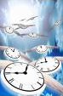
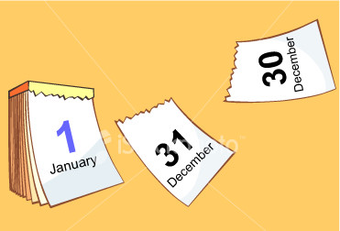
Time

Slide 2
What Happened to Time?
“When as a child I laughed and wept, time crept.
When as a youth I dreamed and talked, time walked.
When I became a full grown man, time ran.
And later as I older grew, time flew.
Soon I shall find while traveling on, time gone”.

Slide 3
Time is Swiftly Passing towards Eternity (Ps. 90:10-12)
“Swiftly we’re turning life’s daily pages, swiftly the hours are changing to years; How are we using God’s golden moments? Shall we reap glory? Shall we reap tears?”
How did we spend our time this past year?
Did we live for the Lord as we should?
We can’t replace the time wasted on sinful or foolish things but we can repent and determine to do better.
Will you take time to be more holy this coming year?

Slide 4
Make Time to Study God’s Word
This is how we show ourselves approved to God (2 Ti. 2:15)
God’s word should be our delight and continually on our minds (Ps. 1:1-2). Read & meditate on it daily.
Let us treasure God’s word in our heart so that we won’t sin. (Psalm 119:9-11; 1 Tim. 4:12-16)
Don’t be foolish, choose to study so that you will understand God’s will (Ephesians 5:15-17).

Slide 5
Make the Time to Teach Someone
Jesus came to seek and save the lost and that must be our aim and goal (Luke 19:10).
“Millions are groping without the gospel, quickly they’ll reach eternity’s night; shall we sit idly as they rush onward? Haste, let us hold up Christ the true light.”
We cannot remain discouraged about all those who have failed to accept our invitation to come and give up!
Our responsibility is to sow the seed of the kingdom and God will give the increase (1 Cor. 3:6-9).

Slide 6
Conclusion
Time is passing quickly, soon we will die, and have to give an account to the Lord for the deeds done in the body. (2 Corinthians 5:10; Hebrews 9:27)
Those who are wise, will take time to be holy and enjoy eternal life while those who are foolish will neglect it and suffer eternal torment and regret!
If you’ve wasted many precious years- repent and come back to the grace and mercy of the Lord (2 Peter 3:9).
Today is the day of salvation! Tomorrow may be too late. (2 Cor. 6:2) Obey the gospel or be restored today!

