Slide 1
Hymns For Worship
103s – I will Give Him All My Praise
155 – Wonderful Love Of Jesus
165 – Thus Remember Me
149 – I Will Sing The Wondrous Story
283 – There’s A Great Day Coming
41s – Light The Fire

Slide 2
Dangerous Distractions

Slide 3
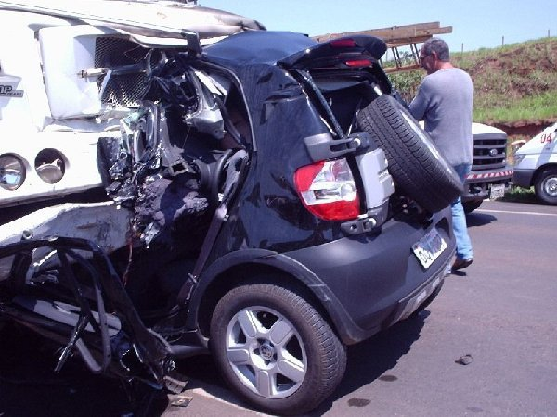
Texting while driving, kills more today than drunk driving. When we first are learning to drive we are too cautious to be distracted while driving. We were not as skilled behind the wheel to put even the smallest amount of attention elsewhere while driving down the road. Even the radio has proven to distract.
But as we gain experience, we sometimes try to juggle these distractions while driving. Most often we get away with it, but the one time you don’t could cost you your life or worse someone else’s life.
Luke 10:38-42 Martha was distracted

Slide 4
Distracted at worship
Remove the distractions

Slide 5
Remove the distractions
Clear your mind of worldly things / cares (Heb. 12:1; Rom 12:1-2)
We “get” to go; Sat night is prep night for worship the next day. (teaches anticipation, and priorities) – (Mat 6:21; 13:44)
Take steps to prepare your mind to study and worship (Eccl. 5:1; 12:13; Psa. 27:4-5; 66:10-16)

Slide 6
Distracted at worship
Remove the distractions
Focus on the Word

Slide 7
Focus on the Word
Understand what you are singing /praying (1 Cor. 14:15; Psa. 47:70)
Understand what is being taught (Eph. 5:17; Gal 1:6-7; 2 Pet 3:14-18)

Slide 8
Distracted at worship
Remove the distractions
Focus on the Word
Focus on your own worship

Slide 9
Focus on your own worship
Psa. 122:1 - Glad to go the house of the Lord.
Don’t distract others, and don’t let others distract you

Slide 10
Distracted at work
Remove the distractions

Slide 11
Remove the distractions
Good soldier entangles not in affairs of world (2 Tim 2:4)
Prepare your mind for work (Eccl. 9:10; Col. 3:23)

Slide 12
Distracted at work
Remove the distractions
Focus on your work responsibilities

Slide 13
Focus on your work responsibilities
Think about what you need to accomplish (1 Cor. 4:17; Prov. 22:29)
Think about time management / ways to better your contribution to the team (Eccl. 3:17)

Slide 14
Distracted at work
Remove the distractions
Focus on your work responsibilities
Focus on your Christian responsibilities at work

Slide 15
Focus on your Christian responsibilities at work
Work as unto the Lord and not unto men. (1 Cor. 4:17)
Don’t stop being a Christian when you clock in at work

Slide 16
Distracted at HOME
Remove the distractions

Slide 17
Remove the distractions
Turn off the T.V.
Get off the computer
Get off your smart phone, ect.

Slide 18
According to the Bureau of Labor Statistics:
2013- American’s spent an average of 5.26hours participating in leisure and sports which includes 2.77 hours watching TV while just spending .14 engaging in Religious activities.
-Religious Activities include those normally associated with membership in or identification with specific religions or denominations, such as attending services; choirs, youth groups, orchestras, or unpaid teaching; and engaging in personal religious practices, such as praying.

Slide 20
Distracted at HOME
Remove the distractions
Focus on your physical responsibilities

Slide 21
Focus on your physical responsibilities
Clean the house; fix the faucet
Easiest way to destroy a house is to do nothing.

Slide 22
Distracted at HOME
Remove the distractions
Focus on your physical responsibilities
Focus on your spiritual responsibilities

Slide 23
Focus on your spiritual responsibilities
Raising your children (Deut. 6:7; Eph. 6:1-4)

Slide 24
“Adults living in households with children under 6 spent an average of 1.84 hours per day providing primary childcare to household children. Adults living in households where the youngest child was between the ages of 6 and 17 spent less than half as much time providing primary childcare to household children--.68 hours a day. (Primary childcare: playing with, reading to, assistance with homework, attending events, health needs, dropping off, pick up, waiting for children.” American Time Use Survey -- 2013 Results – Bureau of Labor Statistics

Slide 26
Deuteronomy 6:7
“You shall teach them diligently to your children, and shall talk of them when you sit in your house, when you walk by the way, when you lie down, and when you rise up.”

Slide 27
Ephesians 6:1-4
“Children, obey your parents in the Lord, for this is right. "HONOR YOUR FATHER AND MOTHER," which is the first commandment with promise: "THAT IT MAY BE WELL WITH YOU AND YOU MAY LIVE LONG ON THE EARTH." And you, fathers, do not provoke your children to wrath, but bring them up in the training and admonition of the Lord.”

Slide 28
Focus on your spiritual responsibilities
Raising your children
Towards your spouse

Slide 29
Towards Your Spouse
1 Cor. 14:35 – “And if they want to learn something, let them ask their own husbands at home; for it is shameful for women to speak in church.”

Slide 30
Towards Your Spouse
Eph. 5:22-28 – “Wives, submit to your own husbands, as to the Lord. For the husband is head of the wife, as also Christ is head of the church; and He is the Savior of the body. Therefore, just as the church is subject to Christ, so let the wives be to their own husbands in everything. Husbands, love your wives, just as Christ also loved the church and gave Himself for her, that He might sanctify and cleanse her with the washing of water by the word, that He might present her to Himself a glorious church, not having spot or wrinkle or any such thing, but that she should be holy and without blemish. So husbands ought to love their own wives as their own bodies; he who loves his wife loves himself.

Slide 31
Towards Your Spouse
Titus 2:3-5 – “the older women likewise, that they be reverent in behavior, not slanderers, not given to much wine, teachers of good things— that they admonish the young women to love their husbands, to love their children, to be discreet, chaste, homemakers, good, obedient to their own husbands, that the word of God may not be blasphemed.”

Slide 32
Dangerous Distractions

Slide 33
Hymns For Worship
103s – I will Give Him All My Praise
155 – Wonderful Love Of Jesus
165 – Thus Remember Me
149 – I Will Sing The Wondrous Story
283 – There’s A Great Day Coming
41s – Light The Fire

