Slide 1
India Trip 2015

Slide 2
Land in Hyderabad and drive to Mahabubnagar District
One week of classes in Jadcherla with faithful preachers
One week of classes in Kothakota with liberal preachers
Go back to Hyderabad and fly to Vijayawada in Guntur District
Five days of classes and preacher meetings
Fly back to Hyderabad & fly north to Delhi connecting to Bagdogra, drive 3 hours to Purnea 50 miles south of Nepal, 2 days of classes
Repeat that route back to Hyderabad (16 hr trip) and work there on trip prep for 2016 and finish work on India support matters

Slide 3
Group of preachers met at Jadcherla meeting house where Deena Dayal preaches (in red)
Notes:
Group preachers at Jadcherla where Deena Dayal,(in red) is the local preacher and one of the elders

Slide 4
Notes:
Men going in at Jadcherla, taking off shoes & photo of me inside during teaching session

Slide 5
Men who received bibles at Jadcherla

Slide 6
Passing through Wanaparthy going to Kothakota to teach preacher classes

Slide 7
Meeting house at Kothakota

Slide 8
Joe Price preaching, child on floor

Slide 9
Me teaching at Kothakota classes

Slide 10
Ladies who fed us & We preached at remote country church w/125 in attendance

Slide 11
Preacher & wife at Kothakota and food she provided for us at lunch for 5 days

Slide 12
Kothakota and the wild pigs…

Slide 13
Classes in Kothakota – hotel in Wanaparthy with my bucket of hot water, 6:30AM

Slide 14
Breakfast, My 2 “cups” of coffee and dosa masala with peanut/chickpea chutney and 2 vodas

Slide 15
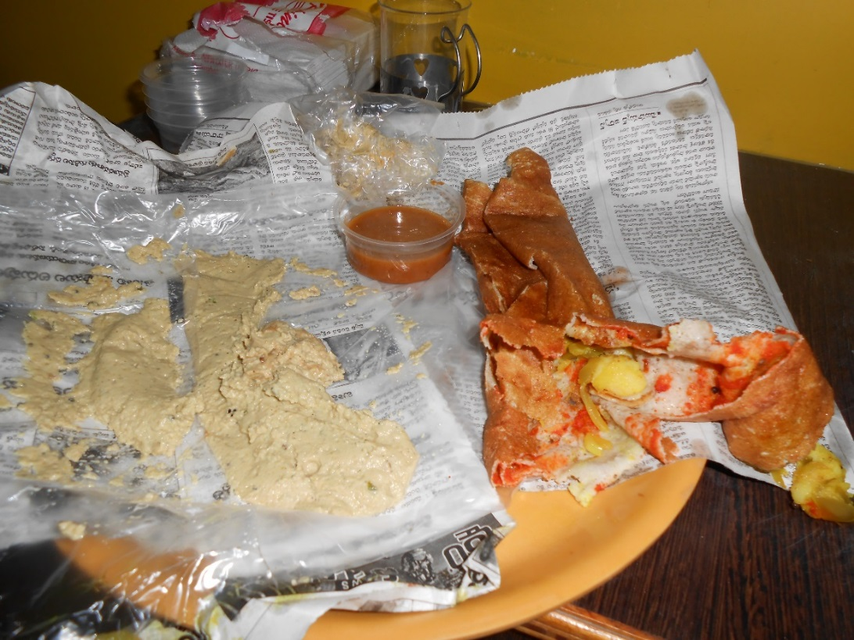
Dosa masala, vodas and chutney opened up

Slide 16
4 baptisms in creek & class manuals given away with bibles at Kothakota

Slide 17
Worship in Vijayawada – Guntur District with Joe’s wife Debbie Price

Slide 18
Dinner at Yesoratnam’s Home in Guntur and naming his granddaughter

Slide 19
Meetings and Classes at Madala Village

Slide 20
Lenin Babu baptized two men from Madala Village in concrete irrigation ditch

Slide 21
Children of Madala and me preaching

Slide 22
Small meeting house & Joe sitting with Lenin in the home of a member for tea break

Slide 23
Confessions of faith to be baptized in creek

Slide 25
Us with David Kumar & Farewell dinner from Rayudu’s home in Madala Village

Slide 26
Siri and Vynella hamming it up with Snoopys my wife sent them

Slide 27
Last place to go: Classes up north – Purnea, vast fields of tea bushes & Lord’s Day worship

Slide 28
Me standing in door of meeting house at Purnea – area where 7 orphan boys sleep

Slide 29
Water pump and family compound of preacher and others

Slide 30
Classes at Purnea and farewell supper in home of Molti Lal and family

Slide 31
We returned to Hyderabad one more time and ended up staying there for three full days. With three of the brethren working with us we got everything ready for our 2016 trip, which is not our normal practice; usually done after we return home. Next trip all our material will be translated into Hindi and Telugu so the students will have this as a resource.
--The work in India is expanding and maturing. Total of 13 baptisms happened before we returned home – 100 or so men received training and we preached in about a dozen different congregations.

