Slide 1
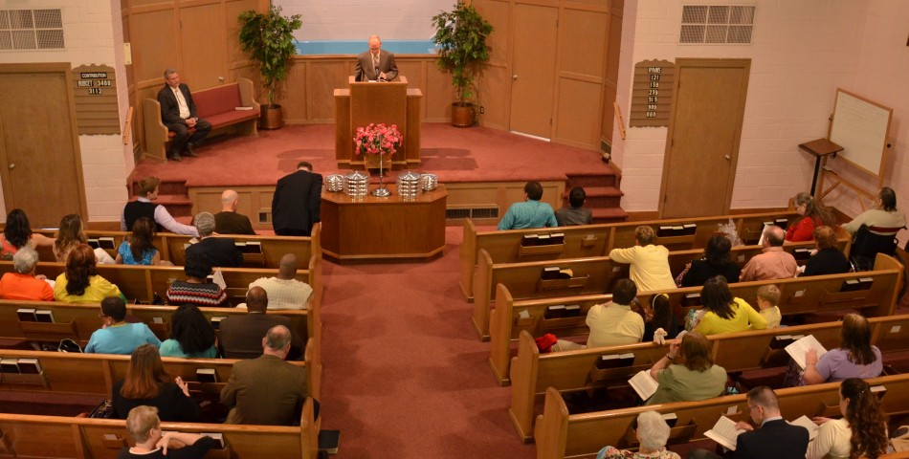
Gathering Together

Slide 2
Introduction
This coming Saturday September 19th through the following Thursday the 24th we will be gathering together to hear Jeremiah Cox preach the gospel to save the lost and strengthen the saints.
What is your attitude towards this opportunity to worship and study God’s word together?
It will be determined by what is important to you which will be shown by your actions.

Slide 3
Glad or Gloomy Attitude?
Will you say- I was glad when they said to me…
…let us watch the NFL or go out to eat after services?
…let us go shopping, fishing, hunting, or golfing?
…let us play baseball, soccer, or basketball?
…but instead of saying ”let us go to the house of the Lord”, (Ps. 122:1) you complain, “Do I have to?”
While these activities aren’t sinful, when we place them above worshiping God, we show what we think of Him.

Slide 4
Attentive or Apathetic?
When Ezra read from Moses’ law for several hours, all the people paid attention to God’s word (Neh. 8:3).
When Jesus spoke, the Scripture says that “all the people were hanging on to every word He said” (Luke 19:48).
Let us not be like the Hebrew brethren who were drifting away from the word (Heb. 2:1-3).
Let us give the more earnest heed to God’s word so that we won’t neglect this great salvation that we have in Christ Jesus.

Slide 5
Thankful or Too Tired?
Jesus cleansed ten lepers but only one thanked Him. (Luke 17:16-17)
If Jesus expected the other nine to be thankful for being healed of an incurable disease, how much more should we be thankful for Christ dying for our sins so that we can have eternal life like Paul did (1 Tim. 1:12ff)?
God rebuked the Jews who were presenting the lame and sick for the offering because worship had become tiresome for them (Mal. 1:13).
For those who would say “I’m too tired to come” after work, Jesus wasn’t too tired to die for you on the cross.

Slide 6
Humbled or Hardened?
A humble person is going to listen to God’s instruction and be a doer of the word, not just a hearer (Jas. 1:21-25).
He/she will be here to encourage the brethren towards love and good deeds but others may get upset at being told that they are not to forsake the assembling of ourselves together (Heb. 10:23-25).
Don’t harden your heart because there is no more sacrifice for sin if you do that (Heb. 3:8, 15; 10:26ff).
The humble encourage others so that others won’t harden their heart (Heb. 3:13).

Slide 7
Eager or make Excuses?
We need to be like the Bereans who “received the word with great eagerness examining the Scriptures daily to see whether these things were so” (Acts 17:11).
Jesus offers the universal invitation to come to the spiritual feast but many were making excuses about why they couldn’t make it (Luke 14:16ff).
If you allow your family, possessions, or desires to distract you from serving the Lord, you can’t be His disciple. (Luke 14:26-27, 33)
Let us all be eager to be here for the spiritual feast!

Slide 8
Resolved or Rejecting?
Barnabas was resolved to encourage the brethren at Antioch to remain true to the Lord (Acts 11:23).
Jeremiah Cox is a young man who has resolved to preach the gospel this coming week and the sermons he presents will be helpful to us so that we might “be strong in the Lord and in the strength of His might” (Eph. 6:10).
There are some who may not make it because they are shut in or sick, or a true emergency comes up, but let it not be because we reject the words of eternal life (Acts 13:46).

Slide 9
What is your Attitude to Gathering Together?
Is it Gladness or Gloomy?
Will you be Attentive or Apathetic toward the Scriptures?
Will you be Thankful to come or say that you’re Too Tired?
Will you Humble or Harden your heart?
Are you Eager to hear the truth or will you offer Excuses why you couldn’t come?
Are you Resolved to be true to the Lord or do you Reject it and judge yourself unworthy of eternal life?

