Slide 1
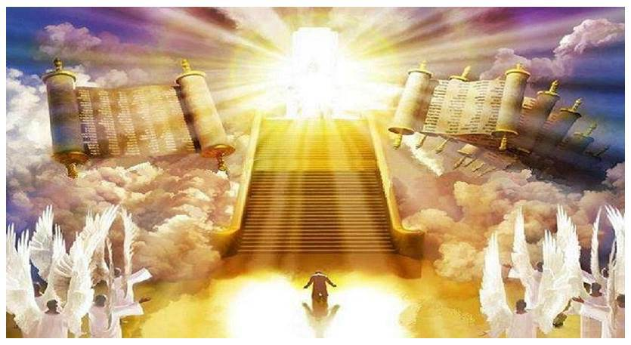
Judgment Day

Slide 2
Judgment Day is Certain after your Death (Heb. 9:27)
Universal- Everyone will be there (Rom. 14:10-12)
Deeds, Words, and Motives will be Judged
(Rev. 20:12-13; Matt. 12:36-37; 1 Cor. 4:5)
God’s Word is the Standard (Jn. 12:48-50; Rev. 20:12)
Messiah (Christ) is the Judge (John 5:27; 2 Cor. 5:10)
Execution of God’s Wrath on Ungodly (Ro. 2:5; Jude 15)
Never ending Joy for the Faithful (Ro. 2:7; 1 Pt. 1:3-9)
Torment for Selfish (Ro 2:8-9; Mt. 8:12; Mr. 9:43-48)

Slide 3
Conclusion
How do we know there is going to be a Judgment Day?
Because the Judge was resurrected (Acts 17:30-31)!
You are going to stand before the Lord and be judged by your words, deeds, & motives. We’re all guilty (Ro. 3:23).
The only way that you can be saved from God’s wrath is through Christ who died for you (Rom. 5:8-9).
Are you ready for the Judgment Day?
Obey the gospel or be restored- Don’t fall into the hands of God & suffer eternal torment (2 Th. 1:7-9; Rv. 20:14-15)

