Slide 1
Hymns for Worship at Woodmont
1- Holy, Holy, Holy
68- Lord, We Come before Thee Now
604- I’m the One
550- For Christ and the Church
263- Is Thy Heart Right with God?

Slide 2
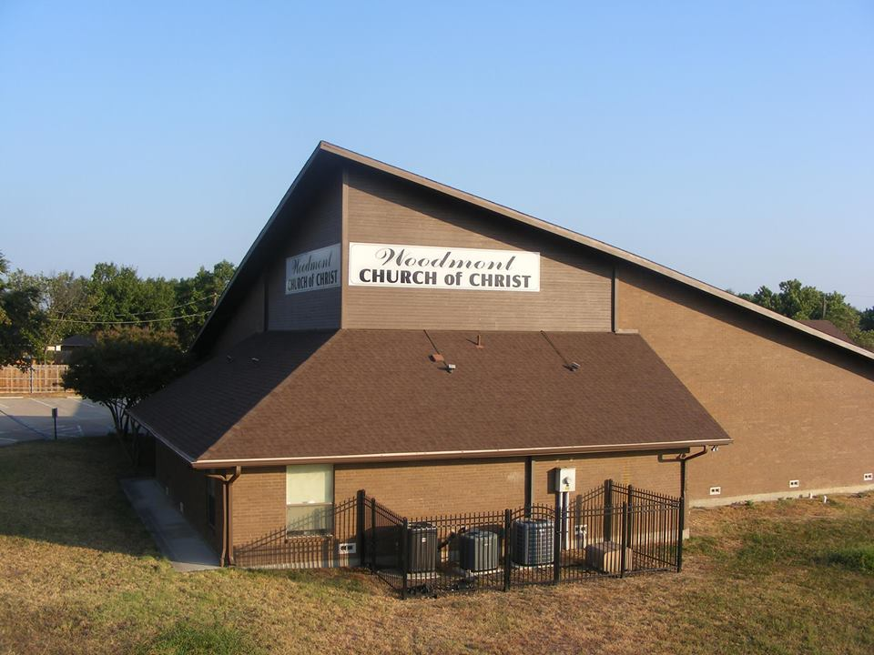

Slide 4
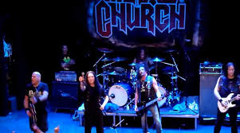

Slide 6
How does God Picture the Church?

Slide 7
The church of Christ or God
Built by Jesus Christ (Matt. 16:18; Acts 2:47)
Purchased with His blood (Acts 20:28)
It is His Bride [He Loved & Gave Himself up for her] (Eph. 5:25, 31-32)
He is head over all things to it (Eph. 1:22)
It is the body of Christ (Eph. 1:23)
He is the Savior of it (Eph. 5:24)

Slide 8
How “church” is Pictured in the NT
Universal [of Christ or God]- not the Pope
Only one (Matt. 16:18; Eph. 1:22-23; 4:4)
The Kingdom of Christ (Matt. 16:19)
The Temple of God (2 Cor. 6:16)
The Household of God (1 Tim. 3:15)
There was no headquarters or organization on earth over the universal church (Jerusalem, Rome, or anywhere else), Christ reigns in heaven as its head.

Slide 9
How “church” is Pictured in the NT
Local- [churches of Christ- plurality] (Rom. 16:16)
When the gospel was preached, those with good and honest hearts obeyed it. Local churches started in Jerusalem, Judea, Samaria, and all over the earth- (Matt. 28:18-20; Acts 1:8; 2:47; 8:5-12; 11:19-21)
Each local church was organized in order to worship God, preach the gospel, edify the saints, and when necessary help needy Christians (John 4:21-24; Acts 2:42, 45; 1 Th. 1:8; Eph. 4:11-16)

Slide 10
The Local Church is not…
…the building (we don’t go to “church”- we are the church who assemble to worship God- 1 Co. 14:23)
…a business (sell property, books, food, raffle tickets but members give as they prosper, 1 Cor. 16:1-2)
…a social center (parties, pot lucks, concert, recreation- the church has a spiritual mission)
…a sister congregation to other churches (the universal church is made of individual Christians, not churches)

Slide 11
Conclusion
Does your picture of the church match up with God’s?
Remember that the church belongs to Christ, not you!
God’s ways & thoughts are much higher than yours & we will be judged by His word (Is. 55:8-9; Jn. 12:48).
Jesus Christ died for your sins so that you wouldn’t have to go to torment (Rom. 5:8-9).

Slide 12
Conclusion
If you believe He is God’s Son (John 8:24),
repent of your sins (Luke 13:3),
confess Him before men (Matt. 10:32),
and are baptized (Mark 16:16)
the Lord has promised to forgive you of all of your sins and add you to His church, not a denomination (Acts 2:36-38, 47; 8:35-38).

Slide 13
Hymns for Worship at Woodmont
1- Holy, Holy, Holy
68- Lord, We Come before Thee Now
604- I’m the One
550- For Christ and the Church
263- Is Thy Heart Right with God?

