Slide 1
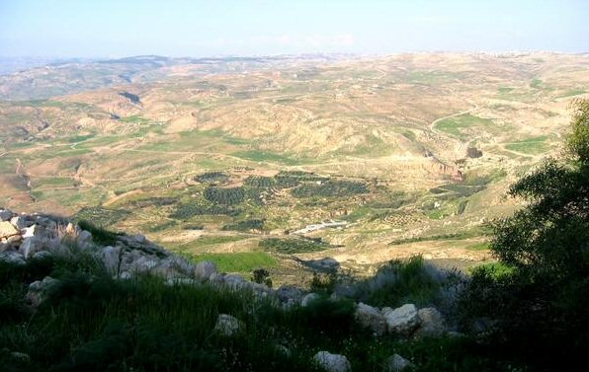
What You Can See from Pisgah

Slide 2
What You Can See from Pisgah (OT)
God’s Promises Fulfilled in the Land of Israel
(Deut. 34:4; Josh. 21:43)
God’s Provisions if you Obey [Physical Blessings]
(Deut. 28:1-6; Josh. 24:13)
God’s Power to Destroy Physical Enemy
(Deut. 7:1; 28:7; Josh. 6:20)
God’s Punishment for Disobedience [Physical Curses]
(Deut. 31:29; 2 Kings 17:7, 19)
God’s Propitiation for Sins of the People
(Deut. 32:43; Lev. 16:16)

Slide 3
What You Can See from Pisgah (NT)
God’s Promises Fulfilled in Christ [Be Diligent-Heavenly Land]
(Heb. 6:13ff; 4:8-11; 11:13-16)
God’s Provisions if you Obey [Seek Him 1st-Spiritual Blessings]
(Heb. 5:8-9; Eph. 1:3ff; Matt. 6:33-34)
God’s Power to Destroy Spiritual Enemy [Cast Error Down]
(Heb. 2:14-15; 13:5-6; 1 Cor. 10:3-6)
God’s Punishment for Disobedience [Hell]
(2 Thess. 1:7-8)
God’s Propitiation for Sins through Blood of Christ [Heaven]
(Rom. 3:23-25; 5:21ff)

