Slide 1
Hymns for Worship at Woodmont
2s- Higher Ground
103s- I Will Give Him All My Praise
102s- And Can it Be
331- Kneel at the Cross
347- Who Will Follow Jesus?

Slide 2
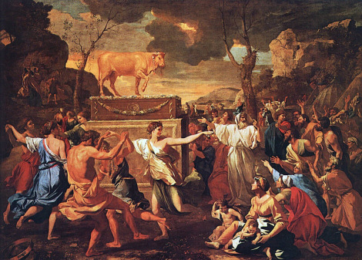
Peer Pressure
to Conform
(Ex. 32)

Slide 3
When Pressured to Conform Remember…
…to stand up for the truth of God’s word- don’t compromise with sin & error
(Ex. 32:1-8, 19-24; Gal. 1:6-10; 2:11-14; 2 Tim. 4:2-5)
…that God will punish evildoers
(Ex. 32:25-28; Heb. 2:1-3; 10:26-31)
…that Christ intercedes for you
(Ex. 32:29-35; Isa. 53:12; Lk. 23:34; Heb. 7:23-25; 4:14ff)

Slide 4
Hymns for Worship at Woodmont
2s- Higher Ground
103s- I Will Give Him All My Praise
102s- And Can it Be
331- Kneel at the Cross
347- Who Will Follow Jesus?

