Slide 1
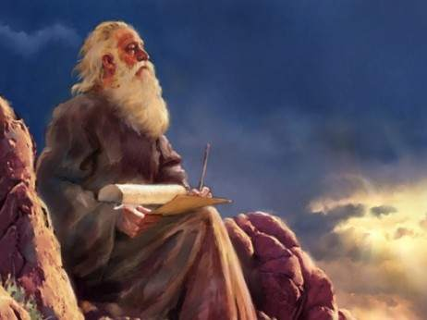
A Prophet like Moses
(Deut. 18:15-22)

Slide 2
God Would Raise up a Prophet like Moses (Deut. 18:15-19)
This prophet would speak all God commanded (18:18)
You must hear so as to understand and obey him (18:15)
Those who don’t heed him will be held accountable (18:19)
No prophet has risen in Israel like Moses since that time whom the Lord knew face to face (34:10-12)
Moses’ law was read every Sabbath and the Jews would be looking for that Prophet (Acts 15:21)

Slide 3
God Would Raise up a Prophet like Moses (Deut. 18:15-19)
This prophet would speak all God commanded (18:18)
You must hear so as to understand and obey him (18:15)
Those who don’t heed him will be held accountable (18:19)
No prophet has risen in Israel like Moses since that time whom the Lord knew face to face (34:10-12)
Moses’ law was read every Sabbath and the Jews would be looking for that Prophet (Acts 15:21)

Slide 4
What Jews said about “the Prophet” & Jesus
John the Baptist said no when he was asked if he was “the prophet” & pointed to one greater than him (John 1:21-32).
The people were saying about Jesus, “John the Baptist, Elijah, Jeremiah, or one of the prophets” (Matt. 16:14)
The Samaritan woman perceived he was a Prophet (Jn 4:19)
After Jesus fed the 5,000, the people said, “this truly is ‘the prophet’ who has come into the world” (John 6:14).
Many people said that he was ‘the prophet’ after hearing him say to come and drink of him (John 7:37)

Slide 5
How Jesus was like the Prophet Moses
Lawgiver (John 1:17; Matt. 28:20; Gal. 6:2)
Mediator (Ex. 20:18-21; 1 Tim. 2:5; Heb. 9:15-17)
Covenant Maker (Heb. 9:18ff)
Intercessor (Ex. 32:30-32; Luke 23:34; Heb. 7:25)
Shepherd (Acts 7:29-30; John 10:11)
Deliverer (Acts 7:35; Heb. 2:14-15)
Judge (Ex. 18:13; John 5:22-23)

Slide 6
Jesus is “The Prophet” Who Was More Glorious than Moses (Heb. 3:3-6)
Jesus said, “if you believed Moses, you would believe Me for He wrote about Me” (John 5:46)
When Peter desired to make a tabernacle for Moses, Elijah, and Jesus, a voice out of heaven said, “this is My beloved Son, listen to Him” (Matt. 17:5)
Jesus said that all things written about Him in the Law of Moses were fulfilled (Luke 24:44ff).
The apostle Peter and Stephen quoted Deut. 18:18 and said “the Prophet” was Jesus (Acts 3:22-23; 7:37, 52-55).

Slide 7
Jesus is the Last & Final Prophet for God
In these last days since the 1st century, God speaks only through His Son (Heb. 1:1-2).
God gave judgment to His Son, and His words will judge us in the last day (John 5:22-23; 12:48-50).
Latter Day Revelations are false, and those who teach contrary to the doctrine are to be accursed (Gal. 1:8-9)
The Pope, Mohammed, Buddha, Charles Taze Russell, Joseph Smith, and others are false prophets- Don’t listen or be deceived by them!

