Slide 1
Hymns for Worship at Woodmont
11s- I Will Wake the Dawn with Praises
115s- Healing in its Wings
90s- Come Share the Lord
4s- The Battle Belongs to the Lord
347- Who Will Follow Jesus?
Notes:
God can use the most feeble, weak, poor, young, uneducated, handicapped, and unlikely people to accomplish His will. Gideon was trying to explain to God why he wasn’t the man to deliver Israel from the Midianites. He looked at his family as being least in Manasseh and he was the youngest in his family. God told Gideon that he had too many people 32,000 vs. 135,000. Those who were afraid which left about 1/3 down to 10,000. Then God gave a lapping water test. Only 300 passed muster and they were going to be the ones to shame the many strong and mighty warriors of Midian. Those old enough to remember all the baptisms, crowds at gospel meetings going on 2 weeks or more. No one is interested and so I’m discouraged. If you are discouraged because you feel that you are weak, uneducated, too young or too old, failure, no good, trash, nothing, useless remember this passage in 1 Cor. 1. God can’t use the strong, mighty, talented, prideful, arrogant people who trust in their own strength. The gospel seems foolish to the Jews and Gentiles. Many put too much trust in scientists, pyschologists, & professors today PhD which lead people astray. They ridicule the creation account, intelligent design, young earth, miracles which confirm the word, especially the gospel to save their soul as being out of step with modern America, we are too sophisticated. But the many will be confounded on the Judgment Day when they have to bow the knee to Jesus and be told to depart from Him into an eternal fire, prepared for the devil and his angels.

Slide 2
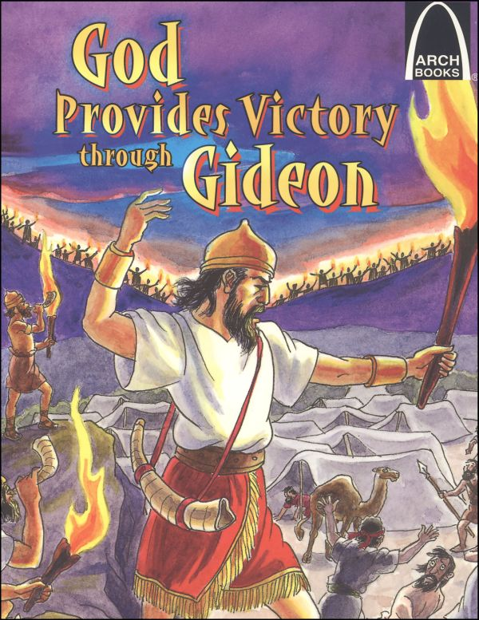

Slide 3
God Provides Victory through Gideon (Judges 6-8)
Notes:
God can use the most feeble, weak, poor, young, uneducated, handicapped, and unlikely people to accomplish His will. Gideon was trying to explain to God why he wasn’t the man to deliver Israel from the Midianites. He looked at his family as being least in Manasseh and he was the youngest in his family. God told Gideon that he had too many people 32,000 vs. 135,000. Those who were afraid which left about 1/3 down to 10,000. Then God gave a lapping water test. Only 300 passed muster and they were going to be the ones to shame the many strong and mighty warriors of Midian. Those old enough to remember all the baptisms, crowds at gospel meetings going on 2 weeks or more. No one is interested and so I’m discouraged. If you are discouraged because you feel that you are weak, uneducated, too young or too old, failure, no good, trash, nothing, useless remember this passage in 1 Cor. 1. God can’t use the strong, mighty, talented, prideful, arrogant people who trust in their own strength. The gospel seems foolish to the Jews and Gentiles. Many put too much trust in scientists, pyschologists, & professors today PhD which lead people astray. They ridicule the creation account, intelligent design, young earth, miracles which confirm the word, especially the gospel to save their soul as being out of step with modern America, we are too sophisticated. But the many will be confounded on the Judgment Day when they have to bow the knee to Jesus and be told to depart from Him into an eternal fire, prepared for the devil and his angels.

Slide 4
God Provides Victory through Gideon (Judges 6-8)
God Uses the Few, Weak, & Humble to Shame the Many, Strong, and Wise (6:15; 7:2-7; 1 Co. 1:21ff; Mt. 7:13-14)
Notes:
God can use the most feeble, weak, poor, young, uneducated, handicapped, and unlikely people to accomplish His will. Gideon was trying to explain to God why he wasn’t the man to deliver Israel from the Midianites. He looked at his family as being least in Manasseh and he was the youngest in his family. God told Gideon that he had too many people 32,000 vs. 135,000. Those who were afraid which left about 1/3 down to 10,000. Then God gave a lapping water test. Only 300 passed muster and they were going to be the ones to shame the many strong and mighty warriors of Midian. Those old enough to remember all the baptisms, crowds at gospel meetings going on 2 weeks or more. No one is interested and so I’m discouraged. If you are discouraged because you feel that you are weak, uneducated, too young or too old, failure, no good, trash, nothing, useless remember this passage in 1 Cor. 1. God can’t use the strong, mighty, talented, prideful, arrogant people who trust in their own strength. The gospel seems foolish to the Jews and Gentiles. Many put too much trust in scientists, pyschologists, & professors today PhD which lead people astray. They ridicule the creation account, intelligent design, young earth, miracles which confirm the word, especially the gospel to save their soul as being out of step with modern America, we are too sophisticated. But the many will be confounded on the Judgment Day when they have to bow the knee to Jesus and be told to depart from Him into an eternal fire, prepared for the devil and his angels. Tracy Shell MI, bedridden but great love for the truth, weak, feeble. Computer boldly preach the word to Baptist preachers.

Slide 5
God Provides Victory through Gideon (Judges 6-8)
God Uses the Few, Weak, & Humble to Shame the Many, Strong, and Wise (6:15; 7:2-7; 1 Co. 1:21ff; Mt. 7:13-14)
God Encourages the Persecuted & Fearful to be Strong in Him (6:25-32; 7:9-15; Matt. 28:20; 2 Tim. 1:7-12; Eph. 6:10)
Notes:
Do you sometimes get overwhelmed by the multitude of people who are in sin and headed for hell and become afraid of doing God’s will (telling others about Jesus) because you will suffer insults, loss of friendships, or family. Remember Gideon. He was told to tear down the altar of Baal that his father had set up. You might need to tell your children, parents or grandparents that they are worshiping with a denomination that isn’t pleasing God or your friends that they are living in sin whether because of drinking, dancing, fornicating, or adulterous marriage. The Lord promised to be with Gideon and yes endured through death threats from the people but he endured. God told him if he was afraid of going down to fight go down to the camp and hear the dream and interpretation. Then he was willing to go down. God isn’t going to speak through a dream but He tells you to realize that God is with you when you do what is right. God has not given us a spirit of fear, but of power, love, and of a sound mind.

Slide 6
God Provides Victory through Gideon (Judges 6-8)
God’s Weapons are Mighty Enough to Destroy the Opposition and Save the Obedient (7:16-22; 8:10; 2 Cor. 10:3-6; Eph. 6:17; Heb. 4:12-13; Acts 2:36-41)
Notes:
What were their weapons? Trumpets, empty pitchers with torches inside them. This is crazy, foolish, and suicidal. But when they blew the trumpets, broke the pitchers, held the torches in their left hands, and the trumpets in the right and cried out, “A sword for the Lord and for Gideon” (7:20) the Lord set the sword of one against the other and 120,000 Midianties died (8:10) and they eventually get the other 15,000 later. While men of Ephraim did help to kill the leaders of Moab, Oreb but the men of Succoth and Penuel refused to help their exhausted souls. The weapons of our warfare are not fleshly, but are divinely powerful for the destruction of fortresses so that men might be obedient to Christ. We are discouraged when we see those who had been faithful brethren in the past, refuse to mark and avoid false teachers (Homer Hailey, Ed Harrell, Shane Scott, Mike Willis, etc.) as they lay down their weapons and are as silent as the tomb as souls are being slaughtered by the errors of men. We use the sword of the Spirit to defend the truth against error but also to save souls as God’s word penetrates good and honest hearts when we preach it like Peter did on Pentecost. We can’t save ourselves, we are sinners in need of God’s grace, mercy, and forgiveness of sins!

Slide 7
God Provides Victory through Gideon (Judges 6-8)
God’s Weapons are Mighty Enough to Destroy the Opposition and Save the Obedient (7:16-22; 8:10; 2 Cor. 10:3-6; Eph. 6:17; Heb. 4:12-13; Acts 2:36-41)
God is to Rule over His People- Exalt His Name, not Man (8:22-23; Ps. 111:9; 1 Cor. 1:10ff; 1 Pet. 4:11; Mt. 28:18)
Notes:
Great victory God gave Israel over Miditanites. Do they give glory to God? No, they wanted Gideon to be king. Too often men want to give credit to men who don’t deserve it, for they were just weak servants who did the Lord’s will. Men want to call spiritual leaders Reverend when only God is Reverend. Corinthians wanted to praise Paul, Peter, and Apollos and had forgotten that Christ was crucified for them and they were baptized in the name of Christ. Exalt the name of Christ when someone is baptized, restored, or recommits their life to the Lord don’t take credit for yourself. Speak the words of God not so that you might receive the glory, honor, and praise (your flesh wants it) but Christ. To God be the glory! God doesn’t want our faith to rest in the wisdom of men but in the power of God (1 Cor. 2:4-5). I planted, Apollos watered, God caused the Corinth (1 Cor. 4:6). Power is of God, not ourselves (2 Cor. 4:7). Power in the message of Christ DBR. (Eph. 3:20-21).

Slide 8
Hymns for Worship at Woodmont
11s- I Will Wake the Dawn with Praises
115s- Healing in its Wings
90s- Come Share the Lord
4s- The Battle Belongs to the Lord
347- Who Will Follow Jesus?
Notes:
God can use the most feeble, weak, poor, young, uneducated, handicapped, and unlikely people to accomplish His will. Gideon was trying to explain to God why he wasn’t the man to deliver Israel from the Midianites. He looked at his family as being least in Manasseh and he was the youngest in his family. God told Gideon that he had too many people 32,000 vs. 135,000. Those who were afraid which left about 1/3 down to 10,000. Then God gave a lapping water test. Only 300 passed muster and they were going to be the ones to shame the many strong and mighty warriors of Midian. Those old enough to remember all the baptisms, crowds at gospel meetings going on 2 weeks or more. No one is interested and so I’m discouraged. If you are discouraged because you feel that you are weak, uneducated, too young or too old, failure, no good, trash, nothing, useless remember this passage in 1 Cor. 1. God can’t use the strong, mighty, talented, prideful, arrogant people who trust in their own strength. The gospel seems foolish to the Jews and Gentiles. Many put too much trust in scientists, pyschologists, & professors today PhD which lead people astray. They ridicule the creation account, intelligent design, young earth, miracles which confirm the word, especially the gospel to save their soul as being out of step with modern America, we are too sophisticated. But the many will be confounded on the Judgment Day when they have to bow the knee to Jesus and be told to depart from Him into an eternal fire, prepared for the devil and his angels.

