Slide 1
Hymns for Worship at Woodmont
2s- Higher Ground
56s- Where Could I Go?
112s- We are One
480- Dare to Stand like Joshua
347- Who Will Follow Jesus?
66- God Bless You Go with God
Notes:
Moses died and Joshua took the Israelites and they conquered the promised land of Canaan. They are rejoicing in their victory in overcoming the giants in the land, fortified cities, and now settling into their land. They needed to be reminded of where they had come from lest they be prideful, complacent, and stubborn. Joshua speaks God’s word to the people on his dying day at Shechem which is significant. There is a connection between their experience and ours as Christians. Let us learn, understand, and apply the Scriptures to our lives

Slide 2
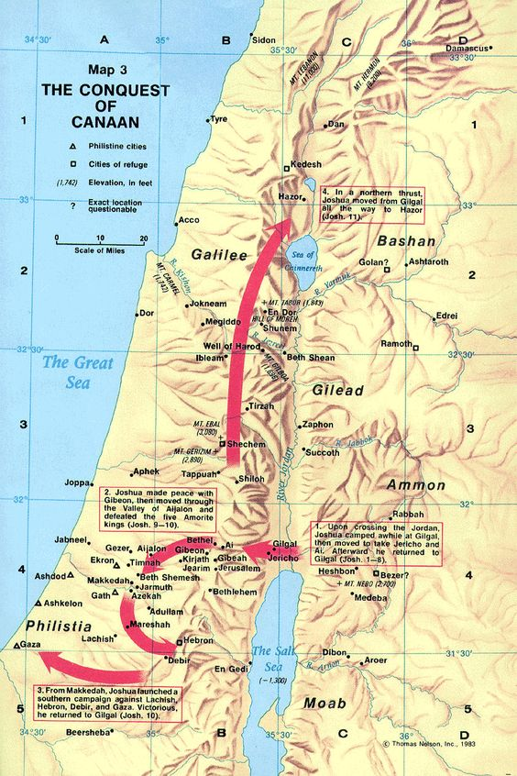
Joshua 24
God’s Call to Remembrance at Shechem
Notes:
Moses died and Joshua took the Israelites and they conquered the promised land of Canaan. They are rejoicing in their victory in overcoming the giants in the land, fortified cities, and now settling into their land. They needed to be reminded of where they had come from lest they be prideful, complacent, and stubborn. Joshua speaks God’s word to the people on his dying day at Shechem which is significant. There is a connection between their experience and ours as Christians. Let us learn, understand, and apply the Scriptures to our lives

Slide 3
Connection: Israelites & Us (Joshua 24)
Sinful Past (v. 1-2; 8:30-35; Gen. 12:1-7; Eph. 2:1-3)
Notes:
The Israelites came from a sinful past where Abraham’s family had been idolaters beyond the Euphrates River. God called Abram from idolatry to the promised land & he came to Shechem (Gen. 12:7).
Joshua read to them from the Law of Moses about their fathers failing to go into the promised land at Shechem in the renewal of the covenant (Num. 14:22-23; Josh. 8:30-35; Deut. 1:39).
We need to remember that we were dead in our sins in the past when we were living in disobedience (Eph. 2:1-3).

Slide 4
Connection: Israelites & Us (Joshua 24)
Sinful Past (v. 1-2; 8:30-35; Gen. 12:1-7; Eph. 2:1-3)
Saved by Grace through Faith/Blessed by God (v. 3-13; 6:2; Heb. 11:30; Deut. 9:4-5; Eph. 2:4-9; 1:3ff)
Notes:
God gave them the land into their hand (24:8, 11; 6:2) They didn’t earn it by their righteousness (Deut. 9:4-6). By God’s grace, mercy, and love He made us alive together with Christ by His grace (Eph. 2:4-8). Salvation is the gift of God and it was not by meritorious works that we are saved and if it was we would boast. (Eph. 2:9) Just as they rejoiced in their salvation from their enemies, we can rejoice in our salvation after we were baptized into Christ for the remission of our sins and are enjoying all the spiritual blessings in Christ. Buried that old man of sin.

Slide 5
Connection: Israelites & Us (Joshua 24)
Sinful Past (v. 1-2; 8:30-35; Gen. 12:1-7; Eph. 2:1-3)
Saved by Grace through Faith/Blessed by God (v. 3-13; 6:2; Heb. 11:30; Deut. 9:4-5; Eph. 2:4-9; 1:3ff)
Submit & Serve the Lord (v. 14a; Eph. 2:10; Rom. 6:16)
Notes:
Because of all that God has done for them, Joshua challenged them to submit and serve the Lord in sincerity and truth. We have been created in Christ Jesus for good works which God prepared beforehand that we should walk in them. We are the servants of whom we obey, whether of sin resulting in death or of obedience resulting in righteousness. Paul was thankful that the Romans brethren had chosen to submit and serve the Lord.

Slide 6
Connection: Israelites & Us (Joshua 24)
Sinful Past (v. 1-2; 8:30-35; Gen. 12:1-7; Eph. 2:1-3)
Saved by Grace through Faith/Blessed by God (v. 3-13; 6:2; Heb. 11:30; Deut. 9:4-5; Eph. 2:4-9; 1:3ff)
Submit & Serve the Lord (v. 14a; Eph. 2:10; Rom. 6:16)
Separate from Idols/World (v. 14b, Ge. 35:4; Eph. 4:17-24)
Notes:
It’s easy to say you will serve the Lord and they promise that they will serve the Lord, but there is a problem. You can’t serve the Lord if you are violating the 1st commandment of the Lord- idolatry. They had to separate from their idols. Again at Shechem which is the scene of when Jacob is coming back to his homeland after being in Laban’s home for 20 years. His wife Rachel and household are holding fast to their idols and Jacob tells them to get rid of them. Rachel stole the idol from her father and hid it when Laban came to look for it on the penalty of death. God isn’t going to bless those who are idolatrous and wasn’t going to bless the Israelites in the land if they hold fast to their idols. They gave to Jacob all the foreign gods and he hid them on the oak near Shechem. We must separate ourselves from our idols/worldly things or God won’t bless us (bad company, friends, family, unbelievers, sinful Gentile lifestyle, etc.)

Slide 7
Connection: Israelites & Us (Joshua 24)
Sinful Past (v. 1-2; 8:30-35; Gen. 12:1-7; Eph. 2:1-3)
Saved by Grace through Faith/Blessed by God (v. 3-13; 6:2; Heb. 11:30; Deut. 9:4-5; Eph. 2:4-9; 1:3ff)
Submit & Serve the Lord (v. 14a; Eph. 2:10; Rom. 6:16)
Separate from Idols/World (v. 14b, Ge. 35:4; Eph. 4:17-24)
Speedy Response Required (v. 15; 2 Co. 6:2; Heb. 3:7ff)
Notes:
This is the last day of Joshua’s life if I’m understanding the record from Joshua 23. You need to make a choice today because tomorrow may be too late and you might harden your heart. If you think its evil to serve the Lord you can choose to serve the gods whom you defeated in getting to the promised land. Joshua says that no matter what you do me and my house are going to serve the Lord. Today is the day of salvation, tomorrow you might harden your heart. Sinner harden not your heart be saved O tonight. Saul didn’t wait when he was told to be baptized. If you think it’s evil or too hard to serve the Lord, you can go back to the church or denomination of your choice and suffer the eternal consequences for there is no more sacrifice for sins (Heb. 10:26ff).

Slide 8
Connection: Israelites & Us (Joshua 24)
Sinful Past (v. 1-2; 8:30-35; Gen. 12:1-7; Eph. 2:1-3)
Saved by Grace through Faith/Blessed by God (v. 3-13; 6:2; Heb. 11:30; Deut. 9:4-5; Eph. 2:4-9; 1:3ff)
Submit & Serve the Lord (v. 14a; Eph. 2:10; Rom. 6:16)
Separate from Idols/World (v. 14b, Ge. 35:4; Eph. 4:17-24)
Speedy Response Required (v. 15; 2 Co. 6:2; Heb. 3:7ff)
Suffer if You Don’t Obey (v. 20, 31; John 3:36)
Notes:
After they said they would serve the Lord a couple of times he told them if you forsake the Lord and serve foreign gods He will do you harm and consume you after He has done good to you. This time they said, “we will serve the Lord our God and obey His voice” and they did all the days that Joshua lived and the elders who survived him. John 3:16 wonderful passage but most people don’t know John 3:36, He who believes in the Son has eternal life; but he who does not obey the Son will not see life, but the wrath of God abides on him.” Suffering will never end while the persecution you endure is only temporary. Remember when you were dead in your sins, don’t go back to that sinful lifestyle, put it away by repenting and confessing your sin, and serve the Lord, do it today!

Slide 9
Hymns for Worship at Woodmont
2s- Higher Ground
56s- Where Could I Go?
112s- We are One
480- Dare to Stand like Joshua
347- Who Will Follow Jesus?
66- God Bless You Go with God

