Slide 1
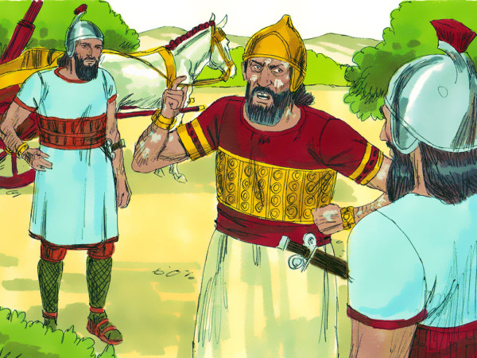
Naaman the Leper

Slide 2
Naaman the Leper (2 Kgs 5) | Lessons for Us Today
Great man but had incurable disease (v. 1) | We’re all guilty of committing sin (Romans 3:23)
God’s Prophet has the only cure (v. 3) | Jesus is the Great Physician (1 Peter 2:24)
God loves even His enemies (Luke 4:25-29) | Jesus loved His enemies & died for all (Heb. 2:9)
Servants help him to seek the cure and receive the message [Israelite girl, Elisha’s servant, Naaman’s servants](v. 2, 10, 13) | Tell others about Jesus [no matter how young or old] (Matt. 19:14; 2 Tim. 2:24-26)

Slide 3
Naaman the Leper (2 Kgs 5) | Lesson for Us Today
The message is simple to obey- dip yourself in the Jordan 7X and you will be cleansed (v. 10) | Obey Jesus including being baptized in water (Heb. 5:9; Acts 8:38; 1 Pt. 3:21)
He was furious [expected something amazing and a better place to wash] (v. 11-12) | God’s ways and thoughts are much higher than man’s (Isaiah 55:8-9)
When he obeyed, he was cleansed (v. 14) | When we obey, we are forgiven of all our sins (Rom. 6:16-18; 1 Cor. 6:9-11)

