Slide 1
Hymns for Worship at Woodmont
50s- ‘Till the Storm Passes By
689- Master the Tempest is Raging
62- Did You Think to Pray?
568- A Soul Winner for Jesus
293- Come to Jesus
87- Be Still My Soul

Slide 2
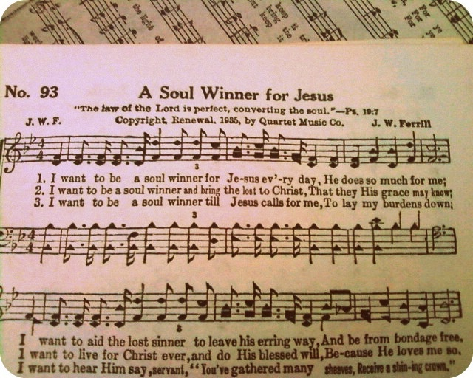

Slide 3
A Soul Winner for Jesus by J. W. Ferrill
I want to be a soul winner (Pr. 11:30)
For Jesus every day, (Luke 19:10; Acts 5:40-42)
He does so much for me; (1 Tim. 1:12-16)
I want to aid the lost sinner (Luke 5:29-32; 15:1ff)
To leave his erring way, (James 5:19-20)
And be from bondage free. (John 8:31-32)

Slide 4
A Soul Winner for Jesus by J. W. Ferrill
I want to be a soul winner (1 Cor. 9:19-22)
And bring the lost to Christ, (John 1:35-42)
That they His grace may know; (1 Cor. 15:9-11)
I want to live for Christ ever, (Gal. 2:20)
And do His blessèd will, (Matt. 28:19-20)
Because He loves me so. (2 Cor. 5:11-15)

Slide 5
A Soul Winner for Jesus by J. W. Ferrill
I want to be a soul winner (Acts 16:9-15)
Till Jesus calls for me, (1 Thess. 5:23-24)
To lay my burdens down, (Rev. 14:13)
I want to hear Him say, Servant, (Matt. 25:21, 23)
“You’ve gathered many sheaves, (Jn. 4:35-41)
Receive a shining crown.” (Rev. 2:10)

Slide 6
Hymns for Worship at Woodmont
50s- ‘Till the Storm Passes By
689- Master the Tempest is Raging
62- Did You Think to Pray?
568- A Soul Winner for Jesus
293- Come to Jesus
87- Be Still My Soul

