Slide 1
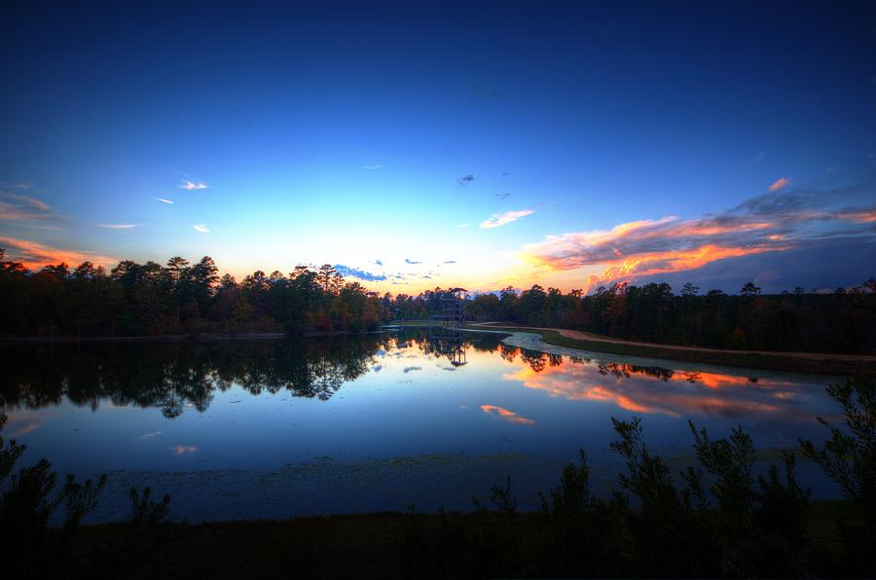
Be Still My Soul by Katharina A. von Schlegel Psalm 46:10-11
Notes:
1697- 1768 pub.1752 100 years after Martin Luther lived, Europe bad shape. racked by 30 years war (Catholics & Protestants. About 25% Germans died. Lutheran church collapsed into ritualism & dead orthodoxy. People quit going to services. Pietist movement started- music, holiness, and missionary zeal. In time of turmoil & discouragement she noticed Psalm 46:10 which says “Be Still and Know that I Am God”. Whatever you’re suffering, trial you’re enduring through, you can find comfort, strength, & peace in the words of this hymn.

Slide 2
Be Still My Soul by Katharina A. von Schlegel
The Lord Will Help You Endure the Cross You’re Carrying
Be still, my soul: the Lord is on thy side (Ps. 118:5-8; Heb. 13:5-6)
Bear patiently the cross of grief or pain. (Luke 9:23; 1 Pet. 2:18ff)
Leave to thy God to order and provide; (Ro. 12:18-19; 1 Cor. 10:13)
In every change, He faithful will remain. (Ps. 46:1-3; 1 Pt. 4:19)
Be still, my soul: thy best, thy heav’nly Friend (John 15:12-15)
Through thorny ways leads to a joyful end. (2 Co. 12:9; Heb. 12:11)
Notes:
Since the Lord is with me, I don’t need to fear- He promised to never leave me! Lord is not your enemy, He’s your best friend! Pain- no answers (tests), Cancer- come back? Dehabilitating disease, Concussion. Lost loved ones or brethren to tragedy. God help bear it! Don’t seek revenge on your enemy (the devil) whatever misery he’s planning for you, leave it to God who is faithful to provide for your needs & help you through it. Love bears all things- let Christ take the load off so that you don’t worry but instead have peace (1 Cor. 13:4; Mt. 11:28-30). Whether there are fires, hurricanes, earthquakes, murder, mayhem, rape, etc. Whatever change & problems are going on in your life, God will be faithful so entrust your souls to Him (1 Pet. 4:19). Jesus said to His disciples, you are my friends if you do what I command (John 15:13). Jesus should be your best friend who will be there everyday of your life on your journey through the thorns that Satan sends your way, remember that God’s grace is sufficient or enough for you to endure through whatever you face for it leads to eternal life. Your best friend in the world died for you & wants you go to heaven with Him for all eternity! Is there any greater love than that!

Slide 3
Be Still My Soul by Katharina A. von Schlegel
God is in Control of the Future, Be Confident
Be still, my soul: thy God doth undertake (Isa. 46:9-10)
To guide the future, as He has the past. (Rv. 1:17; 22:13; Jn. 14:1ff)
Thy hope, thy confidence let nothing shake; (Rom. 8:25; 1 Jn. 4:17)
All now mysterious shall be bright at last. (Rom. 16:25; Rev. 21:23)
Be still, my soul: the waves and winds still know (Mark 4:39-41)
His voice Who ruled them while He dwelt below. (Phil. 4:6-7)
Notes:
We don’t know which way to go or how to direct our steps (Jer. 10:23). We need someone to guide us who knows the way, Christ has been there from the beginning of time with His Father & will be there until the end. We don’t know the future, but we know who holds the future in his hands & knows what will happen. Don’t let anything shake your confidence in the Lord. It’s all mysterious to us now, but God’s plan has been revealed & we know how it’s going to end- Christ & His saints will be victorious over the devil & his minions who will be thrown in the lake of fire. Jesus can still the storm as He did in the 1st century, in the storms of life, we can still have the peace that passes all understanding, as we pray, meditate, & practice His will.

Slide 4
Be Still My Soul by Katharina A. von Schlegel
Suffering is Brief but Joy in Heaven lasts Forever
Be still, my soul: the hour is hast’ning on (Jas. 4:14; Ps. 90:10-12)
When we shall be forever with the Lord. (Ps. 23:6; 16:11)
When disappointment, grief, and fear are gone, (Ro. 5:3-5)
Sorrow forgot, love’s purest joys restored. (Jn. 16:20ff; Ps. 51:12)
Be still, my soul: when change and tears are past (Rev. 21:4)
All safe & blessed we shall meet at last. (2 Ti. 4:18; 1 Th. 4:13-18)
Notes:
The days are passing very quickly. It is now October 15, 2017. Hard to believe how fast this year has passed by. Author total confidence we will always be with the Lord! In this life we are disappointed many times when things don’t turn out the way we want. But many times we ought to be thankful that we didn’t become famous (actor, athlete, rock star), or popular (ladies man, prettiest girl, tell the funniest jokes, have the most friends) or are the envy of others (car, house, phone, etc.)

