Slide 1
Hymns for Worship at Woodmont
9- Our God He is Alive
382- In Heavenly Love Abiding
167- We Saw Thee Not
500- Give Me the Bible
297- Prepare to Meet Thy God
212- Sweet By and By
Notes:
Daily Bible Reading Program- Jeremiah at this time. Reading Jeremiah not in chronological order, DBR good job putting in order, skips around. Two weeks ago God tells Jeremiah not to pray for this people & that Jerusalem would be destroyed. All the other prophets taught peace, people believed it. Can this book really be inspired by God? Inspiration of the Scriptures is very important and there is a pattern to it being preached, written down, and read by all. But King Jehoiachim doesn’t like it and is going to cut it out when he hears God’s word read from a scroll. Are you going to listen to false teachers who cut out the Bible or demand that the gospel preacher cut it straight knowing the Scriptures and not be ashamed of it?

Slide 2
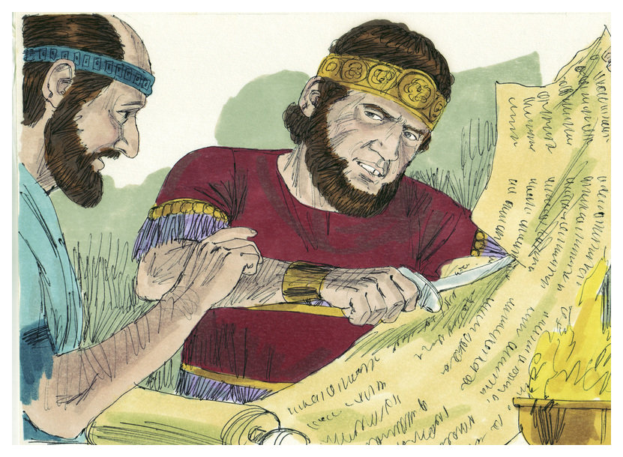
Cutting it Out (Jer. 36:23) or Straight (2 Tim. 2:15)

Slide 3
God’s Word is Inspired & Infallible (2 Ti. 3:16)
God’s Word | Jeremiah
Notes:
God’s Word is inspired & infallible- Quote 2 Tim. 3:16-17 Jeremiah is going to quote from what God said at least 250X from what I could count- “thus says the Lord” “the Lord said to me” “the Lord declares” Old time gospel preachers would say this in gospel meetings. But not much of the word is being preached today (just a few Scriptures, jokes to make you laught, stories to make you cry, no specific application, people leave feeling good w/o being convicted of their sin & repenting of their evil ways.

Slide 4
God’s Word is Inspired & Infallible (2 Ti. 3:16)
God’s Word | Jeremiah
Revealed | 26:1; 1:9
Notes:
God’s word was not put in Jeremiah’s mind but in his mouth. Verbal plenary inspiration. Every word is inspired by God thus it is infallible & inerrant. Authoritative! Read Jeremiah 26:1-19

Slide 5
God’s Word is Inspired & Infallible (2 Ti. 3:16)
God’s Word | Jeremiah
Revealed | 26:1; 1:9
To be Obeyed | 26:2; 7:23
Notes:
It was to be obeyed so that they could be blessed in the land.

Slide 6
God’s Word is Inspired & Infallible (2 Ti. 3:16)
God’s Word | Jeremiah
Revealed | 26:1; 1:9
To be Obeyed | 26:2; 7:23
Repent- Evil | 26:3; 18:8
Notes:
If they repented of their evil God would not destroy Jerusalem as He had planned just like during the days of Hezekiah when he prayed and God destroyed 185,000 Assyrians!

Slide 7
God’s Word is Inspired & Infallible (2 Ti. 3:16)
God’s Word | Jeremiah
Revealed | 26:1; 1:9
To be Obeyed | 26:2; 7:23
Repent- Evil | 26:3; 18:8
Punished- Sin | 26:3; 1:16
Notes:
If they refused to repent, God would punish them for their sin. They had forsaken God and worshiped other gods but they were still worshiping in the temple also.

Slide 8
God’s Word is Inspired & Infallible (2 Ti. 3:16)
God’s Word | Jeremiah
Revealed | 26:1; 1:9
To be Obeyed | 26:2; 7:23
Repent- Evil | 26:3; 18:8
Punished- Sin | 26:3; 1:16
Taught | 26:7; 32:33
Notes:
Jeremiah faithfully taught them God’s Word but they refused to listen as God sent His servants the prophets over & over again!

Slide 9
God’s Word is Inspired & Infallible (2 Ti. 3:16)
God’s Word | Jeremiah
Revealed | 26:1; 1:9
To be Obeyed | 26:2; 7:23
Repent- Evil | 26:3; 18:8
Punished- Sin | 26:3; 1:16
Taught | 26:7; 32:33
Written | 36:1-4, 18
Notes:
Read Jeremiah 36. 605 BC. Time of decision and reckoning for the people. Jeremiah has been preaching for about 23 years now. God wants His word written in a book and desires that it be read to them one last time. Last chance, it is still not too late to repent of their sins and avoid disaster!

Slide 10
God’s Word is Inspired & Infallible (2 Ti. 3:16)
God’s Word | Jeremiah
Revealed | 26:1; 1:9
To be Obeyed | 26:2; 7:23
Repent- Evil | 26:3; 18:8
Punished- Sin | 26:3; 1:16
Taught | 26:7; 32:33
Written | 36:1-4, 18
Read- People | 36:5-19
Notes:
It was read to all the people in the temple. Jeremiah had been restricted- fortunate to escape death sentence (36:10). Micaiah heard it and told all the king’s officials. It was read to them. They were fearful of the coming judgment and said that we have to tell the king. Officials told Baruch to go hide, you and Jeremiah, & don’t let anyone know where you are.

Slide 11
God’s Word is Inspired & Infallible (2 Ti. 3:16)
God’s Word |  | Jehoiakim
Revealed
To be Obeyed
Repent- Evil
Punished- Sin
Taught
Written
Read- People
Notes:
Jeremiah is hid. Now to King Jehioakim and his response to the message. Really it’s a message of grace so that they wouldn’t be punished for their sin if he would realize that fact. But he didn’t.

Slide 12
God’s Word is Inspired & Infallible (2 Ti. 3:16)
God’s Word |  | Jehoiakim
Revealed |  | Cut out- Knife 36:23
To be Obeyed
Repent- Evil
Punished- Sin
Taught
Written
Read- People
Notes:
3 or 4 columns are read (enough to know God was going to punish them for their sin). God’s Word had been revealed to Jeremiah & he thinks cutting it out with a knife is going to get rid of the punishment. He didn’t believe that God was going to fulfill what He promised obviously.

Slide 13
God’s Word is Inspired & Infallible (2 Ti. 3:16)
God’s Word |  | Jehoiakim
Revealed |  | Cut out- Knife 36:23
To be Obeyed |  | Burned scroll- 36:23
Repent- Evil
Punished- Sin
Taught
Written
Read- People
Notes:
Instead of submitting and obeying the word of God he burned the scroll. All the people had heard it already.

Slide 14
God’s Word is Inspired & Infallible (2 Ti. 3:16)
God’s Word |  | Jehoiakim
Revealed |  | Cut out- Knife 36:23
To be Obeyed |  | Burned scroll- 36:23
Repent- Evil |  | Rejected- 36:25
Punished- Sin
Taught
Written
Read- People
Notes:
Instead of repenting, he rebelled and rejected it.

Slide 15
God’s Word is Inspired & Infallible (2 Ti. 3:16)
God’s Word |  | Jehoiakim
Revealed |  | Cut out- Knife 36:23
To be Obeyed |  | Burned scroll- 36:23
Repent- Evil |  | Rejected- 36:25
Punished- Sin |  | Heirs cut off- 36:30
Taught
Written
Read- People
Notes:
No honorable burial for king Jehoiakim but his body would be thrown out in the heat of the day and frost by night. No heirs on the throne like almost all the other kings.

Slide 16
God’s Word is Inspired & Infallible (2 Ti. 3:16)
God’s Word |  | Jehoiakim
Revealed |  | Cut out- Knife 36:23
To be Obeyed |  | Burned scroll- 36:23
Repent- Evil |  | Rejected- 36:25
Punished- Sin |  | Heirs cut off- 36:30
Taught |  | Uriah Killed- 26:21
Written
Read- People
Notes:
Instead of helping Jeremiah teach and spreading the truth, he has the prophet Uriah who preached the same thing as Jeremiah put to death after escaping to Egypt.

Slide 17
God’s Word is Inspired & Infallible (2 Ti. 3:16)
God’s Word |  | Jehoiakim
Revealed |  | Cut out- Knife 36:23
To be Obeyed |  | Burned scroll- 36:23
Repent- Evil |  | Rejected- 36:25
Punished- Sin |  | Heirs cut off- 36:30
Taught |  | Uriah Killed- 26:21
Written |  | Rewritten- 36:32
Read- People
Notes:
Jehoiakim’s plan didn’t work as the scroll is rewritten. Jesus said later, “heaven and earth shall pass away but My words shall never pass away” (Mt. 24:35).

Slide 18
God’s Word is Inspired & Infallible (2 Ti. 3:16)
God’s Word |  | Jehoiakim
Revealed |  | Cut out- Knife 36:23
To be Obeyed |  | Burned scroll- 36:23
Repent- Evil |  | Rejected- 36:25
Punished- Sin |  | Heirs cut off- 36:30
Taught |  | Uriah Killed- 26:21
Written |  | Rewritten- 36:32
Read- People |  | Evil Exposed- 52:2
Notes:
The people of God would know from then on that Jehoiakim was evil and what he did was exposed in God’s word! False prophets & false teachers will never get away with trying to cut out the word of God. Through all the centuries, God’s word has been preserved and translated into every known language on the earth!

Slide 19
God’s Word is Inspired & Infallible (2 Ti. 3:16)
God’s Word |  |  | New Testament
Revealed
To be Obeyed
Repent- Evil
Punished- Sin
Taught
Written
Read- People
Notes:
During the middle ages, for example, the Roman Catholic Church burned thousands of copies of the Bible. But in spite of it, the Bible lives on. Voltaire, the noted French infidel, who died in 1778, made his attempt to destroy the Bible. He boldly made the prediction that within one hundred years the Bible and Christianity would have been swept from existence into oblivion. But Voltaire's efforts and his bold prophecy failed as miserably as did those of his unbelieving predecessors. In fact, within 100 years, the very printing press upon whicli Voltaire had printed his infidel literature, was being used to print copies of the Bible.

Slide 20
God’s Word is Inspired & Infallible (2 Ti. 3:16)
God’s Word |  |  | New Testament
Revealed |  |  | Eph. 3:3-5
To be Obeyed
Repent- Evil
Punished- Sin
Taught
Written
Read- People

Slide 21
God’s Word is Inspired & Infallible (2 Ti. 3:16)
God’s Word |  |  | New Testament
Revealed |  |  | Eph. 3:3-5
To be Obeyed |  |  | Rom. 6:16-18
Repent- Evil
Punished- Sin
Taught
Written
Read- People

Slide 22
God’s Word is Inspired & Infallible (2 Ti. 3:16)
God’s Word |  |  | New Testament
Revealed |  |  | Eph. 3:3-5
To be Obeyed |  |  | Rom. 6:16-18
Repent- Evil |  |  | Acts 17:30-31
Punished- Sin
Taught
Written
Read- People

Slide 23
God’s Word is Inspired & Infallible (2 Ti. 3:16)
God’s Word |  |  | New Testament
Revealed |  |  | Eph. 3:3-5
To be Obeyed |  |  | Rom. 6:16-18
Repent- Evil |  |  | Acts 17:30-31
Punished- Sin |  |  | Rom. 2:5, 8
Taught
Written
Read- People

Slide 24
God’s Word is Inspired & Infallible (2 Ti. 3:16)
God’s Word |  |  | New Testament
Revealed |  |  | Eph. 3:3-5
To be Obeyed |  |  | Rom. 6:16-18
Repent- Evil |  |  | Acts 17:30-31
Punished- Sin |  |  | Rom. 2:5, 8
Taught |  |  | Hebrews 8:11
Written
Read- People

Slide 25
God’s Word is Inspired & Infallible (2 Ti. 3:16)
God’s Word |  |  | New Testament
Revealed |  |  | Eph. 3:3-5
To be Obeyed |  |  | Rom. 6:16-18
Repent- Evil |  |  | Acts 17:30-31
Punished- Sin |  |  | Rom. 2:5, 8
Taught |  |  | Hebrews 8:11
Written |  |  | 2 Peter 3:15-16
Read- People

Slide 26
God’s Word is Inspired & Infallible (2 Ti. 3:16)
God’s Word |  |  | New Testament
Revealed |  |  | Eph. 3:3-5
To be Obeyed |  |  | Rom. 6:16-18
Repent- Evil |  |  | Acts 17:30-31
Punished- Sin |  |  | Rom. 2:5, 8
Taught |  |  | Hebrews 8:11
Written |  |  | 2 Peter 3:15-16
Read- People |  |  | Colossians 4:16

Slide 27
False Teachers Cut Out God’s Word instead of Cutting it Straight (2 Tim. 2:15; 4:2-4)
One (John 17:20-23; Matt. 16:18; Eph. 1:22-23; 4:4)
Holy (1 Peter 1:14-16; 4:1-5; Heb. 12:14)
Works (John 6:29; James 2:24)
Obey (Luke 6:46; Matt. 7:15-23)
Baptism (Mk. 16:16; Ax 2:38; 8:35-38; 22:16; 1 Pet. 3:21)
No man can cut out Scripture- It will judge us (Jn. 12:48). Only hope to escape from hell is obeying Jesus (Heb. 5:9)!
Notes:
FT won’t cut it straight but cut out words which deceives people into believing a lie. Why many denominations? FT not just one church; be holy as God is holy; justified by works, not by faith only. Faith is a work! Methodist Discipline wrong. Martin Luther- James epistle of straw! Call Jesus Lord obey? FP sheep’s clothing tell you want to hear. Baptism is not essential to salvation so why is it in the Bible. It has been figuratively cut out. I’ve heard many say for many years that you don’t have to do it but it’s a good thing to do. Was Jesus DBR essential to our salvation? You may as well cut out His DBR if you are going to say baptism isn’t essential! God’s word will judge us. Jesus only hope! HELL

Slide 28
Hymns for Worship at Woodmont
9- Our God He is Alive
382- In Heavenly Love Abiding
167- We Saw Thee Not
500- Give Me the Bible
297- Prepare to Meet Thy God
212- Sweet By and By
Notes:
Daily Bible Reading Program- Jeremiah at this time. Reading Jeremiah not in chronological order, DBR good job putting in order, skips around. Two weeks ago God tells Jeremiah not to pray for this people & that Jerusalem would be destroyed. All the other prophets taught peace, people believed it. Can this book really be inspired by God? Inspiration of the Scriptures is very important and there is a pattern to it being preached, written down, and read by all. But King Jehoiachim doesn’t like it and is going to cut it out when he hears God’s word read from a scroll. Are you going to listen to false teachers who cut out the Bible or demand that the gospel preacher cut it straight knowing the Scriptures and not be ashamed of it?

