Slide 1
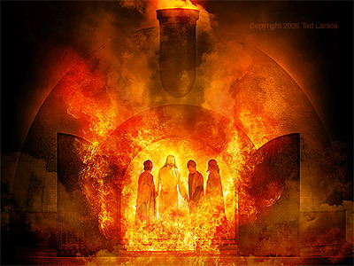
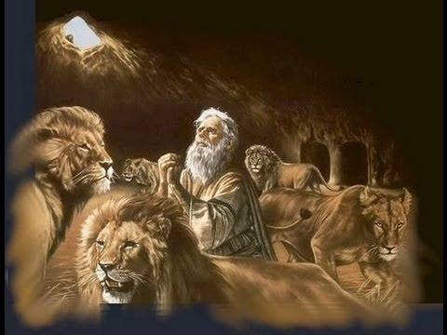
Christians will be Saved from Fiery Trials
Notes:
Daniel & his 3 friends were taken captive by Nebuchadnezzar in the 3rd year of Jehoiakim’s reign (605). Same king who cut up & burned God’s word (Jeremiah 36). Righteous suffered same consequences of wicked. They were in a 3 year training program to serve in the king’s palace. Their faith was severely tested with instant death in the fiery furnace & the lions. But they overcame so as to serve the Lord and the kings of Babylon & Medes & Persians praise the God of heaven as a result. May God help us to imitate their example and overcome the trials we face on a daily basis.

Slide 2
Worldly Kingdoms | Daniel/ 3 Friends | Jesus Christ
Pressure to Surrender (Daniel 3:5-15; 6:7) | Did not Compromise (Dan. 1:8; 3:18; 6:10) | Always Obeyed His Father (John 15:10)
Turn Up the Heat (3:19) | Confident in Crisis (3:16-17) | Endured Pain of the Cross (Heb. 12:2-3)
Condemn Righteous (3:20; 6:16) | God Saved Them because of their Faith (3:17; 6:22-23) | Desired Men be Saved, not Condemned (John 12:47)
Pride before Fall (4:27-31, 37) | Humble before King (2:16, 24, 30) | Humbly Obeyed even to Death (Phil. 2:8)
God Rules (3:28-29; 6:25-27) | Promoted & Prospered (3:30; 6:28) | Established Eternal Kingdom (Dan. 2:44; Mt. 16:19; Rev. 1:5-6)

Slide 3
The World | Christians | Jesus Christ
Pressure to Conform (1 Peter 3:14; 1 Cor. 15:33) | Stand up for Truth (1 Peter 3:15-16; Romans 12:2) | Blessed when You’re Persecuted for His Sake (Mt. 5:10-12)
Put you through Fiery Trials (1 Pet. 1:7; 5:8) | Body-Living Sacrifice Faith Should Grow (Ro. 12:1; Js. 1:2-4) | Full of Compassion & Merciful (James 5:10-11)
Praise False Teacher, Speak Evil of you (Luke 6:26; 2 Peter 2:1-3) | God will Rescue Them from every Evil Deed (2 Timothy 4:18) | Prayed for Wicked to be Saved- 3,000 baptized (Lk. 23:34; Ax 2:41)

Slide 4
The World | Christians | Jesus Christ
Proud of their Sin (2 Timothy 3:1ff) | Humble Yourself under God’s Mighty Hand (1 Peter 5:6) | Intercedes for the Saints (Hebrews 7:25)
They will Bow & Confess Jesus is Lord (Ph. 2:11) but too late. They’ll be condemned! | Resurrected from the Grave to Eternal Life (John 5:28-29) | By His Power He will Transform our Body to be like His (Philippians 3:21)

