Slide 1
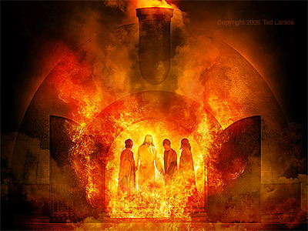
Saved from the Fiery Furnace (Dan. 3)
(Shadrach, Meschach, & Abednego)
Notes:
Daniel & his 3 friends were taken captive by Nebuchadnezzar in the 3rd year of Jehoiakim’s reign (605). Same king who cut up & burned God’s word (Jeremiah 36). Righteous suffered same consequences of wicked. They were in a 3 year training program to serve in the king’s palace. Their faith was severely tested with instant death in the fiery furnace & the lions. But they overcame so as to serve the Lord and the kings of Babylon & Medes & Persians praise the God of heaven as a result. May God help us to imitate their example and overcome the trials we face on a daily basis.

Slide 2
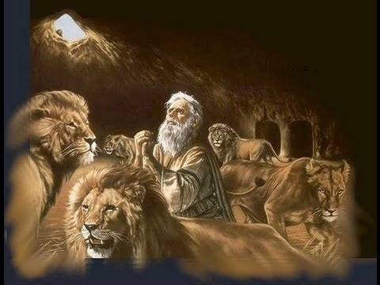
Daniel Saved from the Lions Den (Dan. 6)
Notes:
Daniel & his 3 friends were taken captive by Nebuchadnezzar in the 3rd year of Jehoiakim’s reign (605). Same king who cut up & burned God’s word (Jeremiah 36). Righteous suffered same consequences of wicked. They were in a 3 year training program to serve in the king’s palace. Their faith was severely tested with instant death in the fiery furnace & the lions. But they overcame so as to serve the Lord and the kings of Babylon & Medes & Persians praise the God of heaven as a result. May God help us to imitate their example and overcome the trials we face on a daily basis.

Slide 3
Worldly Kingdoms | Daniel 3 Friends | Jesus Christ
Pressure to Surrender (Dan. 3:5-15; 6:7) | Didn’t Compromise (1:8; 3:18; 6:10) | Always Obeyed His Father (John 15:10)
Turn Up the Heat (3:19) | Confident in Crisis (3:16-17) | Endured Pain of the Cross (Heb. 12:2-3)
Condemn the Righteous (3:20; 6:16) | God Saved Them because of their Faith (3:28; 6:22-23) | Desired Men be Saved, not Condemned (John 12:47)
Notes:
If anyone hears My sayings and does not keep them, I do not judge him; for I did not come to judge the world, but to save the world. The world wants to condemn the righteous, but Jesus wanted them to be saved. While there’s life there’s hope! Judgment Day is coming though.

Slide 4
Worldly Kingdoms | Daniel 3 Friends | Jesus Christ
Pride before Fall (Dan. 4:27-31, 37) | Humble before King (Dan. 2:16, 24, 30) | Humbly Obeyed even to Death (Phil. 2:8)
God Rules in the Kingdoms of Men (3:28-29; 6:25-27) | Promoted & Prospered (3:30; 6:28) | Established Kingdom that would last Forever (Dan. 2:44; Matt. 16:18-19; Rev. 1:5-6)
Notes:
In the days of those kings the God of heaven will set up a kingdom which will never be destroyed, and thatkingdom will not be ^{[av]}left for another people; it will crush and put an end to all these kingdoms, but it will itself endure forever. Jesus promised to build His church and gave to Peter the keys to the kingdom of heaven. Rev. 1:5-6, from Jesus Christ, the faithful witness, the firstborn of the dead, and the ruler of the kings of the earth. To Him who loves us and released us from our sins ^{[a]}by His blood— ⁶ and He has made us to be a kingdom, priests to ^{[b]}His God and Father—to Him bethe glory and the dominion forever and ever. Amen.

