Slide 1
Hymns for Worship at Woodmont
15s- Exalted
21s- On Bended Knee I Come
90s- Come Share the Lord
9- Our God, He is Alive
343- Let Him Have His Way with Thee
496- We Have an Anchor
Notes:
In our DBRP, studied Israelites captivity by Babylonians . Daniel prays & some were able to come back to the land but not all. They came back-started rebuilding, stalled 16 years- Haggai & Zechariah stirred up people to build- they did. The Medes & the Persians are in power now as we come to the book of Esther (time frame between chapters Ezra 6 & 7). Aheseurus- Hebrew, Xerxes (Greek) is ruling from 486-464. The book takes place from about 483-473. It illustrates how God uses ordinary people to overcome apparently impossible obstacles to His plan. God protects His people even though His name is not used in the book. God is working even though not seen. His unseen hand is in it all (Lord I Believe). There is a spiritual battle going on between good & evil since time began until now. To set up how Esther becomes queen, Xerxes has a party that lasts 6 months, & decides to have queen Vashti to display her beauty before all the people, she refuses, and he is advised to find another queen. Beauty contest set up of all the virgins in the land and Esther is one of them. She finds favor before all the people and becomes queen.

Slide 2
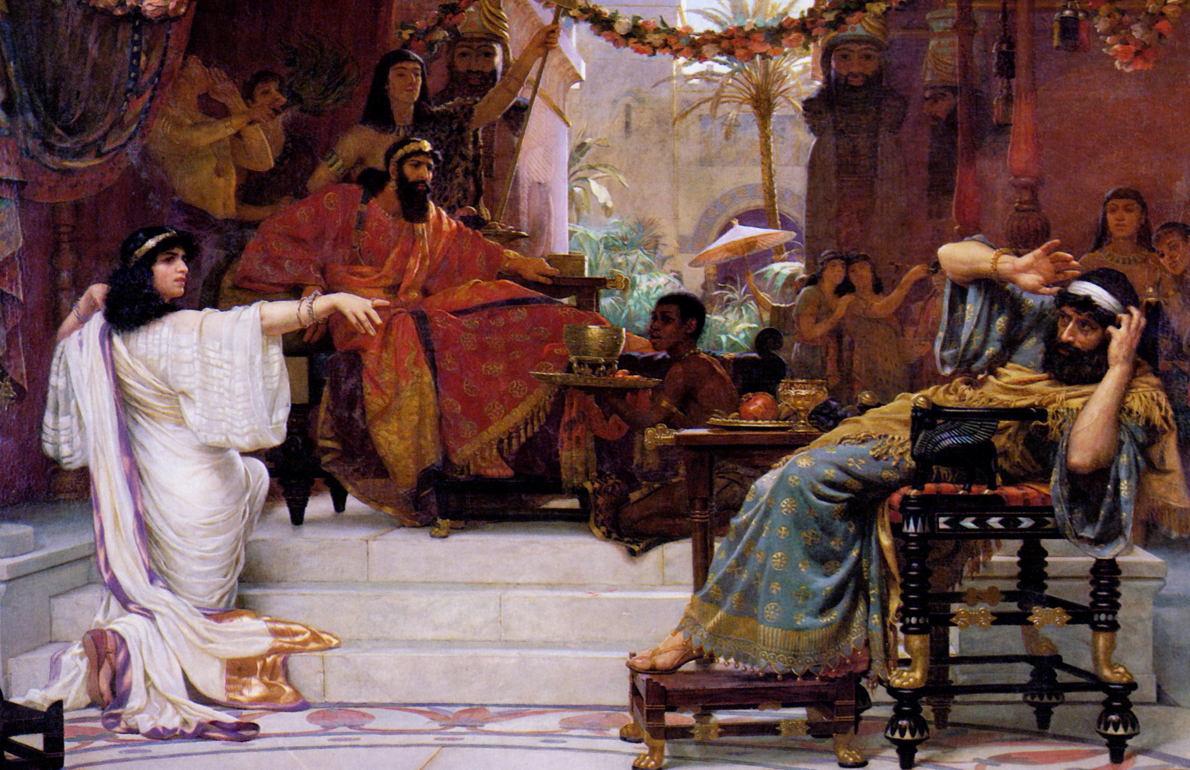
Book of Esther- Jews Spared from Annihilation
Notes:
In our DBRP, studied Israelites captivity by Babylonians . Daniel prays & some were able to come back to the land but not all. They came back-started rebuilding, stalled 16 years- Haggai & Zechariah stirred up people to build- they did. The Medes & the Persians are in power now as we come to the book of Esther (time frame between chapters Ezra 6 & 7). Aheseurus- Hebrew, Xerxes (Greek) is ruling from 486-464. The book takes place from about 483-473. It illustrates how God uses ordinary people to overcome apparently impossible obstacles to His plan. God protects His people even though His name is not used in the book. God is working even though not seen. His unseen hand is in it all (Lord I Believe). There is a spiritual battle going on between good & evil since time began until now. To set up how Esther becomes queen, Xerxes has a party that lasts 6 months, & decides to have queen Vashti to display her beauty before all the people, she refuses, and he is advised to find another queen. Beauty contest set up of all the virgins in the land and Esther is one of them. She finds favor before all the people and becomes queen.

Slide 3
Haman | Mordecai | Esther | Satan | Christ

Slide 4
Haman | Mordecai | Esther | Satan | Christ
All were to bow down to him (Esther 3:1)

Slide 5
Haman | Mordecai | Esther | Satan | Christ
All were to bow down to him (Esther 3:1) | Refused to bow because he was a Jew (Es. 3:2-4)

Slide 6
Haman | Mordecai | Esther | Satan | Christ
All were to bow down to him (Esther 3:1) | Refused to bow because he was a Jew (Es. 3:2-4) | Submissive to authority- becomes queen (Es. 2:7-20)

Slide 7
Haman | Mordecai | Esther | Satan | Christ
All were to bow down to him (Esther 3:1) | Refused to bow because he was a Jew (Es. 3:2-4) | Submissive to authority- becomes queen (Es. 2:7-20) | Wants all bowing to his will (Matt. 4:9; 2 Ti. 2:26)

Slide 8
Haman | Mordecai | Esther | Satan | Christ
All were to bow down to him (Esther 3:1) | Refused to bow because he was a Jew (Es. 3:2-4) | Submissive to authority- becomes queen (Es. 2:7-20) | Wants all bowing to his will (Matt. 4:9; 2 Ti. 2:26) | Refused- Must only worship God (Matt. 4:10)

Slide 9
Haman | Mordecai | Esther | Satan | Christ
All were to bow down to him (Esther 3:1) | Refused to bow because he was a Jew (Es. 3:2-4) | Submissive to authority- becomes queen (Es. 2:7-20) | Wants all bowing to his will (Matt. 4:9; 2 Ti. 2:26) | Refused- Must only worship God (Matt. 4:10)
Writes irrevocable decree- death to all Jews (3:6)

Slide 10
Haman | Mordecai | Esther | Satan | Christ
All were to bow down to him (Esther 3:1) | Refused to bow because he was a Jew (Es. 3:2-4) | Submissive to authority- becomes queen (Es. 2:7-20) | Wants all bowing to his will (Matt. 4:9; 2 Ti. 2:26) | Refused- Must only worship God (Matt. 4:10)
Writes irrevocable decree- death to all Jews (3:6) | Had Faith in God’s Deliverance (4:14)

Slide 11
Haman | Mordecai | Esther | Satan | Christ
All were to bow down to him (Esther 3:1) | Refused to bow because he was a Jew (Es. 3:2-4) | Submissive to authority- becomes queen (Es. 2:7-20) | Wants all bowing to his will (Matt. 4:9; 2 Ti. 2:26) | Refused- Must only worship God (Matt. 4:10)
Writes irrevocable decree- death to all Jews (3:6) | Had Faith in God’s Deliverance (4:14) | Had the Jews fast for 3 days (4:16)

Slide 12
Haman | Mordecai | Esther | Satan | Christ
All were to bow down to him (Esther 3:1) | Refused to bow because he was a Jew (Es. 3:2-4) | Submissive to authority- becomes queen (Es. 2:7-20) | Wants all bowing to his will (Matt. 4:9; 2 Ti. 2:26) | Refused- Must only worship God (Matt. 4:10)
Writes irrevocable decree- death to all Jews (3:6) | Had Faith in God’s Deliverance (4:14) | Had the Jews fast for 3 days (4:16) | World is under his power (1 Jn. 5:19)

Slide 13
Haman | Mordecai | Esther | Satan | Christ
All were to bow down to him (Esther 3:1) | Refused to bow because he was a Jew (Es. 3:2-4) | Submissive to authority- becomes queen (Es. 2:7-20) | Wants all bowing to his will (Matt. 4:9; 2 Ti. 2:26) | Refused- Must only worship God (Matt. 4:10)
Writes irrevocable decree- death to all Jews (3:6) | Had Faith in God’s Deliverance (4:14) | Had the Jews fast for 3 days (4:16) | World is under his power (1 Jn. 5:19) | Trusted in God’s Plan (1 Pt. 2:23)

Slide 14
Haman | Mordecai | Esther | Satan | Christ
Wants Mordecai dead now (Es. 5:9-14)

Slide 15
Haman | Mordecai | Esther | Satan | Christ
Wants Mordecai dead now (Es. 5:9-14) | Helped to spare the king’s life (Es. 2:21ff)

Slide 16
Haman | Mordecai | Esther | Satan | Christ
Wants Mordecai dead now (Es. 5:9-14) | Helped to spare the king’s life (Es. 2:21ff) | Willing to die to save Jews (Es. 4:16)

Slide 17
Haman | Mordecai | Esther | Satan | Christ
Wants Mordecai dead now (Es. 5:9-14) | Helped to spare the king’s life (Es. 2:21ff) | Willing to die to save Jews (Es. 4:16) | Has power of death (Heb. 2:14)

Slide 18
Haman | Mordecai | Esther | Satan | Christ
Wants Mordecai dead now (Es. 5:9-14) | Helped to spare the king’s life (Es. 2:21ff) | Willing to die to save Jews (Es. 4:16) | Has power of death (Heb. 2:14) | Christ died to save man (Heb. 2:9)

Slide 19
Haman | Mordecai | Esther | Satan | Christ
Wants Mordecai dead now (Es. 5:9-14) | Helped to spare the king’s life (Es. 2:21ff) | Willing to die to save Jews (Es. 4:16) | Has power of death (Heb. 2:14) | Christ died to save man (Heb. 2:9)
His pride is humbled (6:1-14)

Slide 20
Haman | Mordecai | Esther | Satan | Christ
Wants Mordecai dead now (Es. 5:9-14) | Helped to spare the king’s life (Es. 2:21ff) | Willing to die to save Jews (Es. 4:16) | Has power of death (Heb. 2:14) | Christ died to save man (Heb. 2:9)
His pride is humbled (6:1-14) | Haman had to honor him (6:11)

Slide 21
Haman | Mordecai | Esther | Satan | Christ
Wants Mordecai dead now (Es. 5:9-14) | Helped to spare the king’s life (Es. 2:21ff) | Willing to die to save Jews (Es. 4:16) | Has power of death (Heb. 2:14) | Christ died to save man (Heb. 2:9)
His pride is humbled (6:1-14) | Haman had to honor him (6:11) | Exposed evil plot of Haman (7:3-6)

Slide 22
Haman | Mordecai | Esther | Satan | Christ
Wants Mordecai dead now (Es. 5:9-14) | Helped to spare the king’s life (Es. 2:21ff) | Willing to die to save Jews (Es. 4:16) | Has power of death (Heb. 2:14) | Christ died to save man (Heb. 2:9)
His pride is humbled (6:1-14) | Haman had to honor him (6:11) | Exposed evil plot of Haman (7:3-6) | Scripture reveals his schemes (2 Co. 2:11)

Slide 23
Haman | Mordecai | Esther | Satan | Christ
Wants Mordecai dead now (Es. 5:9-14) | Helped to spare the king’s life (Es. 2:21ff) | Willing to die to save Jews (Es. 4:16) | Has power of death (Heb. 2:14) | Christ died to save man (Heb. 2:9)
His pride is humbled (6:1-14) | Haman had to honor him (6:11) | Exposed evil plot of Haman (7:3-6) | Scripture reveals his schemes (2 Co. 2:11) | God gives grace to the humble (1 Pet. 5:5f)

Slide 24
Haman | Mordecai | Esther | Satan | Christ
Hanged on his own gallows that he had prepared for Mordecai (Es. 7:9-10)

Slide 25
Haman | Mordecai | Esther | Satan | Christ
Hanged on his own gallows that he had prepared for Mordecai (Es. 7:9-10) | Promoted to sit in Haman’s position and over his house (Es. 8:2; 9:4)

Slide 26
Haman | Mordecai | Esther | Satan | Christ
Hanged on his own gallows that he had prepared for Mordecai (Es. 7:9-10) | Promoted to sit in Haman’s position and over his house (Es. 8:2; 9:4) | Wrote decree with king’s permission- Jews allowed to defeat their enemies (Es. 8:5-17; 9:5,16)

Slide 27
Haman | Mordecai | Esther | Satan | Christ
Hanged on his own gallows that he had prepared for Mordecai (Es. 7:9-10) | Promoted to sit in Haman’s position and over his house (Es. 8:2; 9:4) | Wrote decree with king’s permission- Jews allowed to defeat their enemies (Es. 8:5-17; 9:5,16) | He will be thrown into the lake of fire to be tormented forever (Rv. 20:10)

Slide 28
Haman | Mordecai | Esther | Satan | Christ
Hanged on his own gallows that he had prepared for Mordecai (Es. 7:9-10) | Promoted to sit in Haman’s position and over his house (Es. 8:2; 9:4) | Wrote decree with king’s permission- Jews allowed to defeat their enemies (Es. 8:5-17; 9:5,16) | He will be thrown into the lake of fire to be tormented forever (Rv. 20:10) | The persecuted saints will be victorious to live with Him forever (Rv. 14:13)
Notes:
Jews in captivity in a foreign land, have nothing, the orphan Esther who was submissive & obedient to Mordecai rises to the palace as the queen to be in place so that she can save her people with Mordecai who had wisdom to guide her, and eventually the enemy. Our enemy is the devil who like Haman wants us do his will & submit, who hates God, and wants us to be enslaved in our sins & suffer, but Jesus overcome the devil & his temptations, and died on the cross so that we can be forgiven of our sins. If we are going to go to heaven, we should respond to Jesus’ sacrifice & compassion with humble submission and obedience. Will you respond by obeying the gospel?

Slide 29
Hymns for Worship at Woodmont
15s- Exalted
21s- On Bended Knee I Come
90s- Come Share the Lord
9- Our God, He is Alive
343- Let Him Have His Way with Thee
496- We Have an Anchor

