Slide 1
Hymns for Worship at Woodmont
356- If Jesus Goes with Me
361- In His Time
166- He Loved Me So
131s- For Such a Time as This
278- God is Calling the Prodigal
254- On Jordan’s Stormy Banks

Slide 2
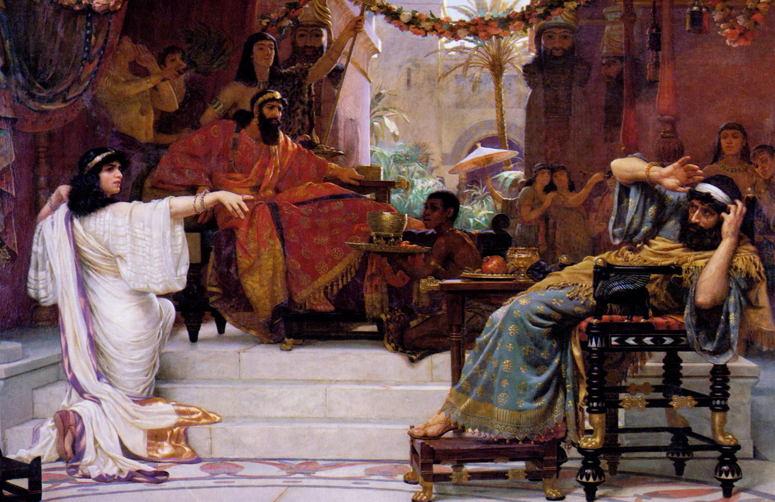
Book of Esther- Jews Spared from Annihilation
Notes:
In our DBRP, studied Israelites captivity by Babylonians . Daniel prays & some were able to come back to the land but not all. They came back-started rebuilding, stalled 16 years- Haggai & Zechariah stirred up people to build- they did. The Medes & the Persians are in power now as we come to the book of Esther (time frame between chapters Ezra 6 & 7). Aheseurus- Hebrew, Xerxes (Greek) is ruling from 486-464. The book takes place from about 483-473. It illustrates how God uses ordinary people to overcome apparently impossible obstacles to His plan. God protects His people even though His name is not used in the book. God is working even though not seen. His unseen hand is in it all (Lord I Believe). There is a spiritual battle going on between good & evil since time began until now. To set up how Esther becomes queen, Xerxes has a party that lasts 6 months, & decides to have queen Vashti to display her beauty before all the people, she refuses, and he is advised to find another queen. Beauty contest set up of all the virgins in the land and Esther is one of them. She finds favor before all the people and becomes queen.

Slide 3
Haman | Mordecai | Queen Esther | Satan | Christ
All were to Bow Down to Him (3:1) | Refused to Bow- he was a Jew (3:2) | Submissive- authority (2:7, 10, 15, 20) | Demands all bow to his will (Mt.4:9; 2 Tim. 2:26) | Refused- Must worship God only (Mt. 4:10)
Writes irrevocable decree- Death-Jews (3:6) | Faith in God’s Deliverance (4:14) | Has Jews fast for 3 days (4:16) | Whole world under his power (1 Jn. 5:19) | Trusted in God’s Plan (1 Pt. 2:23)
Wants Mordecai Dead Now (5:9-14) | Helped spare King’s life (2:21-23) | Willing to die to save Jews (4:16) | Has power of death (Heb. 2:14) | Christ died to save man from sin (Heb. 2:9, 14-18)
Pride is Humbled- (6:1-14) | Haman has to honor him (6:11) | Exposes evil plot of Haman (7:3-6) | Scripture Reveals His Schemes (2 Cor. 2:11) | Provides escape from temptation (2 Pet. 2:9)
Hanged on his own gallows that he had prepared for Mordecai (7:9-10) | Promoted to sit in Haman’s position and over his house (8:2; 9:4) | Wrote decree with king’s permission- Jews allowed to defeat their enemies (8:5-17; 9:5ff) | His end will be in the lake of fire forever (Rev. 20:10) | The persecuted saints will be victorious with Christ to live with Him forever (Rev. 14:12-13)

Slide 4
Book of Esther- Saints Suffer & Save Souls
Notes:
Last week studied book of Esther. Spiritual battle going on between God/Devil. God’s providence working so that Esther & Mordecai overcome Haman who had authority to annihilate all the Jews. This week we will see how God’s word is living & active as we deal with difficult issues in our country.

Slide 5
Haman/World/ Satan | Mordecai/Esther/ Christ | Saints/ New Testament

Slide 6
Haman/World/ Satan | Mordecai/Esther/ Christ | Saints/ New Testament
Demands submission (Est. 3:1; 1 Jn. 5:19)

Slide 7
Haman/World/ Satan | Mordecai/Esther/ Christ | Saints/ New Testament
Demands submission (Est. 3:1; 1 Jn. 5:19) | Refused to Bow (Est. 3:2-4; Mt. 4:9)

Slide 8
Haman/World/ Satan | Mordecai/Esther/ Christ | Saints/ New Testament
Demands submission (Est. 3:1; 1 Jn. 5:19) | Refused to Bow (Est. 3:2-4; Mt. 4:9) | Sacrifice for God, not world (Rom. 12:1-2)

Slide 9
Haman/World/ Satan | Mordecai/Esther/ Christ | Saints/ New Testament
Demands submission (Est. 3:1; 1 Jn. 5:19) | Refused to Bow (Est. 3:2-4; Mt. 4:9) | Sacrifice for God, not world (Rom. 12:1-2)
Punish righteous using deception (3:8; 2 Cor. 11:14)

Slide 10
Haman/World/ Satan | Mordecai/Esther/ Christ | Saints/ New Testament
Demands submission (Est. 3:1; 1 Jn. 5:19) | Refused to Bow (Est. 3:2-4; Mt. 4:9) | Sacrifice for God, not world (Rom. 12:1-2)
Punish righteous using deception (3:8; 2 Cor. 11:14) | Trusted & obeyed God’s law over man’s (4:14; Mt. 15:1-14)

Slide 11
Haman/World/ Satan | Mordecai/Esther/ Christ | Saints/ New Testament
Demands submission (Est. 3:1; 1 Jn. 5:19) | Refused to Bow (Est. 3:2-4; Mt. 4:9) | Sacrifice for God, not world (Rom. 12:1-2)
Punish righteous using deception (3:8; 2 Cor. 11:14) | Trusted & obeyed God’s law over man’s (4:14; Mt. 15:1-14) | If you suffer doing right you’re blessed (Acts 5:29; 1 Peter 2:19; 3:14; 4:16)
Notes:
Petition- people who don’t obey your laws & discriminate, make people feel like outcast, not normal. Punish them for not obeying the law. Christian bakers face $135K fine for refusing to make cake for gay wedding Supreme Court sanctioned sinful homosexual unions in 2015, it set the precedent for Christians who stand up for God’s marriage law in public to be charged with discrimination against right for homosexuals to get married but the Supreme Ruler of the Universe is still living & expects his saints to stand up for His words of truth! Kentucky clerk who was jailed for 5 days refusing to issue marriage licenses to gay couples back in 2015. The Supreme Court is taking up the highly anticipated case of the Colorado baker who refused to make a wedding cake for a same-sex couple just announced last week. Ruling expected June 2018.

Slide 12
Haman/World/ Satan | Mordecai/Esther/ Christ | Saints/ New Testament
Demands submission (Est. 3:1; 1 Jn. 5:19) | Refused to Bow (Est. 3:2-4; Mt. 4:9) | Sacrifice for God, not world (Rom. 12:1-2)
Punish righteous using deception (3:8; 2 Cor. 11:14) | Trusted & obeyed God’s law over man’s (4:14; Mt. 15:1-14) | If you suffer doing right you’re blessed (Acts 5:29; 1 Peter 2:19; 3:14; 4:16)
Persecution even to the point of death (3:13; Acts 22:4)

Slide 13
Haman/World/ Satan | Mordecai/Esther/ Christ | Saints/ New Testament
Demands submission (Est. 3:1; 1 Jn. 5:19) | Refused to Bow (Est. 3:2-4; Mt. 4:9) | Sacrifice for God, not world (Rom. 12:1-2)
Punish righteous using deception (3:8; 2 Cor. 11:14) | Trusted & obeyed God’s law over man’s (4:14; Mt. 15:1-14) | If you suffer doing right you’re blessed (Acts 5:29; 1 Peter 2:19; 3:14; 4:16)
Persecution even to the point of death (3:13; Acts 22:4) | Willing to die to save others (2:21-23; 4:16; Heb. 2:9)

Slide 14
Haman/World/ Satan | Mordecai/Esther/ Christ | Saints/ New Testament
Demands submission (Est. 3:1; 1 Jn. 5:19) | Refused to Bow (Est. 3:2-4; Mt. 4:9) | Sacrifice for God, not world (Rom. 12:1-2)
Punish righteous using deception (3:8; 2 Cor. 11:14) | Trusted & obeyed God’s law over man’s (4:14; Mt. 15:1-14) | If you suffer doing right you’re blessed (Acts 5:29; 1 Peter 2:19; 3:14; 4:16)
Persecution even to the point of death (3:13; Acts 22:4) | Willing to die to save others (2:21-23; 4:16; Heb. 2:9) | Save souls for Christ (2 Tim. 2:24-26; James 5:19-20)

Slide 15
Hymns for Worship at Woodmont
356- If Jesus Goes with Me
361- In His Time
166- He Loved Me So
131s- For Such a Time as This
278- God is Calling the Prodigal
254- On Jordan’s Stormy Banks

