Slide 1
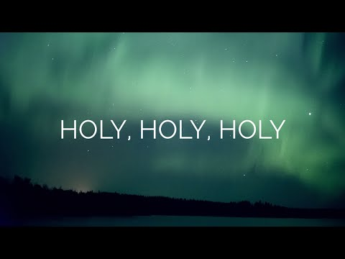
Notes:
Reginald Heber, Born in 1783 to a wealthy, educated family. By 7, translating Latin Classics into English verse, entered Oxford at 17, won 2 awards for poetry. It was written in England. He compiled hymns around the Catholic church calendar. Wanting to celebrate a triune God, Heber wrote “Holy, Holy, Holy” for Trinity Sunday– observed eight Sundays after Easter. He accepted a post to be Catholic biship of Calcutta where he apparently suffered from a heavy workload and tropical climate. He apparently died of an apoplectic stroke at 43. One year after his death, his widow & friends published a collection of 57 of his hymns. The music for the poem was accomplished in 1861 by John Bacchus Dykes.

Slide 2
Holy Holy Holy by Reginald Heber 1783-1826
Holy, holy, holy Lord God Almighty (Isa. 6:3; Rev. 4:8)
Early in the morning my song shall rise to thee (Mk. 1:35)
Holy, holy, holy merciful & mighty (Eph. 2:4-7)
God in three persons, blessed Trinity (John 14:26; 17:21)
God is holy, merciful, and mighty and we ought to praise
Him for it everyday. God the Father, God the Son, and God
the Holy Spirit are each a person in the Godhead and are
united in holiness.
Notes:
Written for Trinity Sunday one Sunday after Pentecost. “God in three persons, blessed Trinity,” True but wording changed our books follow the Baptist hymnal in 1879. God is “perfect in power, in love and purity;” God is worshiped by saints, cherubim, and seraphim; and God is praised “in earth and sky and sea,” and God is “holy, merciful and mighty.”

Slide 3
Holy Holy Holy by Reginald Heber 1783-1826
Holy, holy, holy all the saints adore Thee (Rev. 4:5-11)
Casting down their golden crowns around the glassy sea
Cherubim and seraphim falling down before Thee
Who wert and art and evermore shalt be
The four living creatures (likely Cherubim- Isa. 6:2 and
Seraphim serving God- Ezek. 10:1-20) & 24 elders (likely
12 tribes & 12 apostles representing redeemed of both
covenants) are praising God in worship who lives forever!
Notes:
#4 symbolic of the world we live in. The “4 living creatures" of Rev 4:6 modeled on Ezekiel, touches from Isaiah. Full of eyes before & behind, they are in the midst of the throne, & round about it. One resembles a lion, the other a calf, and the third a man, and the fourth a flying eagle. Each of the creatures has six wings. "They have no rest day and night, saying, Holy, holy, holy, is the Lord God, the Almighty, who was and who is and who is to come." Seraphim- 6 winged being that say Holy Holy Holy (2X). Cherubim 58X was placed in the Most Holy Place. It was above the mercy seat and had wings that covered the ark of the covenant (Ex. 25:20; 1 Kings 8:6-7).
The God of heaven was only above the cherubim. (Ps. 80:1; 99:1; 2 Kings 19:15; Isa. 37:16)

Slide 4
Holy Holy Holy by Reginald Heber 1783-1826
Holy, holy, holy though the darkness hide Thee (2 Cor. 4:4)
Though the eye of sinful man Thy glory may not see (Jn 1:5)
Only Thou art holy there is none beside Thee (Rev. 15:4)
Perfect in power, in love and purity (Matt. 5:48)
Sinful man doesn’t see God’s glory because He loves the
darkness (John 3:19) and doesn’t want to see the light.
God is perfect in power, love and purity which is shown in
His Son’s sacrifice and resurrection.

Slide 5
Holy Holy Holy by Reginald Heber 1783-1826
Holy, holy, holy Lord God almighty (Ps. 19:1-2; 148:7)
All Thy works shall praise Thy name in earth & sky & sea
Holy, holy, holy merciful and mighty (Luke 1:49-51)
God in three persons, blessed Trinity (2 Cor. 13:14)
All of God’s works in creation praise His name everywhere.
The Father, Son, & Holy Spirit are holy, merciful, & mighty!

