Slide 1
Hymns for Worship at Woodmont
66s- Hear, O Israel
87- Be Still My Soul
189- When I Survey the Wondrous Cross
436- I’ll Fly Away
283- There’s a Great Day Coming
670- The Lord Bless and Keep You

Slide 2
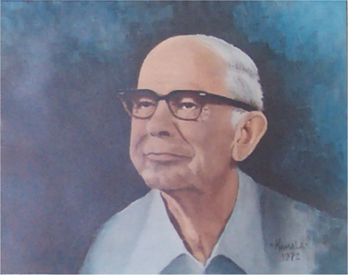
Albert Brumley
1905-1977
“I’ll Fly Away”
1932
Notes:
Sharecropper OK. Parents Christians. Hard workers. Music was prevalent. Rich bass voice. 16 decided to write music. First song published 22. The lure of music brought shy young man out of Oklahoma (didn’t even have $5 for tuition) to Hartford, Arkansas, to Eugene Bartlett, owner of the Hartford Music Company, became friends with him until Eugene’s death in 1941. well, Missouri he met Goldie Schell. Married 1931. Constant encouragement. Perfect wife for a talented, creative, and musical genius. Encouraged him to send “I’ll Fly Away” to be published. Albert studied English and was able to wed the words to music in a powerful way. From the earliest had rhyming dictionary & Roget's Thesaurus. Always carried pencil & paper. 1932, one year after school "I'll Fly Away." Albert composed more than seven hundred songs including “This Word is not My Home”; Jesus, Hold My Hand," "The Blood That Stained The Old Rugged Cross," and "If We Never Meet Again."

Slide 3
I’ll Fly Away by Albert Brumley
Some glad morning when this life is o'er, (Rev. 22:16)
I'll fly away; (Psalm 90:1-14)
To a home on God's celestial shore, (Rev. 22:1)
I'll fly away (I'll fly away). (2 Cor. 5:6-9)
Jesus is the bright and morning star who makes it
possible for us to fly away to God’s heavenly shore
where we’ll be happy forever more.
Notes:
planet Venus, so often seen shining brightly in the early morning. Jesus is the brightness of His glory (Heb. 1:2)

Slide 4
I’ll Fly Away by Albert Brumley
When the shadows of this life have grown, (Ps. 23:4)
I'll fly away; (Matt. 4:16; Luke 1:79; John 11:25)
Like a bird from prison bars has flown,
I'll fly away (I'll fly away)
While here, we’re imprisoned by fear as the shadows of
death creep upon us because of Satan’s hold on this
world. But Christ redeemed us from sin we can be free
to fly away like a bird escaping from his cage.

Slide 5
I’ll Fly Away by Albert Brumley
Just a few more weary days and then,
I'll fly away; (Gal. 6:9; Heb. 12:2-3; Rev. 2:3; 14:13)
To a land where joy shall never end, (Heb. 11:13-16)
I'll fly away (I'll fly away) (1 Thess. 4:13-18)
This life is like a marathon race that exhausts us but in
heaven you will rejuvenated and revitalized to rest from
your labors

Slide 6
I’ll Fly Away by Albert Brumley
Chorus:
I'll fly away, Oh Glory (Rev. 21:1-8)
I'll fly away; (in the morning)
When I die, Hallelujah, by and by,
I'll fly away (I'll fly away).

Slide 7
Hymns for Worship at Woodmont
66s- Here O Israel
87- Be Still My Soul
189- When I Survey the Wondrous Cross
436- I’ll Fly Away
283- There’s a Great Day Coming
670- The Lord Bless and Keep You

