Slide 1
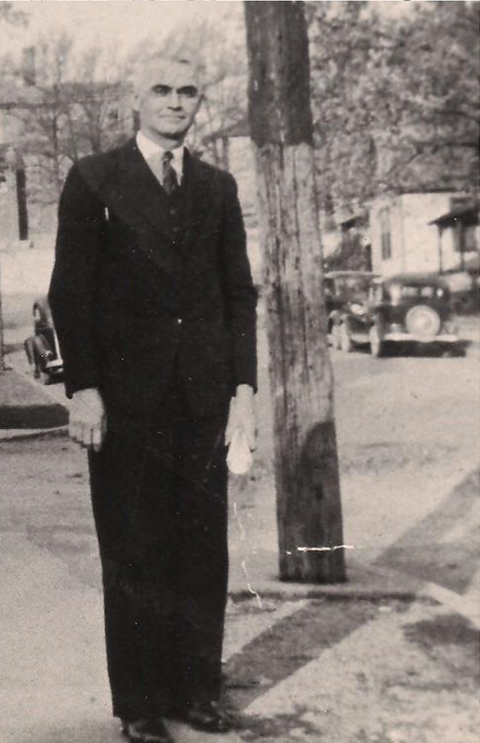
Our God He is Alive by A. W. Dicus 1888-1977

Slide 2
Our God He is Alive by A. W. Dicus
"There is, beyond the azure blue, (Ex. 24:10)
A God concealed from human sight; (Ps. 97:2; Rom. 1:20)
He tinted skies with heavenly hue, (Gen. 9:13-16)
And framed the worlds with His great might.“ (Heb. 11:3)
God is a Spirit who created this universe which we can see
by His invisible almighty power. God made the bright blue
sky, colors of the rainbow, the sunrise and sunset!
Notes:
Lapis lazuli- a sky-blue color; azure. 15c., from Middle Latin lapis lazuli, literally "stone of azure," fromLatin lapis "stone" + Medieval Latin lazuli, genitive of lazulum, from Arabiclazuward (see azure ).At its root, azure comes to us from a French mistranslation of the Arabic word (al)-lazaward, which means “lapis lazuli” — the dazzling deep blue stone that's very common in Afghanistan. There are many references to sapphires in the Old Testament, but most scholars agree that, since sapphire was not known before the Roman Empire, they most likely are references to lapis lazuli. For instance, Exodus 24:10: "As they saw the God of Israel, and there was under his feet as it were a paved work of a sapphire stone.." (KJV). The term used in the Latin Vulgate Bible in this citation is "lapidus sapphiri," the term for lapis lazuli.^{[23]} Modern translations of the Bible, such as the New Living Translation Second Edition,^{[24]} refer to lapis lazuli in most instances instead of sapphire.

Slide 3
Our God He is Alive by A. W. Dicus
"There was, a long, long time ago, (Acts 3:18ff)
A God whose voice the prophets heard; (1 Pet. 1:10-12)
He is the God that we should know, (Jn. 6:45; 8:32)
Who speaks from His inspired word.“(2 Ti. 3:16; He. 1:1-2)
God spoke through all His prophets that Christ would suffer
so that you might know the truth about Him and bless you
by turning you away from you wicked ways!

Slide 4
Our God He is Alive by A. W. Dicus
"Secure is life from mortal mind;
God holds the germ within His hand. (Gen. 1:26-28; 2:7)
Though men may search they cannot find, (Job 38:4ff)
For God alone does understand.“ (Ps. 139:13-16)
God breathed life into man’s nostrils to be fruitful and
multiply which mankind can’t fathom or comprehend how
He did it.
Notes:
Germ- the rudiment of a living organism; an embryo in its early stages.

Slide 5
Our God He is Alive by A. W. Dicus
"Our God–whose Son upon a tree (Gal. 3:13)
A life was willing there to give, (John 10:17-18)
That He from sin might set man free, (John 8:32-34)
And evermore with Him could live.“ (Rom. 6:22-23)
Christ redeemed us from the curse of the law having
been crucified on the cross of Calvary to set us free
from our sins and live with Him in heaven!
Notes:
Born in MO, raised & graduated in IN. He met & married his first wife in 1908 the same year he was baptized into Christ. Vow- “If the Lord will allow me to get an education,” he said, “I will use it in service to Him.” He did. Prepared to preach, taught in rural one room schoolhouse. Left school to become an inverntor, invented a auto turn signal in 1918. Got his PhD. 1940’s taught physics at TN polytechnic institute and was involved helping develop part of the ignition for the atom bomb (Manhattan Project). 1950 academic dean at FC, wife died and married Flora in 1953 who encouraged him to write hymns. At 65 began doing it. In 1966, Time Magazine had a front page headline “God is Dead” & he apparently wrote the hymn “Our God He is Alive” in response. He ended up writing at least 24 hymns. His health began to fail & afflicted with cataracts and glaucoma, which left him almost completely blind. He continued to compose songs, including “Lord, I Believe.”

Slide 6
Our God He is Alive by A. W. Dicus
"There is a God, He is alive, (Acts 17:24-28)
In Him we live, and we survive. (Matt. 4:4)
From dust our God created man; (Gen. 2:7)
He is our God, the great I AM.“ (Ex. 3:14; Rev. 1:18)
God is not dead but alive having created man from
the dust of the ground and the only way that we are
going to survive spiritually is living by His word.

