Slide 1
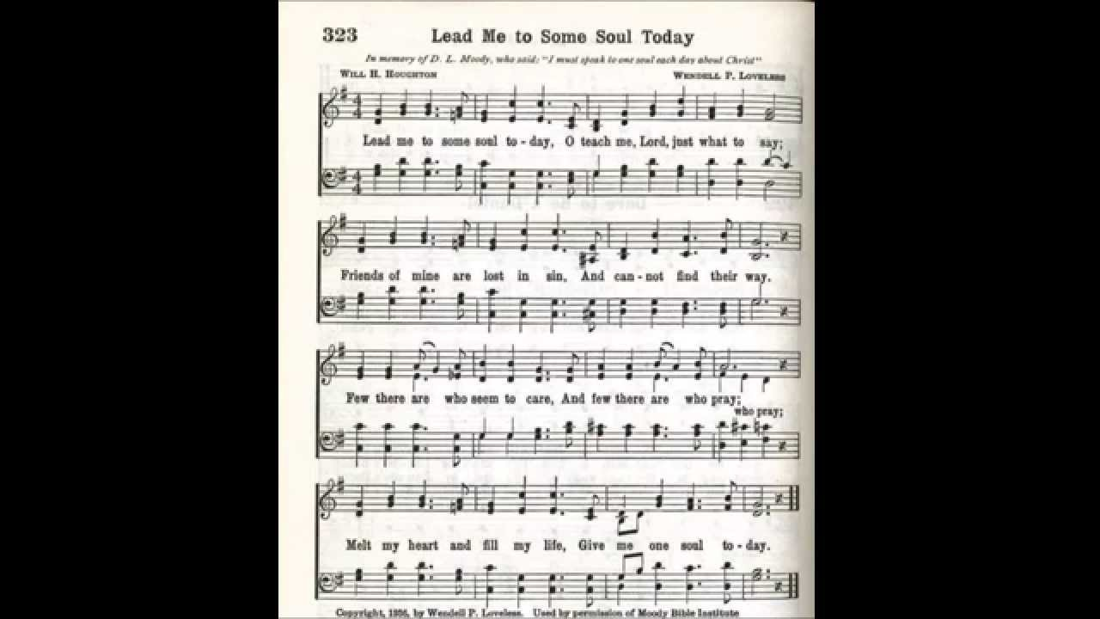
Notes:
The text of stanza 1 was written by Will Henry Houghton in 1936 (1887-1947). A Baptist minister, he became president of Moody Bible Institute at Chicago, IL, in 1934. The tune (Loveless) was composed by Wendell Phillips Loveless (1892-1987). A businessman, he became director of the radio department at Moody Bible Institute, and later served as a minister. The song seems to have been first printed in one of Loveless's five volume series "Radio Songs and Choruses of the Gospel.“The text of stanzas 2-4 in "Hymns for Worship Revised" was written by Ellis J. Crum (b. 1928). It was first published in his 1977 "Special Sacred Selections.“ Like God, we want souls to be saved (1 Tim. 2:3-4; 2 Pet. 3:9).

Slide 2
Lead Me to Some Soul Today by Will Houghton
Lead me to some soul today; (Matt. 16:26)
O teach me, Lord, just what to say; (Ex. 3:10-13)
Friends of mine are lost in sin, (John 9:39-41)
And cannot find their way. (2 Cor. 4:4)
Souls are lost & dying in their sins and headed for
eternal torment in hell. The gospel of Christ is the
only thing that will save them. Plant the seed so that
they might escape the darkness & come to the light!

Slide 3
Lead Me to Some Soul Today by Ellis J. Crum
Lead me to some way-ward soul, (Pr. 11:30)
To one who's wandered from the fold; (Luke 15:1-7)
Help me turn him unto Thee, (Acts 26:17-18)
Thy blessings to behold (James 5:19-20)
How easy it is for us to be like sheep and wander
away from Jesus and listen to a wolf (false teacher).
We need to realize how precious it is to save a soul
from death and cover a multitude of sins!

Slide 4
Lead Me to Some Soul Today by Ellis J. Crum
Lead me from self-righteousness, (Luke 18:9-14)
May Christ always be seen in me; (Gal. 2:20)
How can I do anything less, (Matt. 5:16)
Than lead more souls to Thee? (Ps. 51:10-13)
You can’t be a self righteous hypocrite & lead others
to Christ. Christ must be seen in us by our thoughts,
words, and deeds. Let your light shine so that others
may glorify God.

Slide 5
Lead Me to Some Soul Today by Ellis J. Crum
Open hearts of those I love, (Acts 16:14-15)
To hear and heed the gospel call; (2 Thess. 2:14)
May they start to heav'n above,
And may they never fall. (2 Peter 1:5-11)
God opens hearts by the power of His word but we
must be willing to hear and respond to the gospel.
Practice the Christian graces and you won’t fall!

Slide 6
Lead Me to Some Soul Today by Ellis J. Crum
Few there are who seem to care, (2 Peter 2:5)
And few there are who pray; (James 4:1-4)
Melt my heart and fill my life; (Matt. 9:36-38)
Give me one soul today. (Luke 15:7)
Few seem to care about spiritual things just like in
the days of Noah but he didn’t give up and neither
must be. May our hearts be softened with love &
compassion for the lost like our Lord.

