Slide 1
Hymns for Worship at Woodmont
Praying
Notes:
Ty for prayers for me to preach in McKinney with boldness, simplicity, and purity! Week before relapse Upper Resp. Inf. God answers prayers according to His will. 84% Americans prayed in last week (2011). A Newsweek poll titled “Is God Listening?” those who pray, 87% believed God answers prayers at least some of the time. Why is the world so wicked then? (Rom. 1) Turn ears away from God’s word- when you do that prayer is an abomination (Pr. 28:9). Exercise in futility. Husband abuses wife, he still expects wife to listen to him. People abuse God’s word yet expect Him to listen & respond to their requests. God only hears prayers of righteous, not wicked (1 Pet. 3:12).

Slide 2
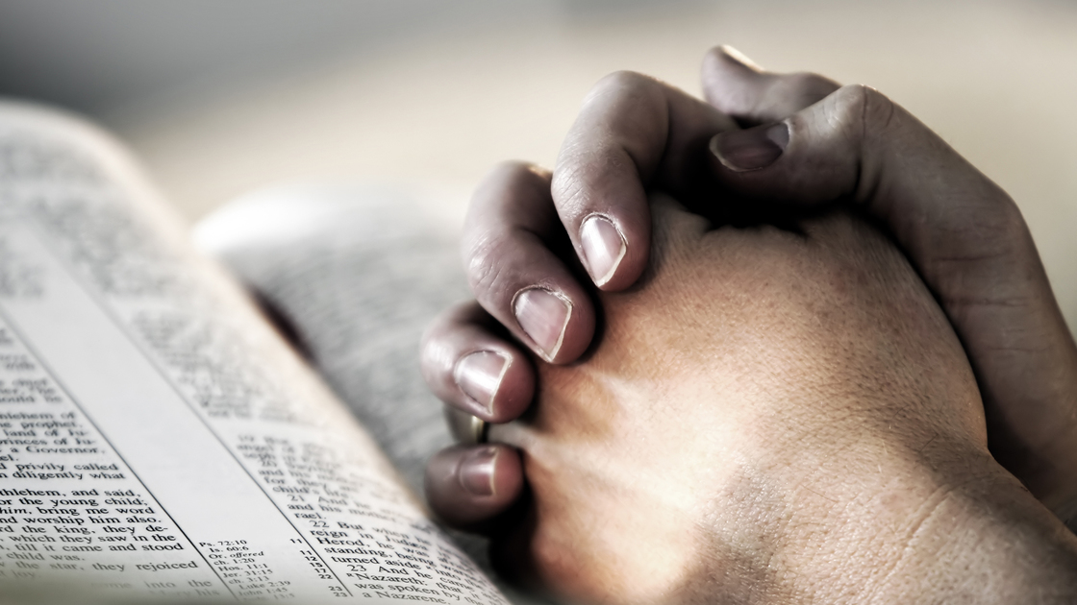
Persevere in Prayer
Notes:
Ty for prayers for me to preach in McKinney with boldness, simplicity, and purity! Week before relapse Upper Resp. Inf. God answers prayers according to His will. 84% Americans prayed in last week (2011). A Newsweek poll titled “Is God Listening?” those who pray, 87% believed God answers prayers at least some of the time. Why is the world so wicked then? (Rom. 1) Turn ears away from God’s word- when you do that prayer is an abomination (Pr. 28:9). Exercise in futility. Husband abuses wife, he still expects wife to listen to him. People abuse God’s word yet expect Him to listen & respond to their requests. God only hears prayers of righteous, not wicked (1 Pet. 3:12).

Slide 3
Persevere in Prayer (Col. 4:2-6)
“Devote yourselves to prayer, keeping alert in it with an
attitude of thanksgiving; praying at the same time for us as
well, that God will open up to us a door for the word, so
that we may speak forth the mystery of Christ, for which I
have also been imprisoned; that I may make it clear in the
way I ought to speak. Conduct yourselves with wisdom
toward outsiders, making the most of the opportunity. Let
your speech always be with grace, as though seasoned
with salt, so that you will know how you should respond to
each person”

Slide 4
Persevere in Prayer (Col. 4:2-6)
Be Devoted (Luke 22:44; Acts 2:42; Col. 1:9; 4:12)
Notes:
Devoted- earnest, constantly diligent, adhere closely to, steadfast. Focus, dedication, zeal, desire. Jesus prayed- Baptism 3:21, often in wilderness 5:16; all night- choosing apostles 6:12; before asking disciples who he was- Peter’s confession 9:18; Transfiguration 9:28; disciples asked Jesus to teach them 11:1; persistent widow- unjust judge- protection; exposing hypocrisy of Pharisees prayers 18:11ff; prayed fervently Gethsemane 22:44ff; prayed for those who crucified him. Obeyed gospel 50 days later- persevered in word, prayer. Paul- persecutor put in prison but prayed w/o ceasing for brethren he didn’t know. Epaphras was a faithful fervent example of dedicated prayer warrior.

Slide 5
Persevere in Prayer (Col. 4:2-6)
Be Devoted (Luke 22:44; Acts 2:42; Col. 1:9; 4:12)
Stay Alert (Matt. 26:36-46; 1 Pet. 5:8)
Notes:
Be devoted keeping alert in it. WATCH in military- pay attention to danger. Metaphorically give strict attention to, be cautious, active. To take heed lest through remission and indolence some destructive calamity suddenly overtake one. (Strong’s) While Jesus was alert & devoted, the disciples were sleepy & unaware of the danger even though Jesus had warned them many times that he would be unmercifully murdered. Watch & pray- spirit is willing but flesh is weak. We must stay on the alert for the devil is seeking to devour our souls.

Slide 6
Persevere in Prayer (Col. 4:2-6)
Be Devoted (Luke 22:44; Acts 2:42; Col. 1:9; 4:12)
Stay Alert (Matt. 26:36-46; 1 Pet. 5:8)
Be Thankful (Col. 2:7; Phil. 4:6-7)
Notes:
lit. “the giving of thanks for God’s grace” We are taught to be thankful (Col. 2:7); we should be thankful because we don’t have to worry- we can have our hearts guarded in Christ Jesus & have the peace that passes all understanding (Ph. 4:6-7). God has heard and answered a multitude of our prayers- are we grateful or do we just notice when we don’t get what we want & then complain about it. Have the attitude of gratitude not frustration. Discouragement can lead to depression and despair. Count your blessings, not your curses.

Slide 7
Persevere in Prayer (Col. 4:2-6)
Be Devoted (Luke 22:44; Acts 2:42; Col. 1:9; 4:12)
Stay Alert (Matt. 26:36-46; 1 Pet. 5:8)
Be Thankful (Col. 2:7; Phil. 4:6-7)
Pray- Open Doors [Gospel] (Acts 14:26; 16:25ff)
Notes:
God opened door- Gentiles. Disciples not teaching them. Persecution- left Jerusalem, Samaria, Gentiles. God sent Peter vision 3X declaring unclean clean. Conscience clear to preach- saved. Paul & Silas beaten, prison, praying & singing. What are they praying for? Release? Open doors for gospel! Prisoners listening. Providential earthquake at midnight, chains fell off, prison doors open, Paul stopped jailer from suicide. Most prisoners- free! Baptized. Along with Lydia’s household beginning of Ephesus church. GM- opportunities to spread the gospel here so souls might be saved. Are you praying for open doors for the gospel, not a miracle?

Slide 8
Persevere in Prayer (Col. 4:2-6)
Be Devoted (Luke 22:44; Acts 2:42; Col. 1:9; 4:12)
Stay Alert (Matt. 26:36-46; 1 Pet. 5:8)
Be Thankful (Col. 2:7; Phil. 4:6-7)
Pray- Open Doors [Gospel] (Acts 14:26; 16:25ff)
Pray- Preacher [Clear Message] (Titus 1:3; Eph. 6:19)
Notes:
Paul humbled himself, asked prayers from brethren (4:4). Why? Teach clearly. Scriptures are. Many confused by preaching they hear (contradict). If it isn’t clear to the good & honest heart who loves the truth and wants to understand it, then (GP) failed his duty. Not understood- hearer ignorance, immaturity, unbelieving heart, complexity or difficulty of the topic. But if the Scripture says that when we read it we can understand it & (NI understand it alike), when the word is preached it should be understood by the hearer. Bereans (Acts 17:11). If it isn’t right- correct like Aquila & Priscilla did with Apollos (Ax 18:24).

Slide 9
Persevere in Prayer (Col. 4:2-6)
Be Devoted (Luke 22:44; Acts 2:42; Col. 1:9; 4:12)
Stay Alert (Matt. 26:36-46; 1 Pet. 5:8)
Be Thankful (Col. 2:7; Phil. 4:6-7)
Pray- Open Doors [Gospel] (Acts 14:26; 16:25ff)
Pray- Preacher [Clear Message] (Titus 1:3; Eph. 6:19)
Pray- Wisdom to Teach Wicked (Eph. 5:15ff; Jas. 1:5ff)
Notes:
Wisdom- say right thing, right time, right heart to all- responsibility plant the seed in good & honest heart- God give increase. Can’t tell of interest. Most unlikely prospect (adulterer, drunkard, drug abuser, murderer) realize sin is so bad- seek way out of suffering. Evil days- make most of time- door closed later. Knowing God’s terror we persuade men (2 Cor. 5:11). Jesus died for you- conviction to teach- be saved. Are you perserving in prayer or growing weary-appears God not answering prayers. 1st century- devoted, alert, thankful, open doors, clarity of message, teaching wicked (is it our focus). If not, might be why you’re suffering. Lord returns- will he find faith on earth?

