Slide 1
Hymns for Worship at Woodmont
9- Our God, He is Alive

Slide 2
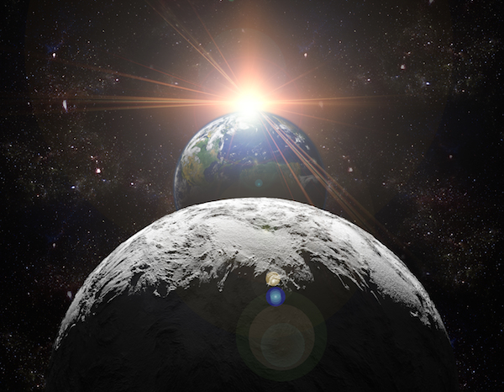
Arguments
for
the
Existence
of
God
Notes:
Does God Exist-significant question. 3/14 Death Stephen Hawking famous evolutionist proponent Big Bang praised. Atheists Convention OK city 3/29-4/1. Possibility of 40% young adults doubt His existence. Manysacrificing to god of popularity, prosperity, power, political parties, political correctness, passion, party lifestyle reflected in tabloid TV, movies, sitcoms, music, lifestyles. God’s existence stated as fact from 1st verse on. Important establish- unbeliever- the Bible is God’s word to make logical reasons why it is more reasonable to believe in God than not. Every Christian needs to be prepared to give a reason for the hope that is within him (1 Pt. 3:15).

Slide 3
Arguments for the Existence of God
Creation Demands a Creator [Something Can’t Come from Nothing] (Ge. 1:1; He. 11:3)
Notes:
Jesus often asked question when facing opposition. Instead of answering, ask question ‘can something come from nothing“’? Universe exists, everything must have a first cause. Big bang explosion 4.6 billions years ago had to have a first cause unless you believe somehow that matter is eternal. Is it more reasonable to believe that matter is greater than mind or mind is greater than matter. Noone would say that the wood somehow made itself into one of these pews. No intelligence put the matter together. Same thing as far as creation. If so, how did non intelligent matter create some.Atheist can’t truly deny this fact unless you believe some kind of miracle matter is eternal.

Slide 4
Arguments for the Existence of God
Creation Demands a Creator [Something Can’t Come from Nothing] (Ge. 1:1; He. 11:3)
Design Demands a Designer (Isa. 40:26; Gen. 1:9ff; 8:22)
Notes:
Earth distance equator c. 25,000 miles, to sun almost 4,000 X as great, 93 million. Neptune, 8th planet from sun, 2 ½ billion miles away, 30X as far away as the sun. 8.61 light years. Light year c. 6 trillion miles. Thousands of light years required-traveling rate 186,000 miles/sec to reach us from these bodies. Can count all stars & galaxies. God Knows all by name! Great power (Isa. 40:26). How did matter create all this w/o chaos in Big Bang? Earth revolves around sun- one revolution/year. Why are there seasons? Man- Billions years ago Earth hit by huge space object, ejecting billions of tons materials & eventually leading to formation of Moon. It also pushed the Earth off kilter by 23.5 degrees. More reasonable Gen. 1; 8:22 or man’s idea Mathematical precision- Haley’s comet 76 years., eclipses years in advance.

Slide 5
Arguments for the Existence of God
Creation Demands a Creator [Something Can’t Come from Nothing] (Ge. 1:1; He. 11:3)
Design Demands a Designer (Isa. 40:26; Gen. 1:9ff; 8:22)
Life Demands a Lifegiver (Gen. 2:7; Ax 17:25; Ps. 139:13)
Notes:
Fact- Life comes from life- biogenesis & can’t come spontaneously from non-living matter. How did it happen? God breathed into man’s nostrils- living being. Longer men study human body, amazed masterpiece, What God did with worthless dust! Can man create life out of nothing? If life cannot arise from non-life, how did it get here? Led atheists to believe in many unscientific & false theories. Common atheistic response today is that SG is not possible now, but it must have been in distant past. Many perform experiments create life, yet failed. Dr Craig Venter, pioneer in genetics, claimed to make a completely new "synthetic" life form from a mix of chemicals. Manufactured new chromosome from artificial DNA in test tube, transferred it into an empty cell and watched it multiply – the very definition of being alive. Speculation far future- Professor Julian Savulescu, expert Practical Ethics-Oxford University, said: “Venter is creaking open the most profound door in humanity’s history, potentially peeking into its destiny.
"He is going toward the role of a god: creating artificial life that could never have existed naturally. "The potential is in the far future, but real and significant: dealing with pollution, new energy sources, new forms of communication. But the risks are also unparalleled.

Slide 6
Arguments for the Existence of God
Creation Demands a Creator [Something Can’t Come from Nothing] (Ge. 1:1; He. 11:3)
Design Demands a Designer (Isa. 40:26; Gen. 1:9ff; 8:22)
Life Demands a Lifegiver (Gen. 2:7; Ax 17:25; Ps. 139:13)
Law Demands a Lawgiver (James 4:12; Ps. 19:7)
Notes:
Laws of nature in place whether we believe God exists or not (gravity, energy, force, etc.) Jump off building 10 stories, believe nothing will happen- don’t believe in God, die. Attest to fact that there is a Lawgiver somewhere. There is a standard of laws in the universe by which we live or there would be chaos & disorder. Jas 4:12, “There is only One Lawgiver oand Judge, the one who is able to save and to destroy”. God has a standard of what’s right and wrong just as He has laws in the universe that all people have to live by.

Slide 7
Arguments for the Existence of God
Creation Demands a Creator [Something Can’t Come from Nothing] (Ge. 1:1; He. 11:3)
Design Demands a Designer (Isa. 40:26; Gen. 1:9ff; 8:22)
Life Demands a Lifegiver (Gen. 2:7; Ax 17:25; Ps. 139:13)
Law Demands a Lawgiver (James 4:12; Ps. 19:7)
Man has a Conscience (Rom. 1:18-20; 2 Cor. 4:1-2)
Notes:
Man possess characteristics & faculties that could not have come from gradual development from animal kingdom (man-apes). Everyone has a sense of right & wrong, fairness, justice, even a a young age. Children- that’s not fair. If an atheist or agnostics has been wronged (stolen from, cursed at, beaten up, slandered, etc.) they will demand that their rights were violated & justice be swift. Why? If there is no God- it shouldn’t matter what anybody does because no one will judge? God has made it evident to man that there is a Creator for which there is no excuse. God made it evident to everyone who has the capability of understanding that there is a living God but they suppress the truth in their wickedness. Man’s conscience needs to be guided by God’s word. Studied last week, Saul lived with a good conscience while persecuting Christians. Conscience w/o guidance from Scripture will lead one to have no guilt of transgressing God’s law. The apostle Paul appealed to the consciences of the brethren at Corinth with the truth of the gospel.

Slide 8
Arguments for the Existence of God
Creation Demands a Creator [Something Can’t Come from Nothing] (Ge. 1:1; He. 11:3)
Design Demands a Designer (Isa. 40:26; Gen. 1:9ff; 8:22)
Life Demands a Lifegiver (Gen. 2:7; Ax 17:25; Ps. 139:13)
Law Demands a Lawgiver (James 4:12; Ps. 19:7)
Man has a Conscience (Rom. 1:18-20; 2 Cor. 4:1-2)
He Raised Jesus up from the Dead (Acts 17:30-31)
Notes:
God gave evidence to all- Judgment. sealed tomb, guards, Jesus definitely died- Fulfilled prophecy, multitude of witnesses, no swoon theory. This is why all people must repent- held accountable for deeds. Hope in DBR of Christ. The fool says there is no God (Ps. 14:1; 53:1) Read Job 38:2-4 . God gave evidence to all & men are w/o excuse. You have the choice to obey or disobey. Problem- not lack of evidence but men wanting to justify their sin & God gave them over to their lusts. Gospel God’s power to save. We have all broken God’s law but God made it possible for forgiveness through His Son!

