Slide 1
Hymns for Worship at Woodmont
78s- Faithful Love
73s- High Above the Seraphim
166- He Loved Me So
23- Great is Thy Faithfulness
331- Kneel at the Cross

Slide 2
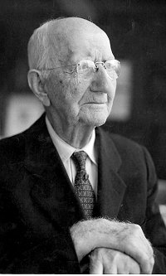
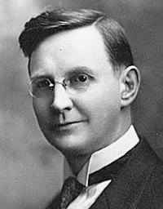
“Great is Thy Faithfulness”
Lamentations 3:22-24
Written by
Thomas O. Chisolm
(1866-1960)
Music by
William M. Runyan
(1870-1957)
Copyright 1923
Notes:
God remains faithful day in and day out in the largest and smallest of circumstances. Ordinary life, Born in log cabin in Franklin, Kentucky. Methodist 27, preached a year, lived in New Jersey and worked as a life insurance agent. He wrote nearly 1,200 poems throughout his life, including several published hymns.

Slide 3
Great is Thy Faithfulness
Great Is Thy faithfulness, O God my Father!
(Psalm 89:1-14, 24, 33, 49)
There is no shadow of turning with Thee;
(James 1:17)
Though changest not, Thy compassions, they fail not
(Malachi 3:6)
As Thou hast been Thou forever wilt be.
(Hebrews 13:8)
Notes:
Typically shadows change according to the changing position of the sun (short midday- lengthy nightfall). But God doesn't change (shorten or lengthen!)because He Himself is His the only absolute reference point! Unlike a shifting shadow, caused by revolution, the Lord is immutable and possesses all power and life in Himself.

Slide 4
Great is Thy Faithfulness
Summer and winter, and springtime and harvest, (Genesis 8:22)
Sun, moon, and stars in their courses above, (Psalm 148:1-6)
Join with all nature in manifold witness
To Thy great faithfulness, mercy, and love.
(Matthew 5:45; Acts 14:17)

Slide 5
Great is Thy Faithfulness
Pardon for Sin and a peace that endureth, (Micah 7:18-20; Ephesians 2:14ff)
Thine own dear presence to cheer and to guide, (Hebrews 13:5; Matthew 28:20)
Strength for today and bright hope for tomorrow (1 Peter 5:6-11; Ephesians 6:10ff)
Blessings all mine, with ten thousand beside! (Ephesians 1:3-4; 2:7; Proverbs 28:20)

Slide 6
Great is Thy Faithfulness
Great Is Thy faithfulness,
Great Is Thy faithfulness,
Morning by morning new mercies I see;
All I have needed Thy hand hath provided
(2 Peter 1:3-4)
Great is Thy Faithfulness, Lord unto me!

Slide 7
Hymns for Worship at Woodmont
78s- Faithful Love
73s- High Above the Seraphim
166- He Loved Me So
23- Great is Thy Faithfulness
331- Kneel at the Cross

