Slide 1
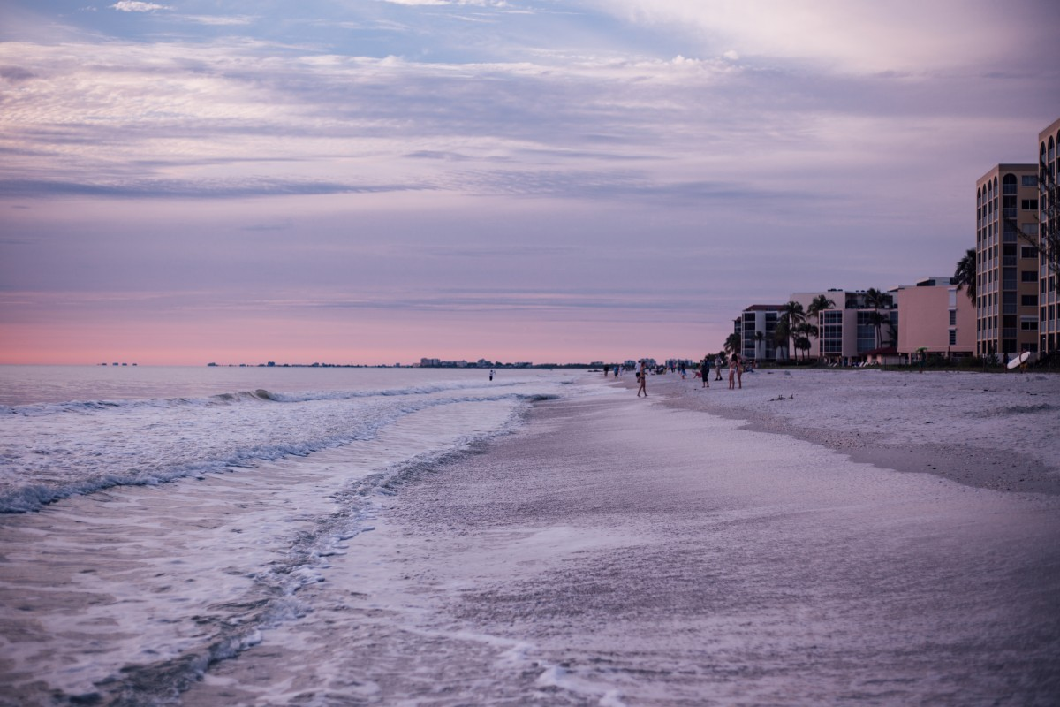
Home of the soul by James Rowe Copyright 1912

Slide 2
Home of the Soul by James Rowe Copyright 1912
If for the prize we have striven, After our labors are o’er, Rest to our souls will be given, On the eternal shore.
We strive toward the prize by exercising self-control, obeying the rules & keeping our eyes focused on Jesus (2 Tim. 2:5; 1 Cor. 9:24-27; Phil. 3:13-14; Heb. 12:1-3). Rest for our souls is in heaven after we have labored for Him (Rev. 14:13; 1 Cor. 15:58).

Slide 3
Home of the Soul by James Rowe Copyright 1912
Yes, a sweet rest is remaining For the true children of God, Where there will be no complaining, Never a chastening rod
Just as Joshua gave rest to Israel in Canaan, there remains a rest for the faithful (Heb. 4:9; 1 John 3:1-3). There’s no complaining or chastening in heaven (Heb. 12:5ff; Phil. 2:14-16)

Slide 4
Home of the Soul by James Rowe Copyright 1912
Soon, the bright homeland adorning, We shall behold the glad dawn; Lean on the Lord till the morning, Trust till the night is gone.
Heaven should be our homeland like the patriarchs (Heb. 11:13-16). We shall behold the glad dawn where Jesus is the bright morning star (2 Pet. 1:19; Ps. 30:5; Rev. 22:16). Trust & lean on Him (Pr. 3:5ff)

Slide 5
Home of the Soul by James Rowe Copyright 1912
Home of the soul, beautiful home, (Rev. 21:22-27; 22:5) There we shall rest, never to roam; Free from all care, happy and bright, Jesus is there, He is the light! Oft, in the storm, lonely are we, Sighing for home, longing for Thee, Beautiful home of the ransomed, Beside the crystal sea.

