Slide 1
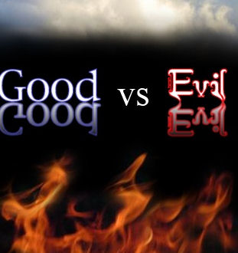
Notes:
English language reflects what God said. Isn’t that amazing. If there is no God, there is no moral standard. This is likely why we have chaos in our society today. Idle mind is the devil’s workshop- summertime. Characteristics of Good vs. Evil- Must discern good from evil by examination & practice (Heb. 5:14; 1 Th. 5:22).

Slide 2
GOOD | EVIL
God (Ps. 106:1; Lk. 18:19) | Devil (John 8:44; Rev. 12:9)
God’s Word (2 Ti. 3:16-17; Ro. 12:2) | Worldly (1 Jn. 2:15-16; Jas. 4:4)
Holy Spirit (1 Co. 2:10ff; Eph. 3:3-5) | Wicked Spirits (Eph. 6:11-12)

Slide 3
GOOD | EVIL
Jesus Christ (Acts 10:38; Matt. 13:37) | Deceptive/ Blinds Unbelieving (2 Co. 4:3-4; 11:3; 13-15)
Seed- Fruit (Mt. 13:38; Lk. 8:11, 15) | Tares- Evildoers (Mt. 13:38-39; Lk. 8:12ff)
Redeemed from sin (Titus 2:14; Eph. 2:4ff) | Dead in Sins (Eph. 2:1-3; Isaiah 5:20ff)

