Slide 1
Hymns for Worship at Woodmont
44- To God be the Glory
118- Take Time to be Holy
152- By Christ Redeemed
144- My Faith Looks Up to Thee
326- Trust and Obey
74- Abide with Me

Slide 2
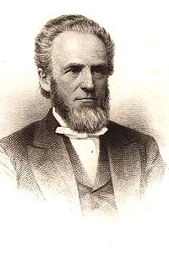
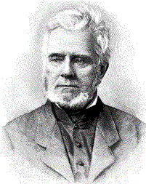
My Faith Looks Up to Thee By Ray Palmer 1808-1886
Tune By Lowell Mason 1792-1872 (written 1830)
Notes:
Palmer wrote these lyrics- after graduating Yale, working as a tutor. He kept it to himself until meeting Lowell Mason in Boston. When Mason asked him to write something for a new hymnal, Palmer showed him these lyrics from 2 years ago. Mason composed this tune shortly after reading it. Several days later he saw Palmer again and said, You may live many years and do many good things, but I think you will be best known as the author of My Faith Looks Up to Thee.

Slide 3
My Faith Looks Up to Thee by Ray Palmer 1830
My faith looks up to Thee,
Thou Lamb of Calvary, Savior divine!
Now hear me while I pray, take all my sins away,
O let me from this day be wholly Thine!
Since Jesus is the Lamb of God who takes away the sins of
the world, our faith should look up Him (John 1:29; Ro. 10:17;
Col. 3:1). We aren’t saved by saying the sinner’s prayer but by
faith in God’s working by being baptized into Christ (Heb. 5:8-
9; Col. 2:12). As Christians, we can pray for forgiveness of sins
and we are promised it will happen (1 John 1:9).

Slide 4
My Faith Looks Up to Thee by Ray Palmer 1830
May Thy rich grace impart
Strength to my fainting heart, my zeal inspire!
As Thou hast died for me, O may my love to Thee,
Pure warm, and changeless be, a living fire!
God’s grace is sufficient for us to overcome our weakness
through His strength to humbly do His will (2 Cor. 12:9-10).
In response to His sacrifice, our love for Him should be boiling
over with enthusiasm to do His will everyday (Rom. 12:11;
Titus 2:14; 1 Pet. 3:13; 2 Cor. 5:14-15).

Slide 5
My Faith Looks Up to Thee by Ray Palmer 1830
While life’s dark maze I tread,
And griefs around me spread, be Thou my guide;
Bid darkness turn to day, wipe sorrow’s tears away,
Nor let me ever stray from Thee aside.
Satan has blinded the minds of many, making the world a sinful and
confusing place to live with many griefs (2 Cor. 4:4; 1 Tim. 6:9).
God’s word is the light that can guide us so that we can be in
fellowship with Him (Ps. 119:105; 1 Jn. 1:1-7). God will wipe away
all tears in heaven (Rev. 21:4). Since we can fall away, we request
His help to not stray (Heb. 3:12-14; 4:14-16; 1 Pt. 2:25).
Notes:
Maze- a state of bewilderment or confusion.

Slide 6
Hymns for Worship at Woodmont
44- To God be the Glory
118- Take Time to be Holy
152- By Christ Redeemed
144- My Faith Looks Up to Thee
326- Trust and Obey
74- Abide with Me

