Slide 1
Hymns for Worship at Woodmont
70s- Mansion over the Hilltop
33s- In Your Holy Sight
385- What Did He Do?
19- Heavenly Sunlight
315- O Why Not Tonight?

Slide 2
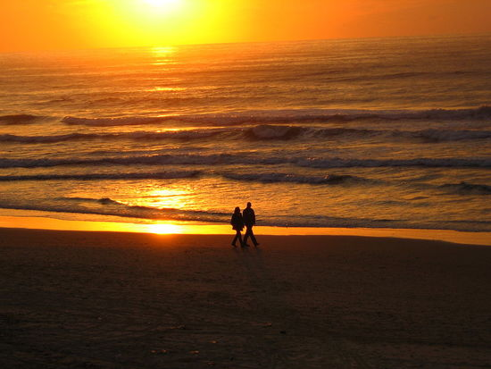
Walking
in
Sunlight
By
Henry
J.
Zeller
1899
Notes:
Born NJ, Mar. 15, 1859. Educated in the Mt. Holly public schools, at Pennington Seminary, and at Taylor University Methodist minister in 1882. Promoted campmeeting movement. Composed by George Harrison Cook (1864-1946 or 1948). Little is known about the composer. Spent his life in the ministry of preaching, composing, and song training. Toward the end of his life, he was living at Ocean Grove, NJ. Around 1899 Cook set down the music and brought it to Zelley, asking him to provide words for it.

Slide 3
Walking in Sunlight by Henry J. Zelley 1899
"Walking in sunlight all of my journey, (Ps. 119:105)
Over the mountains, through the deep vale, (Ex. 13:21)
Jesus has said, ‘I’ll never forsake thee,’ (Ps. 56:11-13)
Promise divine that never can fail.“ (Heb. 13:5-6)
As God guided the Israelites through the wilderness to
the promised land, we trust in His promises to lead us
because He never fails & has promised to never leave or
forsake us.

Slide 4
Walking in Sunlight by Henry J. Zelley 1899
"Shadows around me, shadows above me,
Never conceal my Savior and Guide. (Lk. 1:76-79)
He is the light; in Him is no darkness. (John 8:12)
Ever I’m walking close to His side.“ (1 John 1:5-7)
The shadows of darkness (sin) doesn’t conceal the fact
that Jesus is the light of the world who our Savior and
Guide. If we keep His commandments we’ll be walking
close to His side.

Slide 5
Walking in Sunlight by Henry J. Zelley 1899
"In the bright sunlight, ever rejoicing, (Jn. 1:1-13, 5:35)
Pressing my way to mansions above, (Phil. 3:13-14)
Singing His praises, gladly I’m walking, (Eph. 5:1-21)
Walking in sunlight, sunlight of love.“
We’re rejoicing singing His praises & walking in His light
that leads to eternal life in heaven!

Slide 6
Walking in Sunlight by Henry J. Zelley 1899
"Heavenly sunlight, heavenly sunlight,
Flooding my soul with glory divine; (2 Peter 1:2-4)
Hallelujah, I am rejoicing,
Singing His praises, Jesus is mine.“ (Col. 3:16-17)
Since we have escaped the world’s corruption to become
partakers of the divine nature, we are rejoicing for we
belong to Christ.

