Slide 1
Hymns for Worship at Woodmont
4- Blessed Assurance
149- I Will Sing the Wondrous Story
100s- Lamb of God
34- Worthy art Thou
300- I Am Coming Lord
399- Face to Face

Slide 2
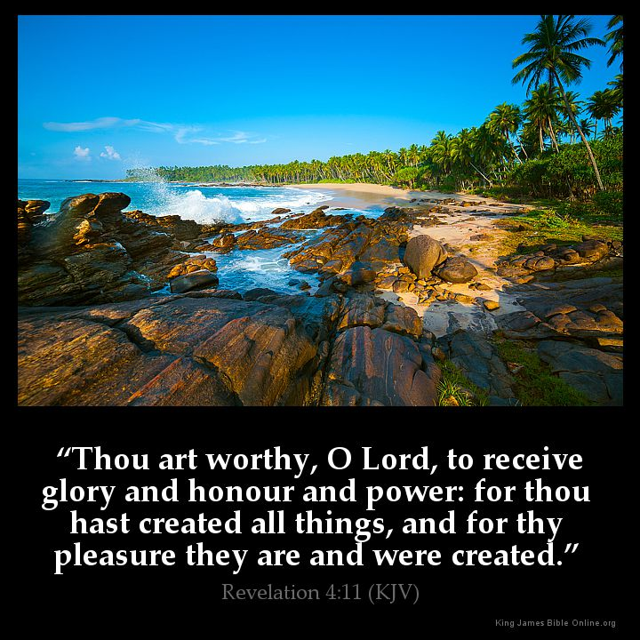
Notes:
The song was penciled on the flyleaf of his copy of B. W. Johnson's "Notes" early one Sunday morning in 1930 when Teddlie was studying Revelation chapter 5 for his sermon while preaching in Belton, TX. Baptized into Christ 1903. The 8th of 9 children in a singing family, 1st singing school at 9 taught by his brother Jim. Went to school at Denton and Waco. Soon after his baptism, he began teaching singing schools, producing gospel songs, and publishing hymnbooks. 130 hymns credited to him.

Slide 3
Worthy Art Thou by Tillit S. Teddlie 1885-1987
"Worthy of praise is Christ our Redeemer, (Rev. 5:9, 12)
Worthy of glory, honor, and power! (Rev. 5:12)
Worthy of all our souls’ adoration, (Phil. 1:27; 4:8)
Worthy art Thou! Worthy art Thou!“ (Rev. 4:11)
God exalted Christ because of His death, burial,
resurrection, & therefore He is worthy of all our praise,
adoration, and honor (Phil. 2:5-11).

Slide 4
Worthy Art Thou by Tillit S. Teddlie 1885-1987
"Lift up the voice in praise & devotion, (Rev. 4:10 5:14)
Saints of all earth before Him should bow; (Rom. 14:11)
Angels in heaven worship Him saying, (Heb. 1:6)
‘Worthy art Thou! Worthy art Thou!’“
God’s angels worship Christ & all saints should bow
before Him because He is Deity (Matt. 4:10)

Slide 5
Worthy Art Thou by Tillit S. Teddlie 1885-1987
"Lord, may we come before Thee with singing, (Ps 100)
Filled with Thy spirit, wisdom, and power; (Eph. 5:15ff)
May we ascribe Thee glory and honor; (Rev. 4:9-11)
Worthy art Thou! Worthy art Thou!“
Being filled with God’s Spirit, wisdom, and power we
should glorify and honor Him with our voices for He is
worthy to be praised forever!

Slide 6
Hymns for Worship at Woodmont
4- Blessed Assurance
149- I Will Sing the Wondrous Story
100s- Lamb of God
34- Worthy art Thou
300- I Am Coming Lord
399- Face to Face

