Slide 1
Hymns for Worship at Woodmont
44- To God be the Glory
97- O to be Like Thee
161- Hallelujah! What a Savior!
500- Give Me the Bible
301- Soul a Savior Thou art Needing
122- Now the Day is Over

Slide 2
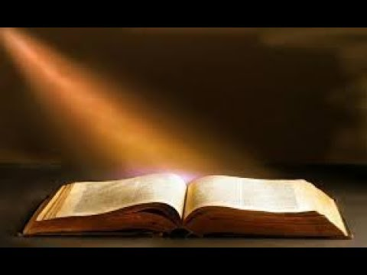
Give Me the Bible by Priscilla Jane Owens 1883
Notes:
1829-1907 She taught children in Baltimore for 50 years. She wrote over 200 songs mainly for children. Probably writing about them in this song. They were ‘lone and tempest tossed’, had ‘broken’ hearts, felt ‘fear’ and ‘grief’, and walked in ‘gloom’. Not a very happy picture, huh? 1800’s were tough w/o modern advances in medicine. Bible taught on Sundays, both in the classroom and with her poetic pen.

Slide 3
Give Me the Bible by Priscilla Jane Owens 1883
Give me the Bible, star of gladness gleaming,
To cheer the wand’rer lone and tempest tossed;
No storm can hide that radiance peaceful beaming,
Since Jesus came to seek and save the lost.
Jesus Christ is the star from Jacob who fulfilled prophecy of being the Messiah (Num. 24:17; Rev. 22:16). He is the Word which is able to cheer up the lonely who obey Jesus and will help them when the storms of life come
(Jn. 1:1-5, 14; 16:33; Lk. 19:10; Matt. 7:24-25; Heb. 1:3).

Slide 4
Give Me the Bible by Priscilla Jane Owens 1883
Give me the Bible, when my heart is broken,
When sin and grief have filled my soul with fear;
Give me the precious words by Jesus spoken,
Hold up faith’s lamp to show my Savior near.
Our hearts are broken by sin which separates us from God & leave us fearful of Judgment (Isa. 59:1-2; Heb. 10:26ff). The precious words that Jesus spoke leads to eternal life and we need to trust in God’s word which tells that the Savior is near (John 12:49; Ps. 34:18; Phil. 4:5ff)

Slide 5
Give Me the Bible by Priscilla Jane Owens 1883
Give me the Bible, all my steps enlighten,
Teach me the danger of these realms below;
That lamp of safety o’er the gloom shall brighten,
That light alone the path of peace can show.
Jesus is the light of the world who illumines all the traps Satan tries to blind us with so that we can walk by the lamp of God’s word to safety & peace in this dark world of sin (John 8:12; 2 Cor. 4:4-6; Ps. 119:105; Luke 1:79).

Slide 6
Give Me the Bible by Priscilla Jane Owens 1883
Give me the Bible, lamp of life immortal,
Hold up that splendor by the open grave;
Show me the light from Heaven’s shining portal,
Show me the glory gilding Jordan’s wave.
God’s word is a lamp that leads us to immortality through His resurrection (Pr. 6:20-23; 2 Tim. 1:8-11; Rev. 22:14).
Gilding- “a thin gold leaf or layer to a surface”… “Jordan is a figure of death passing from this life into eternity… “Through the eye of faith we can see the golden shores of death which beckons us to eternal life in heaven” (Leon Brashear, braggschurchofchrist.com)
Notes:
The word gilding refers to applying a thin gold leaf or layer to a surface. We know that Israel crossed the Jordan to enter the Promised Land. For us Jordan is a figure of death; of passing from this life into eternity. For the faithful child of God death should hold no fear. It is the doorway into Paradise and eventually Heaven, the eternal home of the soul. The song teaches us the value of death! It is a wonderful experience for those who are prepared (Ps. 116:15). By the eye of faith we can see the golden shores of death which beckons us to eternal life with God in heaven.

Slide 7
Give Me the Bible by Priscilla Jane Owens 1883
Give me the Bible, holy message shining;
Thy light shall guide me in the narrow way;
Precept and promise, law and love combining,
Till night shall vanish in eternal day.
Everyone should desire to hear God’s word with its holy message guiding us to the narrow way that leads to life (1 John 3:2-3; Matt. 7:14). The Bible unites love and law, precept & promise until God’s light illumines heaven & He puts out sin & nighttime (Matt. 22:37-40; Rev. 21:23ff)
Notes:
The word gilding refers to applying a thin gold leaf or layer to a surface. We know that Israel crossed the Jordan to enter the Promised Land. For us Jordan is a figure of death; of passing from this life into eternity. For the faithful child of God death should hold no fear. It is the doorway into Paradise and eventually Heaven, the eternal home of the soul. The song teaches us the value of death! It is a wonderful experience for those who are prepared (Ps. 116:15). By the eye of faith we can see the golden shores of death which beckons us to eternal life with God in heaven.

Slide 8
Hymns for Worship at Woodmont
44- To God be the Glory
97- O to be Like Thee
161- Hallelujah! What a Savior!
500- Give Me the Bible
301- Soul a Savior Thou art Needing
122- Now the Day is Over

