Slide 1
Hymns for Worship at Woodmont
1s- I Stand in Awe
186- I Stand Amazed
153- ‘Tis Set the Feast Divine
614- The Fruit of the Spirit
632- Come unto Me

Slide 2
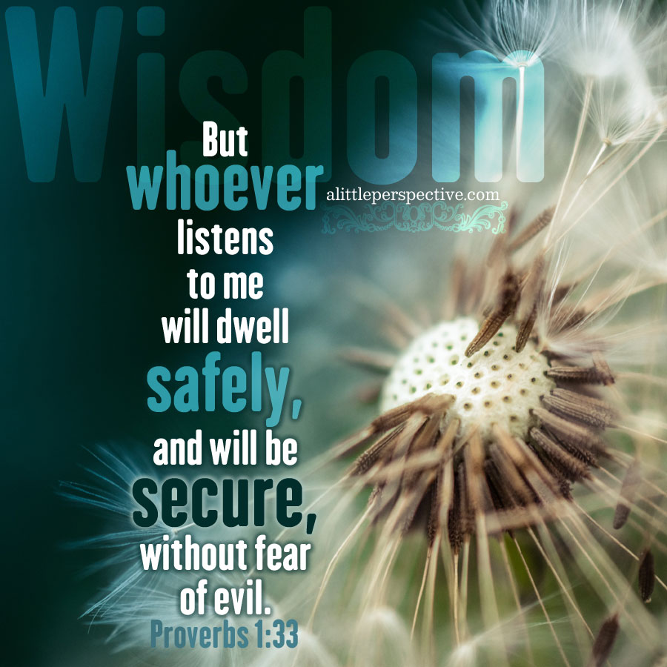
The
Rewards
of
Wisdom
Notes:
Rewards of Wisdom- Prolonged life, peace, prosperity, and power (spiritual benefits from God)

Slide 3
Rewards of Wisdom | Conditional Promise | Dangers if you reject Wisdom
Notes:
Betach- place of refuge; abstractly {safety} both the fact (security) & feeling (trust); often safely. Sharmar- keep, guard, protect (if you keep His word, He will keep you from evil) Sakal- Intelligent, Circumspect Aram- beware Prudence- caution with regard to practical matters; discretion; providing for future; sagacious, circumspect, sober. Words you use. Choosing friends, who you will marry, cautious listen to warning bells of conscience so as to not to make fatal decision (drink, dance, fornicate, get rich quick schemes). Prudent people think ahead, and do what they can to prepare for the future. One of the earmarks of prudence is to “look before we leap.” Prudent- some things best covered up or ignored insult (12:16); give cautious answers (12:23); think ahead (Prov. 22:3); healthy skepticism. (14:15); handle correction well (15:5); study (18:15)

Slide 4
Rewards of Wisdom | Conditional Promise | Dangers if you reject Wisdom
Protection (Pr. 1:33; 3:19-26; Eccl. 7:12; 1 Peter 1:3-5)
Notes:
Betach- place of refuge; abstractly {safety} fact (security) & feeling (trust); often safely. Sharmar- keep, guard, protect (if you keep His word, He will keep you from evil). In this world we need to have protection (burglars, kidnappers, rapists, murderers, terrorists) & insurance protection (life, auto, health, home, accidents). Need protection for souls which can only be provided by God’s wisdom- sleep securely & not be fearful from our spiritual enemy. It is more important than money because a fool & is money will soon be parted.

Slide 5
Rewards of Wisdom | Conditional Promise | Dangers if you reject Wisdom
Protection (Pr. 1:33; 3:19-26; Eccl. 7:12; 1 Peter 1:3-5) | Put on God’s Armor [Obey His Word] (Pr. 4:4-6; 8:32; Ep. 6:11; Jn. 15:10)

Slide 6
Rewards of Wisdom | Conditional Promise | Dangers if you reject Wisdom
Protection (Pr. 1:33; 3:19-26; Eccl. 7:12; 1 Peter 1:3-5) | Put on God’s Armor [Obey His Word] (Pr. 4:4-6; 8:32; Ep. 6:11; Jn. 15:10) | Led Astray (Pr. 5:23; 8:36; 20:1; Eph. 4:14; (2 Pet. 2:2, 15, 18)

Slide 7
Rewards of Wisdom | Conditional Promise | Dangers if you reject Wisdom
Protection (Pr. 1:33; 3:19-26; Eccl. 7:12; 1 Peter 1:3-5) | Put on God’s Armor [Obey His Word] (Pr. 4:4-6; 8:32; Ep. 6:11; Jn. 15:10) | Led Astray (Pr. 5:23; 8:36; 20:1; Eph. 4:14; (2 Pet. 2:2, 15, 18)
Prudence (Pr. 1:2-4; 8:5, 12; 16:20; 19:14)
Notes:
Sakal (13X in Pr.) Intelligent, Circumspect (1:3; 10:19; 19:14; 21:16) Aram (8X in Pr. 12:16, 23; 14:15; 22:3; 27:12)- beware, cautious. Bene (34X in Pr. 1:2,5,6; 8:5,9; 16:21; 17:10; 18:15)- separate mentally, distinguish, understand Prudence- caution with regard to practical matters; discretion; providing for future; sagacious, circumspect, sober. Words you use. Choosing friends, who you will marry, cautious listen to warning bells of conscience so as to not to make fatal decision (drink, dance, fornicate, get rich quick schemes). Prudent people think ahead, and do what they can to prepare for the future. One of the earmarks of prudence is to “look before we leap.” Prudent- some things best covered up or ignored insult (12:16); give cautious answers (12:23); think ahead (Prov. 22:3); healthy skepticism. (14:15); handle correction well (15:5); study (18:15)

Slide 8
Rewards of Wisdom | Conditional Promise | Dangers if you reject Wisdom
Protection (Pr. 1:33; 3:19-26; Eccl. 7:12; 1 Peter 1:3-5) | Put on God’s Armor [Obey His Word] (Pr. 4:4-6; 8:32; Ep. 6:11; Jn. 15:10) | Led Astray (Pr. 5:23; 8:36; 20:1; Eph. 4:14; (2 Pet. 2:2, 15, 18)
Prudence (Pr. 1:2-4; 8:5, 12; 16:20; 19:14) | Understand His Will [Forsees Evil] (22:3; 10:19; 12:16, 23; 14:15; 15:5; 18:15; 21:11)
Notes:
Prudent- some things best covered up or ignores insult (12:16); give cautious answers, doesn’t show off his knowledge (12:23); thinks ahead, sees danger & takes precautions (22:3); healthy skepticism, doesn’t believe everything he hears, sensible. (14:15); handles correction well from parents (15:5); study- he is eager and ready to learn (18:15); when a mocker is punished the naïve gains understanding, helps him to become prudent

Slide 9
Rewards of Wisdom | Conditional Promise | Dangers if you reject Wisdom
Protection (Pr. 1:33; 3:19-26; Eccl. 7:12; 1 Peter 1:3-5) | Put on God’s Armor [Obey His Word] (Pr. 4:4-6; 8:32; Ep. 6:11; Jn. 15:10) | Led Astray (Pr. 5:23; 8:36; 20:1; Eph. 4:14; (2 Pet. 2:2, 15, 18)
Prudence (Pr. 1:2-4; 8:5, 12; 16:20; 19:14) | Understand His Will [Forsees Evil] (22:3; 10:19; 12:16, 23; 14:15; 15:5; 18:15; 21:11) | Death (Proverbs 21:16; Heb. 10:26-31)
Notes:
Whoever strays from the path of prudence comes to rest in the company of the dead.. (21:16). Wages of sin is death, God’s gift is eternal life in Jesus (Rom. 6:23). Everybody loves to get a prize and there is no greater gift than wisdom. It is a gift that keeps on giving throughout eternity. Without it we are fools and will suffer eternal torment in hell with regrets which will never end. Those who don’t obey the gospel will be punished forever while the righteous enjoy eternal life. Protected by God’s power through faith. Prudence to help you foresee the danger of sin & the snares of the devil so that you can overcome it & live for Jesus!
God wants to give it to you but you must refuse to do what seems right to you & obey Him

Slide 10
Hymns for Worship at Woodmont
1s- I Stand in Awe
186- I Stand Amazed
153- ‘Tis Set the Feast Divine
614- The Fruit of the Spirit
632- Come unto Me

