Slide 1
Hymns for Worship at Woodmont
2- Hallelujah Praise Jehovah
110s- I Will Call upon the Lord
166- He Loved Me So
436- I’ll Fly Away
319- Only a Step

Slide 2
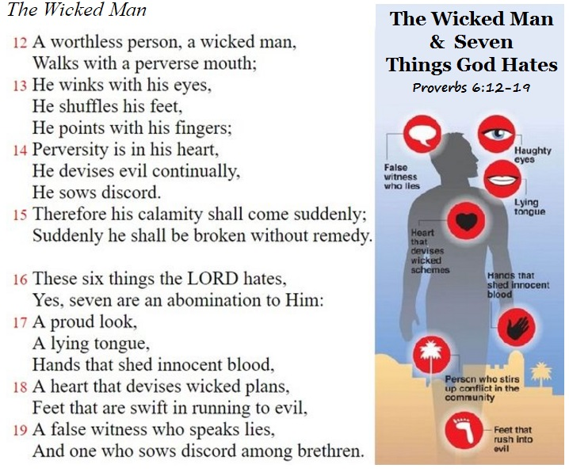
Notes:
What do you hate? What is disgusting, morally repugnant, filthy, stinks to you? (Bathroom smells, vomit, carcass, skunk, spoiled food, etc.) You shouldn’t hate anybody or anything should you? Love, love, love. God hates sin; he hates every sin; he hates nothing but sin. Some thinks smell, bring a stench to his nostrils, & disgusting & despicable to him. He has revealed His feelings to mankind. Read Proverbs 6:12-19 Whole body involved- eyes, feet, tongue, hands, fingers, heart, feet, Men of Belial ruin to come suddenly, & w/o remedy, because God hates their practices. Pro_6:16. Easy to judge others, but not ourselves by His standard, but we must hate the things that God hates & especially when we see it in us. Examine yourselves!

Slide 3
Things that God Hates (Proverbs 6:12-19)
Haughty Eyes (Pr. 30:13; Ps. 10:4; 18:27; Luke 18:9ff)
Notes:
God hates haughty eyes. Eyes are the window to the soul. “There is a generation whose eyes are so lofty, and whose eyelids are lifted up disdainfully” They are arrogant. They don’t seek for God- all their thoughts are there is no God. Like the Pharisees who trusted in themselves that they were righteous & viewed others with contempt. Exalt themselves, condemn others. “For you save a humble people, but the haughty eyes you bring down” God will bring them down, they will bow down & confess Jesus is Lord in the end.

Slide 4
Things that God Hates (Proverbs 6:12-19)
Haughty Eyes (Pr. 30:13; Ps. 10:4; 18:27; Luke 18:9ff)
Lying Tongue (Pr. 12:22; 17:4; 19:5, 9; Rev. 21:8)
Notes:
“Lying lips are an abomination to the Lord, but those who act faithfully are his delight” But everybody does it & make a living off of it like politicians, lawyers, & used car salesman, solicitors, etc.! Satan is a liar & the father of all lies since the beginning. God hates lies & whatever apparent advantage comes from it. If we lie for personal gain, get out of trouble, from weakness, false teaching, He hates it. The abomination not in motive, but the lie itself. Liars listen to and are deceived by liars. “An evildoer listens to wicked lips, & a liar gives ear to a mischievous tongue” They won’t get away with it-God will punish the liar in hell (Pr. 19:5, 9; Rev. 21:8). All liars will have their part in the lake that burns with firestone. “Let God be found true though every man be a liar” (Rom. 3:4). God hates every lie, don’t ever say that at least it did some good in the end.

Slide 5
Things that God Hates (Proverbs 6:12-19)
Haughty Eyes (Pr. 30:13; Ps. 10:4; 18:27; Luke 18:9ff)
Lying Tongue (Pr. 12:22; 17:4; 19:5, 9; Rev. 21:8)
Hands Killing the Innocent (2 Kgs. 21:6; 24:4; Rev. 19:2)
Notes:
“Thou shalt not kill” & God killed all those innocent people in Canaan didn’t He? Should be translated murder. Killed in accidents, self-defense, etc. God gave them plenty of time to repent & they refused. It was because of their wickedness that Israel was able to go into the promised land. Manasseh made his son pass through the fire, practiced witchcraft and used divination, and dealt with mediums and spiritists. He did much evil in the sight of the Lord provoking Him to anger. Judah punished “for the innocent blood which he shed, for he filled Jerusalem with innocent blood; and the Lord would not forgive” (2 Kgs 24:4). God will avenge the blood of the innocent from righteous Abel on down to all the prophets, apostles, brethren martyred for Christ.

Slide 6
Things that God Hates (Proverbs 6:12-19)
Haughty Eyes (Pr. 30:13; Ps. 10:4; 18:27; Luke 18:9ff)
Lying Tongue (Pr. 12:22; 17:4; 19:5, 9; Rev. 21:8)
Hands Killing the Innocent (2 Kgs. 21:6; 24:4; Rev. 19:2)
Heart Devising Wickedness (Ps. 37:12; Esther 3:8ff; 7:10)
Notes:
The wicked plots against the righteous And gnashes at him with his teeth. Haman plotted to exterminate all the Jews because one Jew Mordecai refused to bown down to him because it would have violated God’s command for Mordecai to do so. Haman has the king sign a decree for all these people to be destroyed because they refuse to obey the king’s laws and bribes him with putting a lot of money into the treasury from the booty of his victims. How cold blooded is that? But God hates those who devise wickedness and he is hung on the same gallows that he wanted Mordecai hung on.

Slide 7
Things that God Hates (Proverbs 6:12-19)
Haughty Eyes (Pr. 30:13; Ps. 10:4; 18:27; Luke 18:9ff)
Lying Tongue (Pr. 12:22; 17:4; 19:5, 9; Rev. 21:8)
Hands Killing the Innocent (2 Kgs. 21:6; 24:4; Rev. 19:2)
Heart Devising Wickedness (Ps. 37:12; Esther 3:8ff; 7:10)
Feet Racing to do Evil (Rom. 3:15; Matt. 26:4; Acts 23:12)
Notes:
To run to mischief" is to carry out without delay what has already been devised in the heart. The chief priests & elders were swift to do what they devised in their heart to Jesus. It implies more than falling or sliding into sin, which is common to all. When Paul became a traitor to their cause of Judaism, Jews made an oath that they would not eat or drink until Paul was killed but it was found out by his nephew and he escaped the 40 Jews who were going to ambush him.

Slide 8
Things that God Hates (Proverbs 6:12-19)
Haughty Eyes (Pr. 30:13; Ps. 10:4; 18:27; Luke 18:9ff)
Lying Tongue (Pr. 12:22; 17:4; 19:5, 9; Rev. 21:8)
Hands Killing the Innocent (2 Kgs. 21:6; 24:4; Rev. 19:2)
Heart Devising Wickedness (Ps. 37:12; Esther 3:8ff; 7:10)
Feet Racing to do Evil (Rom. 3:15; Matt. 26:4; Acts 23:12)
A Lying Witness (Ps. 27:12; Matt. 26:60; Acts 6:13)
Notes:
Perjury may be employed, not only in ruining the innocent, but also in defending the guilty. David said, Do not deliver me over to the ^{[a]}desire of my adversaries, For false witnesses have risen against me, And such as breathe out violence. False witnesses rose up against Jesus & said “destroy the temple of God & raise it up in 3 days” He was talking about the temple of His body. Stephen’s trial similar. Purpose to silence a true-speaking tongue by death; the same base employment of false witnesses (speaks against the temple & against the holy place stir up hatred towards them); the same wresting of good words into criminal acts; and the same meekness and patience unto death in the righteous martyrs.

Slide 9
Things that God Hates (Proverbs 6:12-19)
Haughty Eyes (Pr. 30:13; Ps. 10:4; 18:27; Luke 18:9ff)
Lying Tongue (Pr. 12:22; 17:4; 19:5, 9; Rev. 21:8)
Hands Killing the Innocent (2 Kgs. 21:6; 24:4; Rev. 19:2)
Heart Devising Wickedness (Ps. 37:12; Esther 3:8ff; 7:10)
Feet Racing to do Evil (Rom. 3:15; Matt. 26:4; Acts 23:12)
A Lying Witness (Ps. 27:12; Matt. 26:60; Acts 6:13)
Sowing Strife among Brethren (2 Pet. 2:1; Rom. 16:17)
Notes:
Yes God hates these things and 7 are an abomination to Him, especially sowing strife among brethren. God gives all these warnings about false teachers, work secretly behind closed doors, seduce many to follow after them not the Lord by telling them what they want to hear. Mark and avoid those who cause divisions and offenses contrary to the doctrine of Christ. God hates those who divide brethren over their personal opinions, pet projects, transgressing God’s word to please people and live in the lap of luxury.

Slide 10
Conclusion
Do you exalt yourself above others or humble yourself?
Are you one who tells lies or always tells the truth?
Are you a killer of the innocent or protector of them?
Are you devising wickedness in your heart or charity?
Are your feet eager to do evil or good?
Would you lie on the witness stand or tell the truth?
Are you a strifemaker or a peacemaker?
Notes:
Every knee will bow & tongue confess- Jesus is Lord! Too late for many. Using their body- God created-His purpose-used it for evil. God punish them in hell. But unlike unmerciful Haman, God is just & sent His Son to die to pay the penalty for sins so that people could be reconciled to Him and start using every part of the body for good and for His holy purposes. If you need to obey the gospel do it now!

Slide 11
Hymns for Worship at Woodmont
2- Hallelujah Praise Jehovah
110s- I Will Call upon the Lord
166- He Loved Me So
436- I’ll Fly Away
319- Only a Step

